Slide 1
Industrial Hygiene Equipment Overview
if you want it, we got it…
Presented by: ETTA Bureau, OSH Division, 919-707-7876
Notes:
Revised 2020
The information in this presentation is provided voluntarily by the N.C. Department of Labor, Education Training and Technical Assistance Bureau as a public service and is made available in good faith. This presentation is designed to assist trainers conducting OSHA outreach training for workers. Since workers are the target audience, this presentation emphasizes hazard identification, avoidance, and control – not standards. No attempt has been made to treat the topic exhaustively. It is essential that trainers tailor their presentations to the needs and understanding of their audience.
The information and advice provided on this Site and on Linked Sites is provided solely on the basis that users will be responsible for making their own assessment of the matters discussed herein and are advised to verify all relevant representations, statements, and information.
This presentation is not a substitute for any of the provisions of the Occupational Safety and Health Act of North Carolina or for any standards issued by the N.C. Department of Labor. Mention of trade names, commercial products, or organizations does not imply endorsement by the N.C. Department of Labor.
NCDOL Resources:
SN 56A Heavy and Light Duty Pneumatic Staplers
STD 1-12.1 Guarding of Fan Blades
STD 1-12.4 Radial Saws - Labeling
STD 1-12.14 Power Transmission Belts
STD 1-12.15 Automatic Cut-off Saws - Guards
STD 1-12.17 Radial Saws - Guards
STD 1-12.18 Ripsaws, Cutoff Saws, & Radial Saws
STD 1-12.19 Sewing Machines - Guards
STD 1-12.22 Engraving Presses – Guards
STD 1-12.23A Three-Roller Printing Ink Mills - Guards
STD 1-12.25A Metal Cutting Shears – Awareness Barriers
STD 1-12.26A Cutoff Wheels and Masonry Saws
STD 1-12.27 Mechanical Power Presses and Iron Workers
STD 1-13.1 Air Nozzle Pressure for Cleaning
STD 1-13.4 Portable Belt Sanders - Guards

Slide 2
Objectives
1926 Subpart I
In this course, we will discuss the following:
Why is it important?
IH equipment
Calibrations and accuracy
Effectively managing your time
Group work
Notes:
Describe the objectives to the students, explaining what they will learn in this course.

Slide 3
Why is it important?
Familiarize yourself with all of our equipment
Ability to evaluate and quantify
Save time and increase effectiveness
Knowledge is power

Slide 4
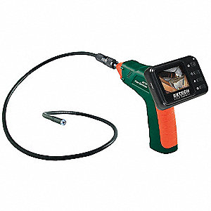
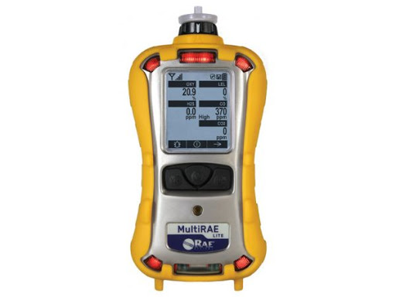
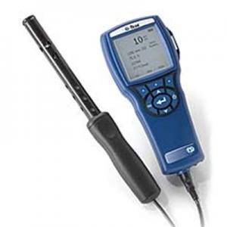
Indoor Air Quality- Jill Warren
Boroscope
Fungal growth
4-gas meter
LEL
H2S
CO
O2
Qtrak
CO
CO2
T and H

Slide 5
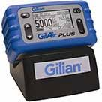
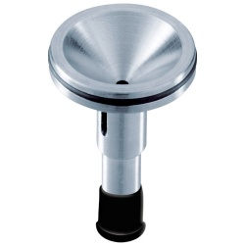
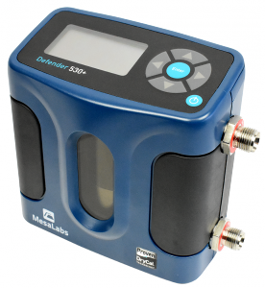
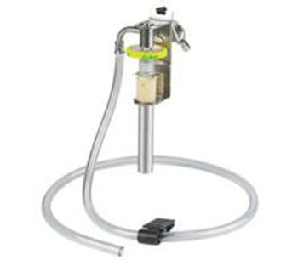

Active air sampling – John Jaskolka
Pumps
High flow
Low flow
Calibrators
Cyclones
Dorr-oliver
Aluminum
Media

Slide 6
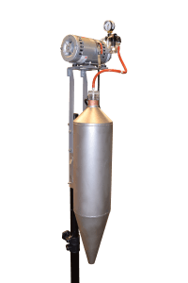
Active air sampling – John Jaskolka
What is this????

Slide 7
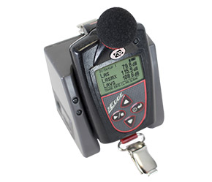
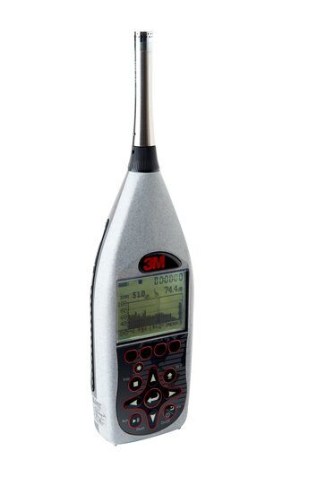
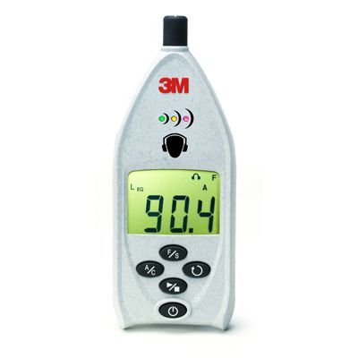
Noise – Paul Sullivan
Dosimeters
violation
Octave band analyzers
abatements
Sound level meters
screening

Slide 8
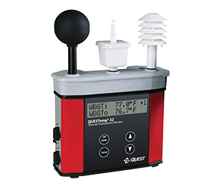
Heat stress– Grant Quiller
WBGT
handheld

Slide 9
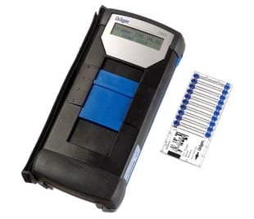
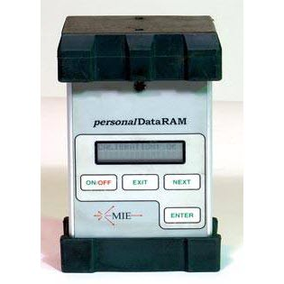
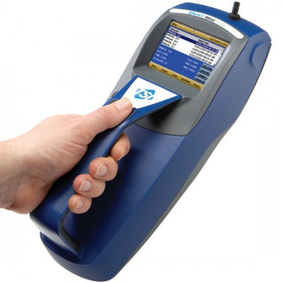
IH Equipment
Draeger CMS
Acids
Formaldehyde
Dusttrak
Total & respirable dust
Mass concentration?
MIE PDR
Total & respirable dust

Slide 10
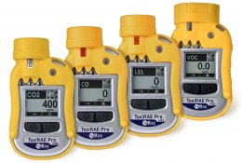
IH Equipment
ToxiRAE – Single Gas
CO
CO2
CL
NH3
ToxiRAE PID
VOC
10.6 lamp

Slide 11
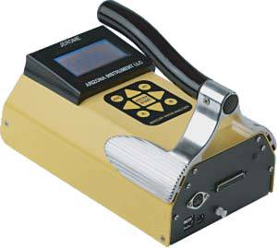
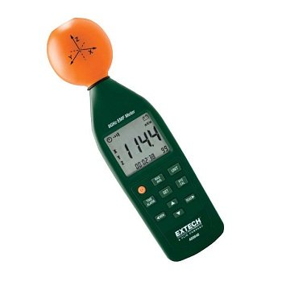
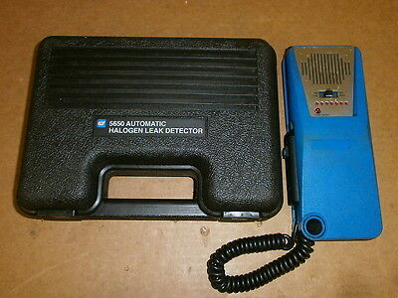
IH Equipment
Jerome J405
Mercury vapor
Extech
EMF
TIFF 5650
Halogen detector

Slide 12
Other Equipment
Tachometer
Force gauge
pH monitor
Light meter
Calipers
Screens
Slip meter
Measuring wheel
Intrinsically safe camera

Slide 13
Calibration and accuracy
Annual calibrations
Dustrak
Qtrak
WBGT
Dosimeters
Calibrators
Maintain these records

Slide 14
Calibration and accuracy
Calibration gas
Single gas
VOC
4-gas
Active air sampling
Within 5%

Slide 15
Calibration and accuracy
Why is this important??!!

Slide 16
Effectively managing your time
Required to quantify all air contaminant complaints
Permissible Exposure Limits
8-hour time-weighted averages
Short-term exposure limits
Ceilings
Make the best use of your time
What does the OSHA Technical manual say

Slide 17
Effectively managing your time
Can you conduct full shift sampling on every inspection?

Slide 18
Group work #1
Referral 203448295 Smithfield Packaging
Due to equipment failure in the ventilation system of the production equipment, there was a nitrogen leak that displaced oxygen in the processing area. Five employees were taken to the hospital and treated and released.

Slide 19
Group work #2
Complaint 209612654 Sealand
Employees are operating concrete saws without wearing respiratory protection and are exposed to the dust. The work is being performed in the evenings.

Slide 20
Group work
Complaint #209677327 Chicago Tube and Iron
Employees are experiencing symptoms, including headaches and nausea, due to being exposed to smoky fumes, from MASTERDRAW® lubricant, coming from the induction oven, and filling the air.

Slide 21
Group work
Complaint #209654250 Tarheel Marble Company, Inc.
Employees are experiencing coughing and sneeze while inside the facility. Employees are inhaling dust from the polishing of marble and gas fumes from a machine used to warm parts. Employees are not provided proper mask while inside the facility.

Slide 22
Summary
In this course, we discussed:
Why is it important?
IH equipment
Calibrations and accuracy
Effectively managing your time

Slide 23
Thank You For Attending!
Final Questions?
1-800-NC-LABOR
(1-800-625-2267)
www.labor.nc.gov

