Slide 1
Heat Stress
Presented by: Grant Quiller, OSH Compliance West
Notes:
Revised 2/20/2018
The information in this presentation is provided voluntarily by the N.C. Department of Labor, Education Training and Technical Assistance Bureau as a public service and is made available in good faith. This presentation is designed to assist trainers conducting OSHA outreach training for workers. Since workers are the target audience, this presentation emphasizes hazard identification, avoidance, and control – not standards. No attempt has been made to treat the topic exhaustively. It is essential that trainers tailor their presentations to the needs and understanding of their audience.
The information and advice provided on this Site and on Linked Sites is provided solely on the basis that users will be responsible for making their own assessment of the matters discussed herein and are advised to verify all relevant representations, statements, and information.
This presentation is not a substitute for any of the provisions of the Occupational Safety and Health Act of North Carolina or for any standards issued by the N.C. Department of Labor. Mention of trade names, commercial products, or organizations does not imply endorsement by the N.C. Department of Labor.

Slide 2
Outline
Part I
Introduction
Definitions
Heat Stress
Heat Strain
Prevention of HRI
Part II
State of enforcement
Investigation guidelines
What NC is doing

Slide 3
Outline
Part I
Introduction
Definitions
Heat Stress
Heat Strain
Prevention of HRI
Part II
State of enforcement
Investigation guidelines
What NC is doing

Slide 4
Introduction
Why is it important?
423 deaths between 1992 and 2006
20x higher for crop workers
4,190 lost time heat stress cases in 2010

Slide 5
On August 1, 2006, a 44-year-old Hispanic migrant farm worker (the victim) died after succumbing to heat stroke while working in a tobacco field on a farm in North Carolina. The victim arrived on the farm from Mexico on July 21, 2006. On July 24 he was assigned to work in the tobacco fields, where he worked for the next week. On August 1, 2006, he started work at 7 a.m., had a short break between 9 and 10 a.m. that included soda and crackers, and ate lunch between noon and 1 p.m. The weather was hot and humid with a heat index (a measure of the combined effects of high temperatures and high humidity on the body) between 100 and 110. He had been working in a tobacco field when around 3 p.m. he complained to the crew leader that he was not feeling well. The victim drank some water and was driven back to the workers’ housing and left alone to rest. At approximately 3:45 p.m. the victim was found unconscious on the steps of the house. Emergency medical service (EMS) personnel were immediately called and responded within five minutes. The victim was transported to the hospital where his core body temperature was recorded at 108º F and he was pronounced dead.
https://www.cdc.gov/niosh/face/in-house/full200604.html
Notes:
NIOSH FACE (Fatality Assessment and Control Evaluation) Program
https://www.cdc.gov/niosh/face/in-house/full200604.html

Slide 6
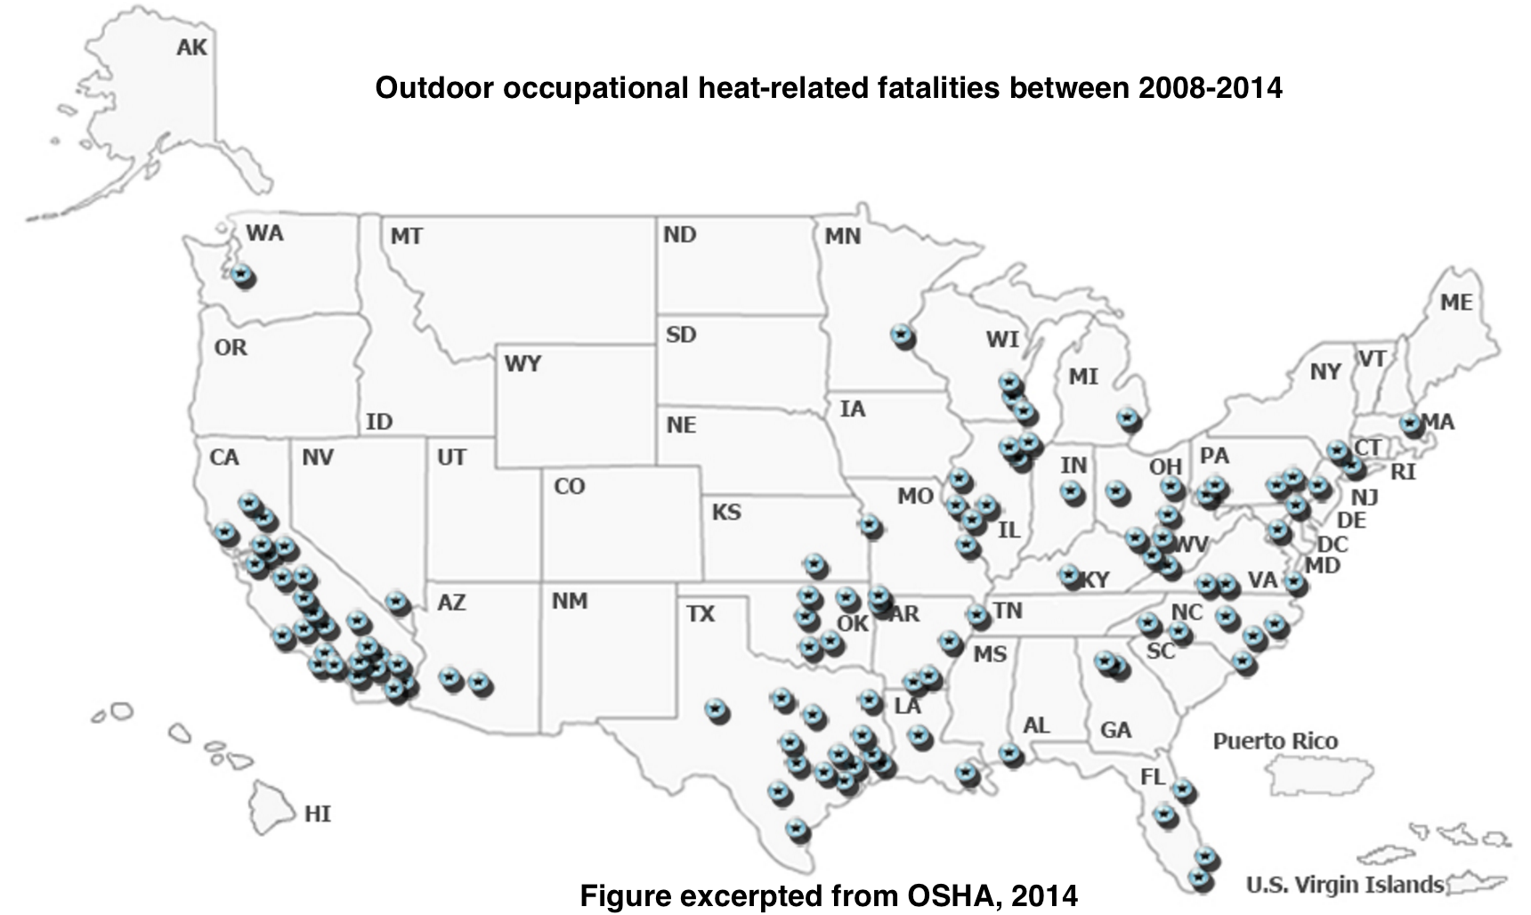

Slide 7
Introduction
Why am I teaching today?
-Hispanic
-Agriculture or ‘un-skilled’ labor
-Climate change
-Master’s thesis
Notes:
Not too many generations separated from family members working the fields
Higher rate of injury and illness
A labor group who is often forgotten about – IH and other feedback
Don’t understand their rights as a worker in the united states

Slide 8
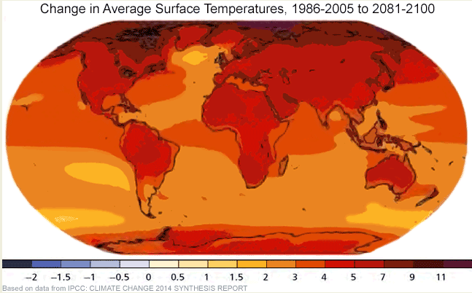
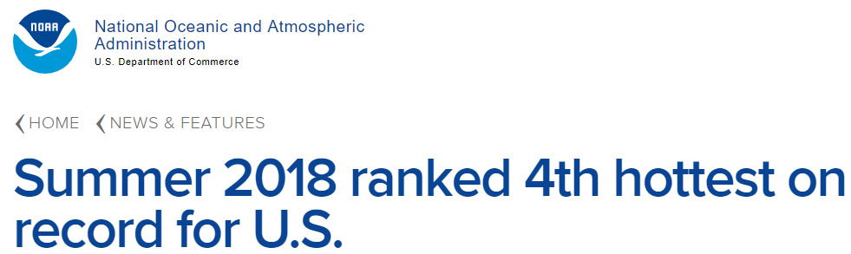
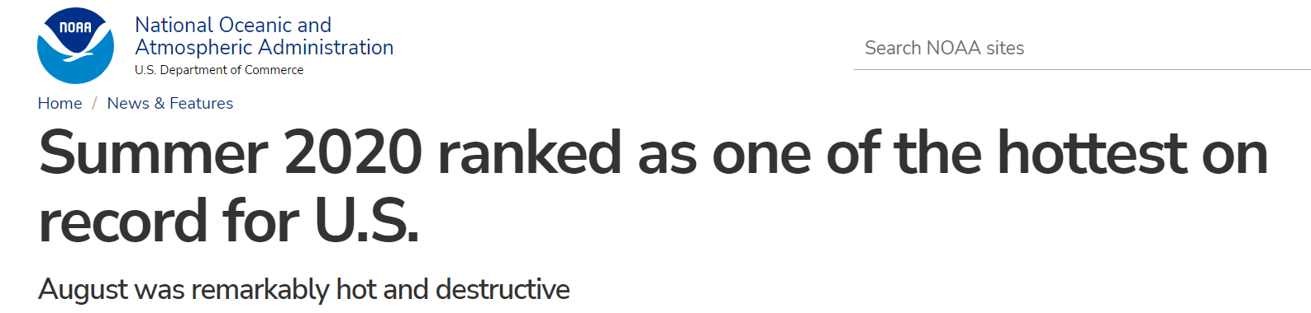
Introduction

Slide 9
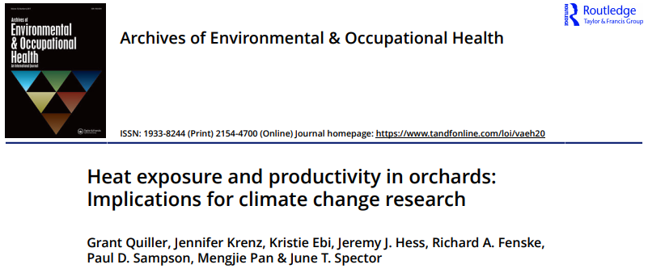
Introduction
Notes:
Not too many generations separated from family members working the fields
Higher rate of injury and illness
A labor group who is often forgotten about – IH and other feedback
Don’t understand their rights as a worker in the united states

Slide 10
Introduction - Objectives
Definitions of terms associated with Heat Stress
Heat Stress disorders and health effects
Prevention and control of Heat Stress
Heat Stress inspection procedures
How to write a Heat Stress citation

Slide 11
Outline
Part I
Introduction
Definitions
Heat Stress
Heat Strain
Prevention of HRI
Part II
State of enforcement
Investigation guidelines
What NC is doing

Slide 12
Definitions
Heat Stress
Sum of environmental and metabolic heat loads on an individual
Heat Strain
Overall physiological response resulting from heat stress
Heat Related Illness (HRI)
spectrum of disorders due to environmental exposure to heat.

Slide 13

Definitions
Heat
Measure of energy in terms of quantity.
Calorie
Heat required to raise 1 gram of water 1 degree Celsius
Metabolic Heat
By-product of the body’s activity

Slide 14
Outline
Part I
Introduction
Definitions
Heat Stress
Heat Strain
Prevention of HRI
Part II
State of enforcement
Investigation guidelines
What NC is doing

Slide 15
Heat Stress
Conduction
Transfer of heat between materials that contact each other.
Convection
Transfer of heat in a moving fluid.
Evaporative cooling
The cooling effect of sweat evaporating from
the skin.
Radiation
Transfer of heat through space.
Metabolic
Internal production of heat

Slide 16
Heat Stress
Heat Balance Equation
S = M ± W ± R ± C ± K − E − RES [W/m2]
S – rate of heat storage
M – rate of metabolic heat production
W – rate of mechanical work accomplished
R – rate of heat exchange by radiation
C – rate of heat exchange by convection
K – rate of heat exchange by conduction
E – rate of heat exchange by evaporation
RES – rate of heat exchange by respiration
Notes:
37 degrees Celsius or 98.6 degrees F

Slide 17
Outline
Part I
Introduction
Definitions
Heat Stress
Heat Strain
Prevention of HRI
Part II
State of enforcement
Investigation guidelines
What NC is doing

Slide 18
Heat strain
Body Response to Heat
Elimination of heat
2 step process
core ----> shell -----> environment
Blood is the primary vehicle used by the body to transfer heat from the core to the skin.
brain ---> blood ---> heat away from the core
Notes:
Afferent thermo receptor sensors -> hypothalamus -> efferent response
Tightly regulated around 37 equilibrium

Slide 19
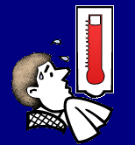
Heat Strain - HRI
Heat Rash
Heat Cramps
Heat Exhaustion
Heat Stroke

Slide 20
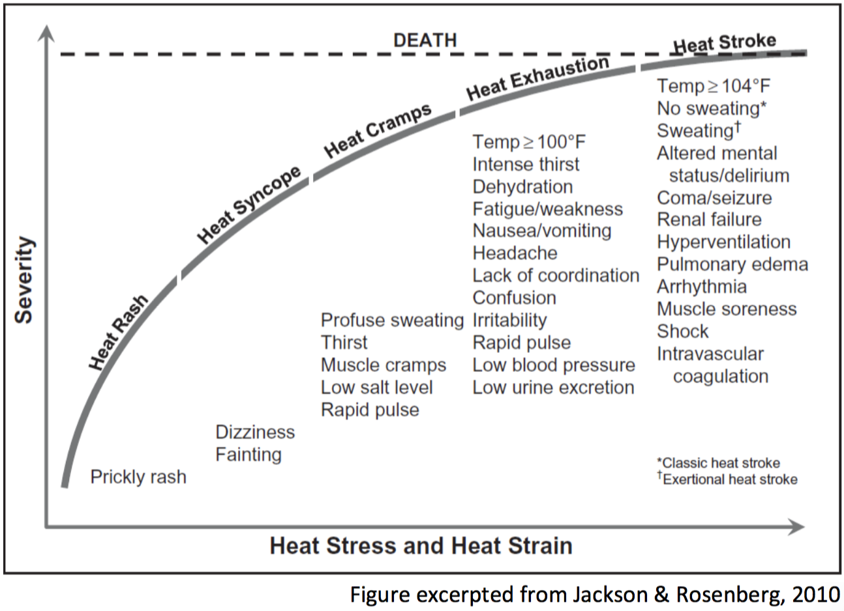
Heat strain
Notes:
Afferent thermo receptor sensors -> hypothalamus -> efferent response
Tightly regulated around 37 equilibrium

Slide 21
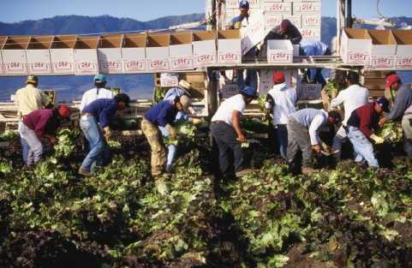
Heat Strain - Heat Rash
“Prickly Heat”
Sweat cannot freely evaporate from the skin and sweat ducts become plugged.
Prevented by:
Breathable clothing
Thorough cleansing of the skin
Mild drying lotions

Slide 22
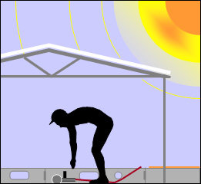
Heat Strain - Heat Cramps
Cause
Excessive water loss/sweating, dehydration
Symptoms
Shriveled skin, dry mouth and tongue, and sunken eyes

Slide 23
Heat Strain - Heat Exhaustion
Blood supply is not large enough to supply oxygen through the body and remove heat from the core.
Blood pools in the skin which leaves less for the brain.
Symptoms
Fatigue, headache, dizziness, profuse
sweating, rapid pulse, thirst, loss of
appetite, nausea, vomiting, and fainting.

Slide 24
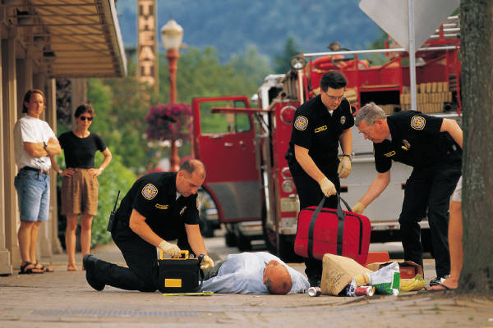
Heat Strain - Heat Stroke
Core temperature rises so high that the body stops sweating.*classic heat stroke
Exertional heat stroke can still be sweating
Symptoms
Skin is hot and dry, flushed; rapid pulse; confusion; nausea; convulsions; unconsciousness; rectal temperature > 105.8 Fahrenheit.

Slide 25
Heat Strain
Factors Contributing to Heat Disorder Susceptibility
Age
Weight
Physical Fitness
Acclimatization
Metabolism
Alcohol and Drug use
Medical conditions
Hypertension
Prior heat injury

Slide 26
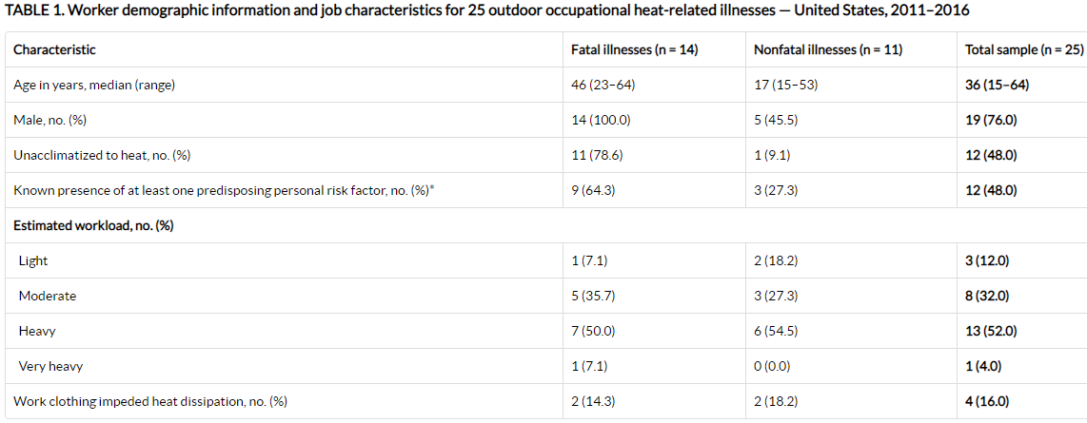
Heat Strain

Slide 27
Outline
Part I
Introduction
Definitions
Heat Stress
Heat Strain
Prevention of HRI
Part II
State of enforcement
Investigation guidelines
What NC is doing

Slide 28
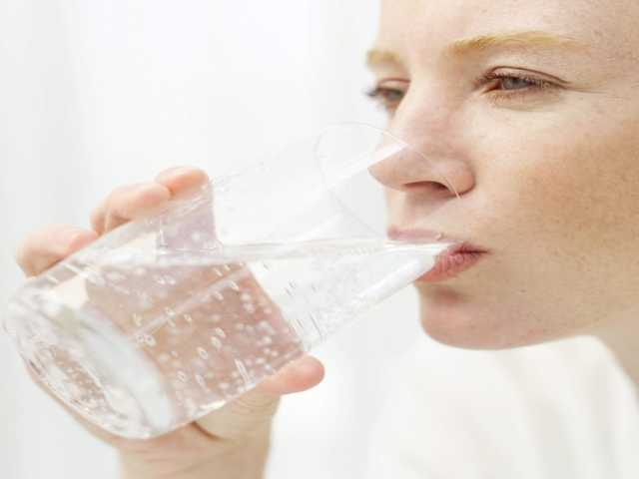
Prevention and Control
Engineering Controls
Personal Protective Equipment (PPE)
Work Practices

Slide 29

Engineering Controls
General ventilation
Air treatment/air cooling
Air conditioning
Local air cooling
Convection
Heat conduction
Radiant heat sources
Shielding
Insulation and surface modification
Notes:
Used to dilute hot air w/ cooler air. Works better in cooler climates.
Reduces temperature of air be removing heat and humidity.
Cool rooms. Portable blower with built-in chiller (minimal set up time).
Using fans (as long as air temperature is less that skin temperature. Changes in air speed help with convective heat exchange (the exchange between the skin surface and the surrounding air) and the rate of evaporation.
Insulating the hot surface that generates the heat and changing the surface itself.
Surfaces that exceed 95 degrees Fahrenheit are sources of infrared radiation that can add to the worker’s heat load. Flat black surfaces absorb heat more than smooth polished ones. Cooler surfaces around the worker help because the worker’s body radiates heat towards them.

Slide 30
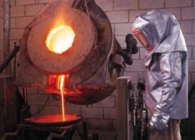
PPE
Reflective clothing
Auxiliary body cooling
Ice vests
Wetted clothing – low humidity
Water-cooled garments – hoods, vests and “long johns”
Circulating air – vortex tubes, compressed air
Notes:
Aprons, jackets and suits that completely enclose the worker from neck to feet, can stop the skin from absorbing radiant heat. However, most reflective clothing does not allow heat exchange through the garment, the reduction of radiant heat must more that offset the corresponding loss in evaporative cooling. Reflective clothing must be worn as loosely as possible. Where radiant heat is high, auxiliary cooling systems may be necessary beneath reflective clothing.
Filled with water. CO2 can be used also. Ice packs last 2-4 hours under moderate to heavy loads and need frequent replacement. Do not encumber the worker and permit maximum mobility. Relatively inexpensive.
Simple and inexpensive. Effective when reflective or other impermeable protective clothing is worn, Very effective under conditions of high temperature and low humidity.
Use of water cooled garments requires battery-driven circulating pump, liquid-ice coolant, and a container.
Circulating air – most effective, but most complex. Improves evaporative and convective cooling. Vortex tube used to reduce temperature. The hot and cold air is separated. Cool air or hot air can be supplied depending upon the temperature. Noisy and requires constant source of compressed air supplied through a hose. Limits worker mobility. Workers feel cool and forget to drink, therefore dehydration can be problem.
Respirators increase stress on worker which contributes to overall heat stress. TECP suits will increase risk.

Slide 31

Work Practices
Work rate
The fastest way to decrease the rate of heat production is to decrease the work rate.
Age (over 40)
The maximum possible output of heat decreases with age. Older people start sweating later and at a lower rate.
Body size
Skin area to weight ratios.

Slide 32
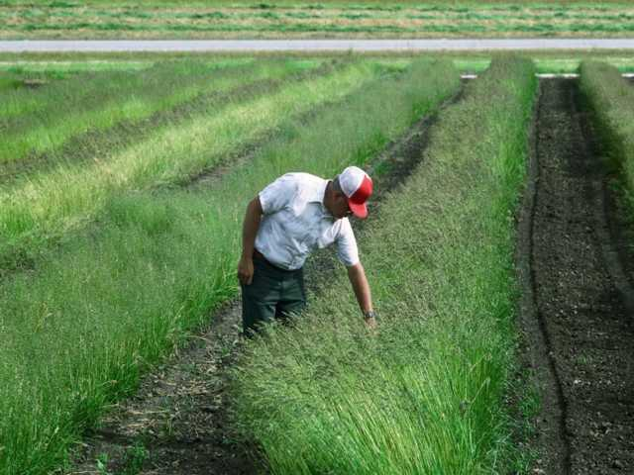
Acclimatization
Acclimatization
Successive heat exposures of at least one hour per day
Initially, 20% exposure for the first day, followed by 20% per day increase in exposure over the next four days

Slide 33

Re-Acclimating
After long absences
50% exposure on day back
20% per day increase for the next 2 days
Final 10% on the 3rd day

Slide 34
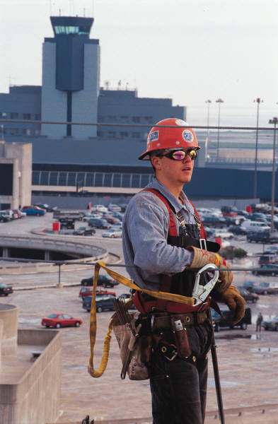
Administrative/Work Practice Controls
Administrative controls
Perform work activities during cooler periods of the day
Minimize activity in hot area
Slow down the work pace
Reduce the number and duration
of exposures
Wear proper clothing
Provide recovery areas

Slide 35
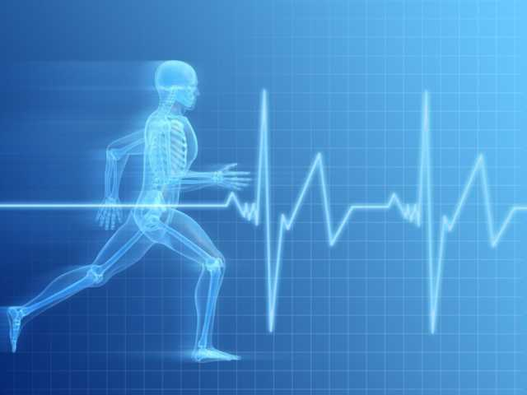
Work Monitoring Programs
Personal monitoring
Heart rate
Recovery heart rate
Oral temperature
Extent of body water loss
Notes:
Heart rate – radial pulse for 30 seconds at beginning of rest period. >110/min shorten next work period by 1/3 and maintain rest period
Recovery heart rate – compare the pulse taken at 30 seconds with pulse at 2.5 minutes after rest break starts. Interpret using table in Tech. Manual.
Oral temp – taken after work but before fluids. If temp. >37.6 degrees Celsius, decrease nest work cycle by 1/3.
Body water loss – weigh worker at beginning and end of each shift. Loss should not exceed 1.5% of total body weight. Increase fluid intake if >1.5 % observed.

Slide 36

Training
Knowledge of hazards
Predisposing factors – age, etc.
Signs and symptoms
PPE
First aid
Health effects of heat stroke

Slide 37
Outline
Part I
Introduction
Definitions
Heat Stress
Heat Strain
Prevention of HRI
Part II
State of enforcement
Investigation guidelines
What NC is doing

Slide 38

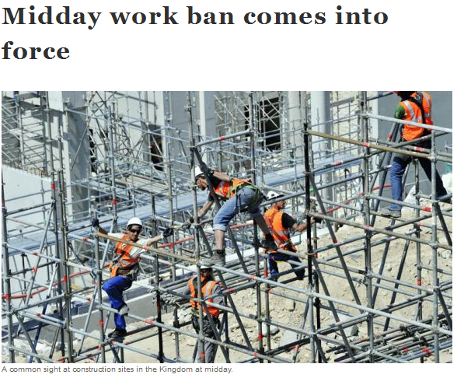
State of Enforcement
States with heat standards
Cities in Texas mandating water breaks
International attention

Slide 39
Investigation Guidelines
Employer and Employee Interviews
Review 200/300 logs
Discuss steps taken to reduce heat stress problems
Identify potential heat sources
Assess training
Walk-around Inspection
Identify actual heat sources
Interview employees
Conduct monitoring
Work-Load Assessment
Identify activity level and type of clothing

Slide 40
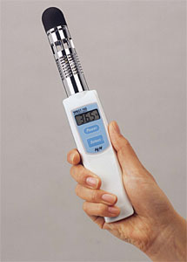
Investigation Guidelines
Sampling methods
Body temperature
Instrumentation available not reliable for compliance
Environmental
Made at or close to exposed worker
Average for multiple areas

Slide 41
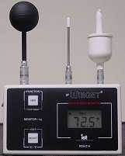
Wet Bulb Globe Temperature
WBGT index
Combines air temperature, humidity, air flow, and radiant heat to measure the risk of heat stress disorders
QuesTemp 15 and WIBGET
WBGT monitors

Slide 42
Definitions
Globe temperature
Temperature inside a blackened, hollow, thin copper globe
Natural wet bulb
Measured by exposing a wet sensor to the effects of evaporation and convection.
Dry bulb
Measured by a thermal sensor shielded from direct radiant energy sources.

Slide 43
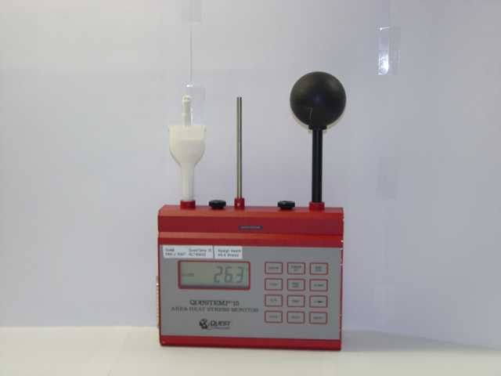
Dry Bulb
Wet Bulb
Globe

Slide 44
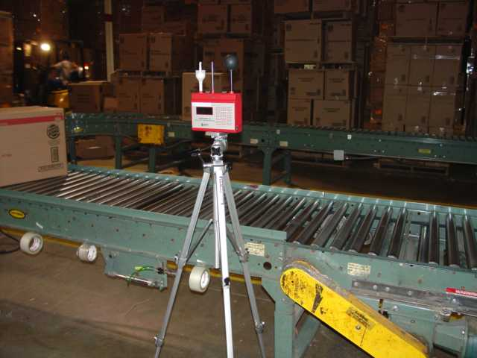
Notes:
Positioning of the Monitor
VIDEO OF THE EMPLOYEES FOR USE IN ESTIMATING METABOLIC RATE

Slide 45
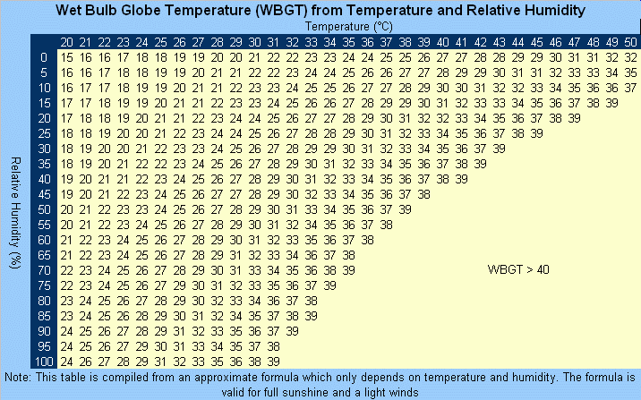
WBGT Index
For indoor
WBGTin = 0.7WB + 0.3GT
For outdoor
WBGTout = 0.7WB + 0.2GT + 0.1DB

Slide 46
Table 1 Clothing Adjustment Values
Clothing Type | WBGT Addition Value
Summer Work Uniform | 0.0 º C
Cloth Overalls (woven material) | +3.5 º C
Double Cloth Overalls | +5.0 º C

Slide 47
Table 2 Heat Stress TLVs
Acclimatized | Work Load
Work-Rest Regimen | Light | Moderate | Heavy | Very Heavy
Continuous work | 29.5 ºC | 27.5 ºC | 26.0 ºC
75% work – 25% rest each hour | 30.5 ºC | 28.5 ºC | 27.5 ºC
50% work – 50% rest each hour | 31.5 ºC | 29.5 ºC | 28.5 ºC | 27.5 ºC
25% work – 75% rest each hour | 32.5 ºC | 31.0 ºC | 30.0 ºC | 29.5 ºC

Slide 48
Table 2 Heat Stress TLVs
Un-Acclimatized | Work Load
Work-Rest Regimen | Light | Moderate | Heavy | Very Heavy
Continuous work | 27.5 ºC | 25.0 ºC | 22.5 ºC
75% work – 25% rest each hour | 29.0 ºC | 26.5 ºC | 24.5 ºC
50% work – 50% rest each hour | 30.0 ºC | 28.0 ºC | 26.5 ºC | 25.0 ºC
25% work – 75% rest each hour | 31.0 ºC | 29.0 ºC | 28.0 ºC | 26.5 ºC

Slide 49
Table 3 Activities within Metabolic Rate Categories
CATEGORY | EXAMPLE ACTIVITIES
Resting | Sitting Quietly
 | Sitting with moderate arm movements
Light | Sitting with moderate arm and leg movements
 | Standing with light work at machine or bench while using mostly arms
 | Using a table saw
 | Standing with light or moderate work at machine or bench and some walking about
Moderate | Scrubbing in a standing position
 | Walking about with moderate lifting or pushing
 | Walking on level at 6 Km/hr while carrying 3 Kg weight load
Heavy | Carpenter sawing by hand
 | Shoveling dry sand
 | Heavy assembly work on a non-continuous basis
 | Intermittent heavy lifting with pushing or pulling (e.g. pick and shovel work)
Very Heavy | Shoveling wet sand

Slide 50
Table 3 Activities within Metabolic Rate Categories
CATEGORY | EXAMPLE ACTIVITIES
Resting | Sitting Quietly
 | Sitting with moderate arm movements
Light (<290 Watts) | Sitting with moderate arm and leg movements
 | Standing with light work at machine or bench while using mostly arms
 | Using a table saw
 | Standing with light or moderate work at machine or bench and some walking about
Moderate (290-400 Watts) | Scrubbing in a standing position
 | Walking about with moderate lifting or pushing
 | Walking on level at 6 Km/hr while carrying 3 Kg weight load
Heavy (400-520 Watts) | Carpenter sawing by hand
 | Shoveling dry sand
 | Heavy assembly work on a non-continuous basis
 | Intermittent heavy lifting with pushing or pulling (e.g. pick and shovel work)
Very Heavy (>520 Watts) | Shoveling wet sand

Slide 51
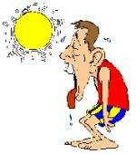
Calculation of Heat Stress TLV
TWA WBGT = WBGT₁*t₁ + WBGT₂*t₂ ₊….₊ WBGT_{n}*t_{n}
---------------------------------------------
t₁ + t_{n} +…+ t_{n}

Slide 52

Calculation of Heat Stress TLV
TWA M = M₁*t₁ + M₂*t₂ ₊….₊ M_{n}*t_{n}
----------------------------
t₁ + t_{n} +…+ t_{n}

Slide 53
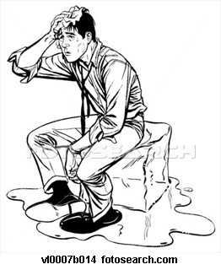
Calculation of Heat Stress TLV
Using the TWA WBGT and the TWA M
Decide whether exposed employees are acclimatized or un-acclimatized
Determine TLV based on appropriate Figure from the TLV Documentation

Slide 54
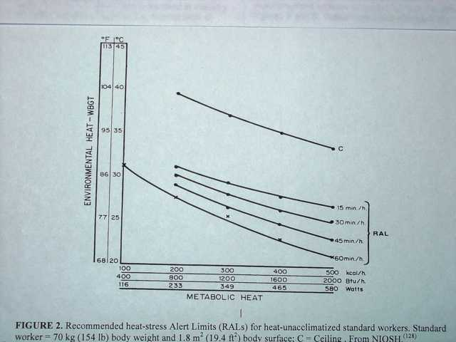
Un-Acclimatized

Slide 55
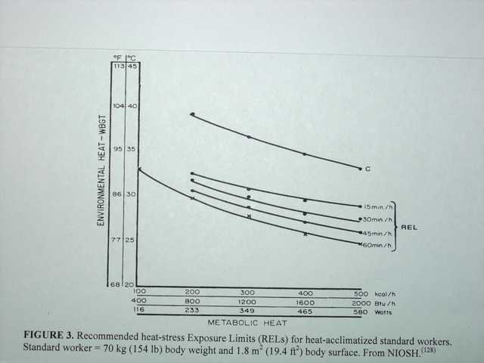
Acclimatized

Slide 56
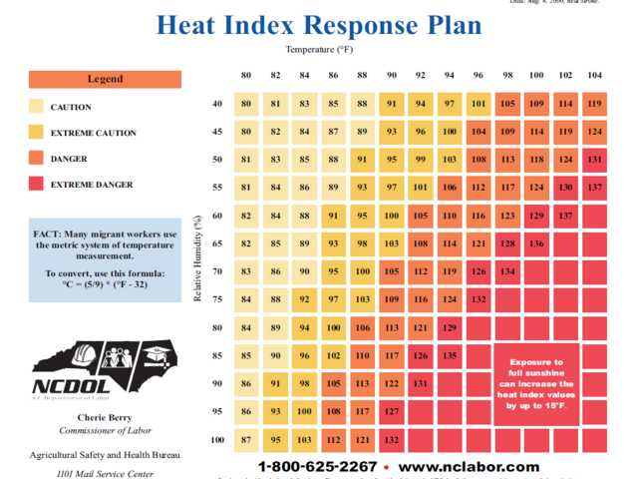

Slide 57
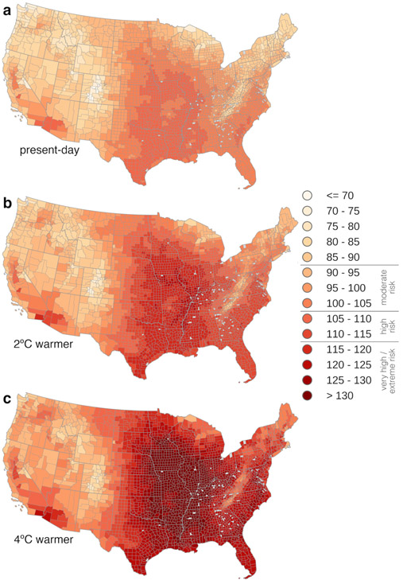

Slide 58

Example
Indoor facility
Full shift WBGT measurements taken
Employee works in 3 areas during the day
4 hours in location one, soldering parts while sitting
3 hours in location two, assembling parts while standing
1 hour in location three, loading a truck with boxes of finished product
WBGT₁ of 29.0 ^{O}C, WBGT₂ of 26.5 ^{O}C, & WBGT₃ of 31.5 ^{O}C

Slide 59
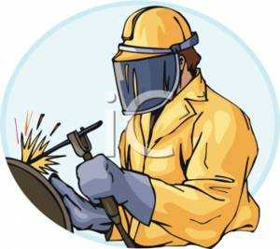
Example
TWA WBGT = 29.0*240 + 26.5*180 + 31.5*60
---------------------------------------------
240 +180 + 60
TWA WBGT = 28.0 ^{O}C

Slide 60
Table 3 Activities within Metabolic Rate Categories
CATEGORY | EXAMPLE ACTIVITIES
Resting to Light (<290 Watts) | Sitting Quietly
 | Sitting with moderate arm movements
 | Sitting with moderate arm and leg movements
 | Standing with light work at machine or bench while using mostly arms
 | Using a table saw
 | Standing with light or moderate work at machine or bench and some walking about
Moderate (290-400 Watts) | Scrubbing in a standing position
 | Walking about with moderate lifting or pushing
 | Walking on level at 6 Km/hr while carrying 3 Kg weight load
Heavy (400-520 Watts) | Carpenter sawing by hand
 | Shoveling dry sand
 | Heavy assembly work on a non-continuous basis
 | Intermittent heavy lifting with pushing or pulling (e.g. pick and shovel work)
Very Heavy (>520 Watts) | Shoveling wet sand

Slide 61

Example
TWA M = 145*240 + 218*180 + 500*60
----------------------------
240 + 180 + 60
TWA M = 208 Watts

Slide 62
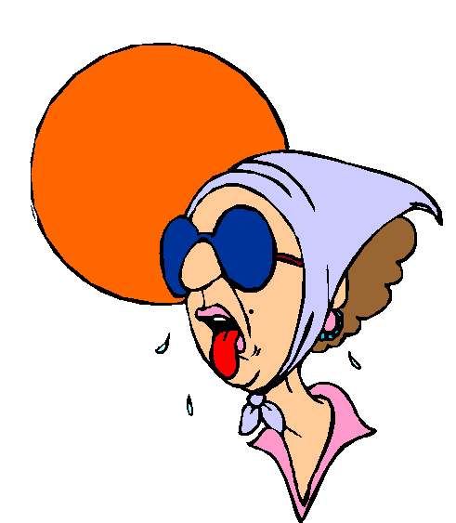
Example
TWA WBGT = 28.0 ^{O}C
TWA M = 208 Watts

Slide 63
Un-Acclimatized

Slide 64
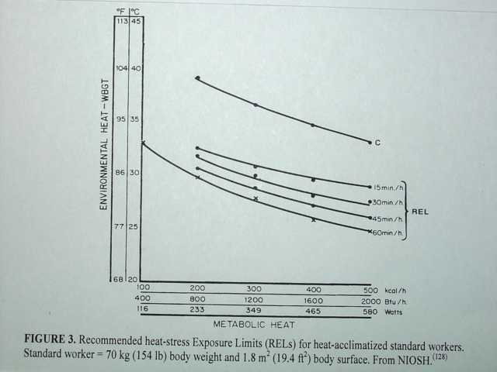
Acclimatized

Slide 65
Outline
Part I
Introduction
Definitions
Heat Stress
Heat Strain
Prevention of HRI
State of enforcement
What NC is doing

Slide 66

Investigation Guidelines
If the TLV for heat stress is exceeded…
And the employer has not implemented some heat stress prevention tactics…
A General Duty Clause citation may be appropriate

Slide 67
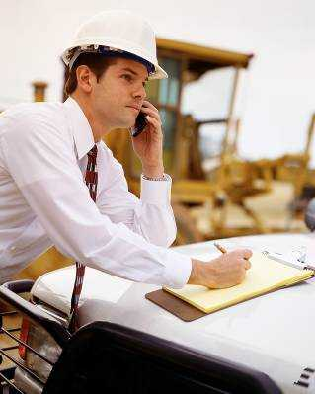
Citations
95-129 (l) - General Duty Clause support criteria:
4 Things:
Serious
Recognized hazard
Abatement available
Likely to cause death or serious physical harm
Notes:
Potential for serious or causing serious harm or death
Even with workload assessment and monitoring data showing problems you may have difficulty citing if no one is having a problem.

Slide 68
What NC is doing
Inspection 318077690
CSHO Curt Hobson
Charlotte Mecklenburg Police Department
Notes:
Potential for serious or causing serious harm or death
Even with workload assessment and monitoring data showing problems you may have difficulty citing if no one is having a problem.

Slide 69
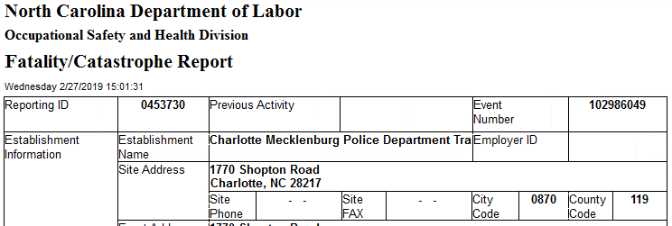
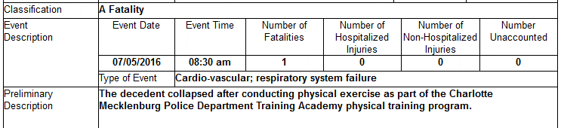
What NC is doing

Slide 70
What NC is doing
Inspection 318077690
CSHO Curt Hobson
Charlotte Mecklenburg Police Department
Notes:
Potential for serious or causing serious harm or death
Even with workload assessment and monitoring data showing problems you may have difficulty citing if no one is having a problem.

Slide 71
What NC is doing
Opening conference
two heat injuries recorded in 2015
stated that no water was provided at the physical training area.
heat stress prevention program that had been established in the Basic Law Enforcement Training Student Handbook

Slide 72
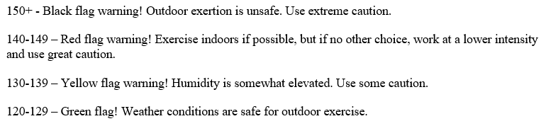
What NC is doing
Walk-through
students need to be aware of the Flag conditions

Slide 73
What NC is doing
none of the recruits interviewed knew what the Flag Warning conditions were for the morning of the fatality.
From CLT Douglas airport –
@ 6:52 AM T= 80.1°F and Humidity = 76% => 156.1 Black Flag Warning,
@ 7:52 AM T= 82.9°F and Humidity =70% => 152.9 Black Flag Warning
@ 8:52 AM T=86°F and Humidity = 65% => 151 Black Flag Warning

Slide 74
What NC is doing
majority of work-related emergency department visits for heat-related illness in NC are among 19-45 year old males, on occasion the temperature was below 85 degrees Fahrenheit

Slide 75
What NC is doing
some of the students came from different parts of the country but did not have any specific procedures for acclimatization
encouraged to not take breaks during PT
On the date of the fatality the students were required to wear bullet proof vest
EE core body temp was 105.9F

Slide 76
What NC is doing
Standard Number: 95.129(01)
a) At the Charlotte-Mecklenburg Police Department Training Academy, on or about July 5th, 2016, a heat stress awareness and prevention program was not implemented for employees/recruits while performing strenuous physical training. Employees/recruits were required to complete the physical training session in a high temperature, high humidity environment with no water provided, breaks not encouraged while wearing bullet proof vest.

Slide 77
What NC and Fed OSHA doing
Scott is asking questions
“On October 27, 2021, OSHA published an Advance Notice of Proposed Rulemaking (ANPRM) for Heat Injury and Illness Prevention in Outdoor and Indoor Work Settings in the Federal Register.”
Comment period closed January 26,2022.

Slide 78

Resources
Technical Manual – Chapter 4
www.osha.gov
NIOSH
http://www.cdc.gov/niosh/homepage.html
ACGIH – TLV book
Weather Underground
http://www.wunderground.com/

Slide 79
Summary
Defined terms associated with Heat Stress
Heat Stress disorders and health effects
Prevention and control of Heat Stress
Heat Stress inspection procedures
How to write a Heat Stress citation

Slide 80
Thank You For Attending!
Final Questions?
1-800-NC-LABOR
(1-800-625-2267)
www.nclabor.com

Slide 81
