Slide 1
N.C. Department of Labor OSH Division
Exposures to Health Hazards Special Emphasis Program
Notes:
Rev 2: 8/22/2020

Slide 2

Objectives
Recite the exposures relevant to the Health Hazards Special Emphasis Program
Recognize where exposures to these targeted chemicals occur and important conditions impacting their hazards
Know how to evaluate SEP Health Hazards during your inspections
Make referrals as needed

Slide 3
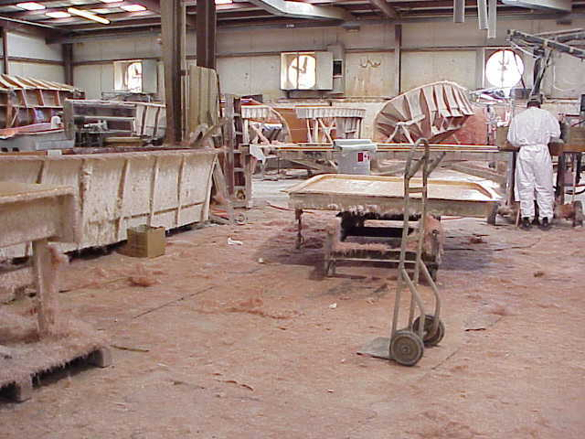
Health Hazards SEP – OPN 135
Purpose
Target more high hazard industries
Reduce the number of occupational exposures to lead, silica, asbestos, isocyanates, and
hexavalent chromium

Slide 4
Health Hazards SEP – OPN 135
Fiscal Year 2005
Health Hazards SEP implemented
Styrene, asbestos, lead, isocyanates, and silica
Goal of 200 compliance inspections
Referral and complaint inspections conducted
Fiscal Year 2009
OPN 135 revised
Styrene dropped and hexavalent chromium added
Goal of 200 compliance inspections
Health hazards training included in General Industry and Construction 10-hour courses
Fiscal Year 2014
Added un-regulated substances without a PEL (ex. 1-bromopropane)
Added follow-up inspections for exposures above the PEL

Slide 5
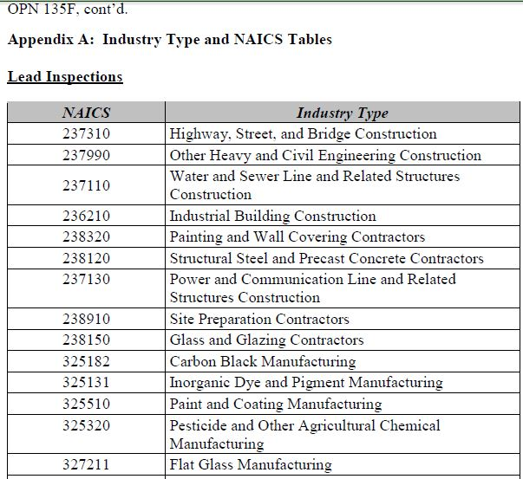
OPN 135- Appendix A – NAICS examples

Slide 6
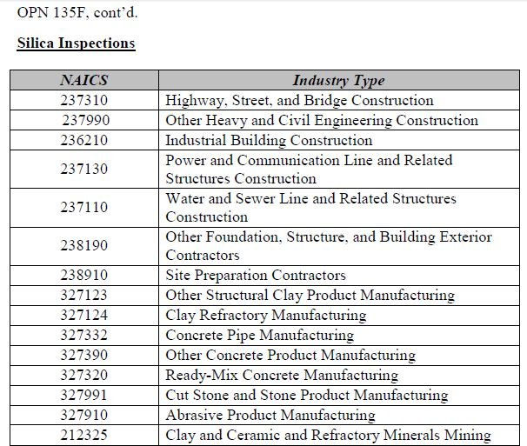
OPN 135- Appendix A – NAICS examples

Slide 7
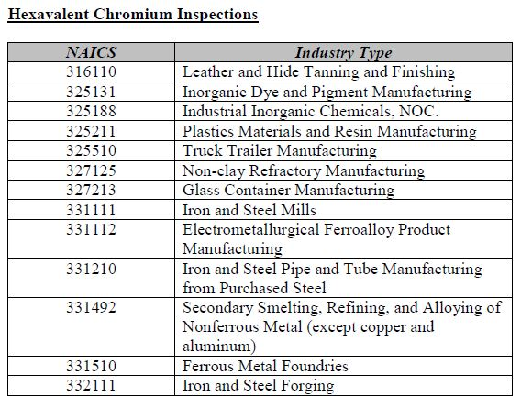
OPN 135- Appendix A – NAICS examples

Slide 8
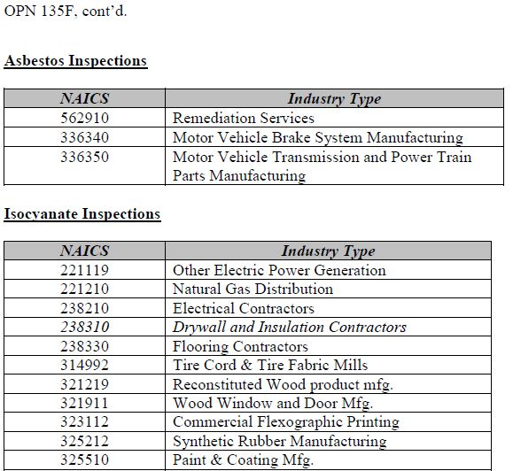
OPN 135- Appendix A – NAICS examples

Slide 9
Compliance Inspections
Can you recognize lead, silica, hexavalent chromium, isocyanates, and asbestos exposures during your inspections?
Are you prepared if those employees are involved in lead, silica or asbestos related activities?
Are you prepared if those employees are involved in isocyanates or hexavalent chromium related activities?

Slide 10
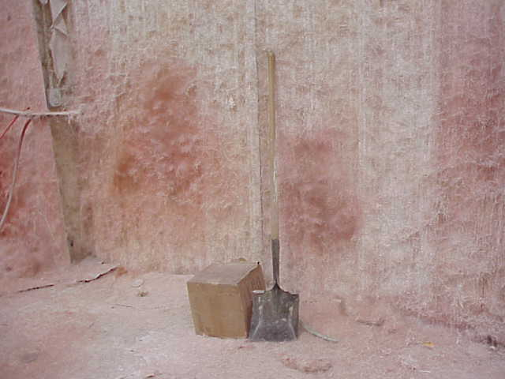
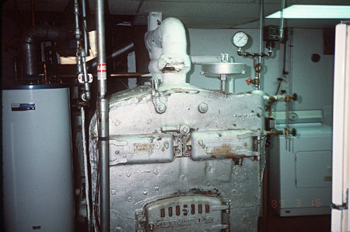
Compliance Inspections

Slide 11
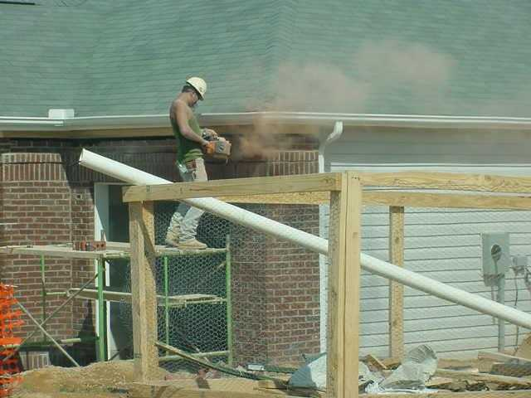
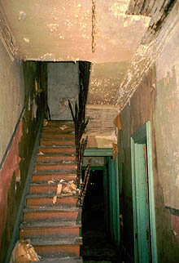
Compliance Inspections

Slide 12
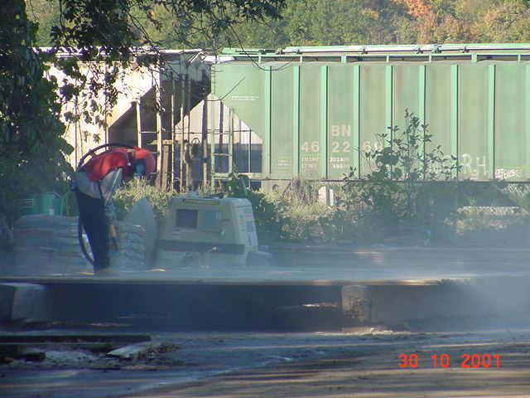
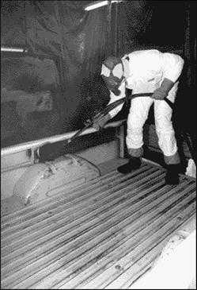
Compliance Inspections

Slide 13
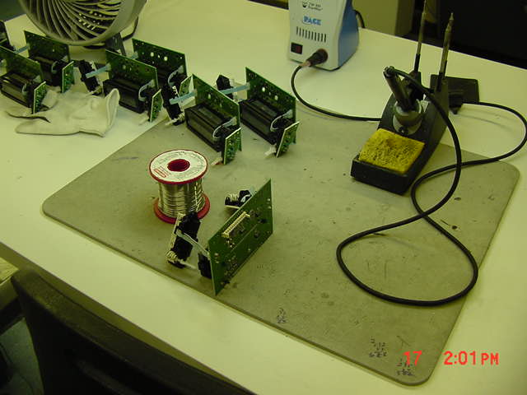
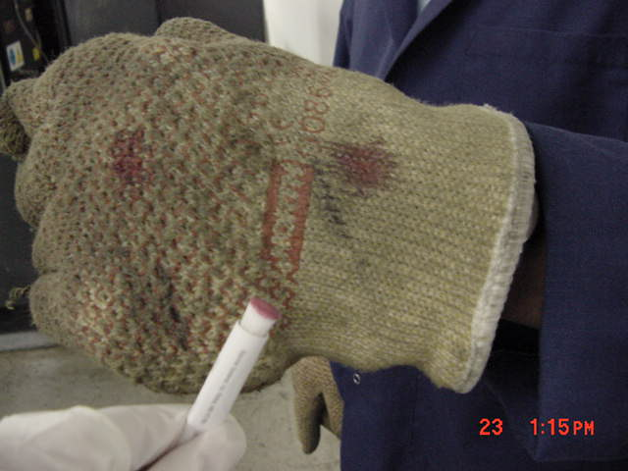
Lead Exposures
Cutting, welding, grinding, abrasive blasting
Lead paint removal
Foundries
Manufacturing of ammunition
Firearm ranges
Electronics

Slide 14
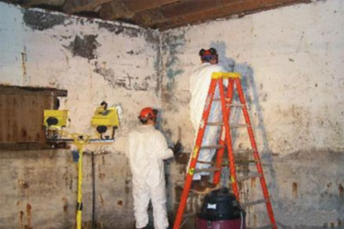
Lead Evaluation and Control
Routes of Exposure
Associated Illnesses
PELs
General Industry Standard
Construction Industry Standard
Sampling Media
Analysis
Respiratory Protection
Notes:
Intentionally unfilled for notes.

Slide 15
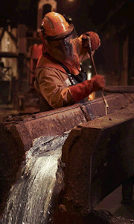
Lead Standard
1910.1025
1926.62
Means metallic lead, all inorganic lead compounds, and organic lead soaps
Excluded from this definition are all other organic lead compounds
Notes:
Lead Icon Graphic Created by NCDOL Tom Wilder 07-22-15
LEAD: Lead exposure is a leading cause of workplace illness – not just in construction but in other industries as well
The slide lists the areas that have lead exposures for general industry.
Below is information on construction:
Over the past several years, OSHA inspections have documented elevated blood lead levels in construction and other workers
Exposure found in construction work involves tasks such as welding, cutting, brazing, blasting on lead paint surfaces
Workers can be exposed to lead through inhalation of fumes and dusts, as well as through ingestion as a result of lead-contaminated hands, food, drinks, cosmetics, tobacco products, and clothing. Furthermore, workers can take lead home on their clothes, skin, hair, tools, and in their vehicles, potentially exposing their families to harmful health effects. Workers may be exposed to lead from a variety of work activities.

Slide 16
Lead Health Effects
1910.1025, Appendix A
1926.62, Appendix A
Acute effects: Show up sooner usually after high exposure
Symptoms can include metallic taste, stomach pain, vomiting, diarrhea and black stools which could potentially cause intoxication, coma, respiratory arrest, or death
Short term occupational exposures of this magnitude are highly unusual, but not impossible
Notes:
Lead Icon Graphic Created by NCDOL Tom Wilder 07-22-15
Acute effects: Severe exposure can cause nervous system damage, with symptoms such as intoxication, coma, respiratory arrest, and even death.
Important Note: Children are more susceptible to lead then adults. The acute health effects listed above are typically found in children from ingestion of lead.

Slide 17
Lead Health Effects
1910.1025, Appendix A
1926.62, Appendix A
Chronic effects: Take longer to develop and often are attributed to lower cumulative exposures over time
Symptoms can include tiredness, weakness, weight loss, insomnia, headache, nervous irritability, fine tremors, numbness, dizziness, anxiety and hyperactivity which could potentially lead to:
Damage of the nervous system and brain
Anemia
Kidney disease
Notes:
Lead Icon Graphic Created by NCDOL Tom Wilder 07-22-15
Chronic effects: The symptoms often seen with significant long-term exposure include loss of appetite, constipation, nausea, and stomach pain. Symptoms also can include excessive tiredness, weakness, weight loss, insomnia, headache, nervous irritability, fine tremors, numbness, dizziness, anxiety, and hyperactivity. Because these symptoms are common to a variety of health problems, they can be overlooked by exposed workers. These symptoms can damage the nervous, blood, urinary and/or the reproductive systems.

Slide 18
Lead Exposure Limits
1910.1025
1926.62
Permissible exposure limit (PEL) = 50 µg/m³ as an 8 hour time-weighted average (TWA)
Employers shall implement engineering controls and safe work practices to prevent exposure
Employers shall provide protective clothing and where necessary, and respiratory protection in accordance with 29 CFR 1910.134
Action level (AL) = 30 µg/m³ as an 8 hour TWA
Notes:
Lead Icon Graphic Created by NCDOL Tom Wilder 07-22-15
The major elements of the lead standards are:
• Requires that employers use engineering controls and work practices, where feasible, to reduce worker exposure below the PEL if employees are exposed above the PEL for > or = to 30 days per year. If exposed < 30 days per year, employer must reduce exposure to < 200 µg/m³ as an 8 hr. time-weighted average (TWA) with engineering controls and may use a combo of engineering, administrative, work practice and PPE to reduce to 50 µg/m³ as an 8 hr. time-weighted average (TWA) .
• Requires that employees be provided with protective clothing and, where necessary, with respiratory protection accordance with 29 CFR 1910.134.
Respirators are required to be worn:
while engineering controls are being installed
when engineering controls have reduced exposure levels as low as feasible but still above PEL
• Employers are required to assess the exposures of employees to determine whether additional protections are required. 1926 requires the employees to be protected with respiratory protection and other PPE (based on job task) until this assessment is made.
PEL can be adjusted for extended workshifts. This is the only substance-specific standard that allows this (see paragraph (c)(2)).

Slide 19
Medical Surveillance
1910.1025
1926.62
In General Industry, employer shall institute a medical surveillance program for employees who are or may be exposed above the action level for more than 30 days per year
Appendix C - Medical Surveillance Guidelines
In Construction, employer shall provide initial medical surveillance for any employee exposed at or above the action level for any one day
Notes:
Lead Icon Graphic Created by NCDOL Tom Wilder 07-22-15
The medical surveillance includes Biological monitoring in the form of blood samples. Below is the standard on acceptable amounts of lead in the blood and when an employee shall be removed from the work environment.
1910.1025(j)(2)(i)(B) At least every two months for each employee whose last blood sampling and analysis indicated a blood lead level at or above 40 ug/100 g of whole blood. This frequency shall continue until two consecutive blood samples and analyses indicate a blood lead level below 40 ug/100 g of whole blood; and
1910.1025(k)(1)(i)(A) The employer shall remove an employee from work having an exposure to lead at or above the action level on each occasion that a periodic and a follow-up blood sampling test conducted pursuant to this section indicate that the employee's blood lead level is at or above 60 ug/100 g of whole blood;

Slide 20
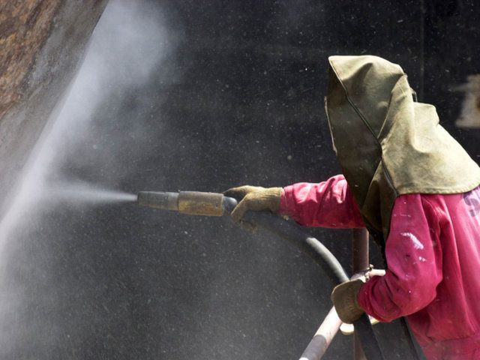
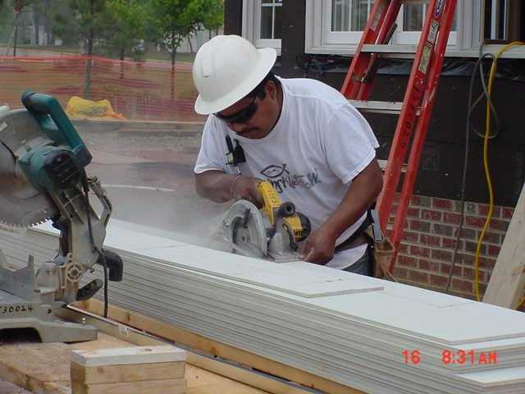
Silica Exposures
Abrasive blasting
Manufacture of glass and pottery
Crushing, loading, hauling, chipping, hammering, drilling, and dumping of rock or concrete
Masonry work
Cutting concrete siding
Manufacturing concrete products

Slide 21
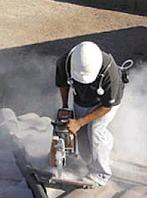
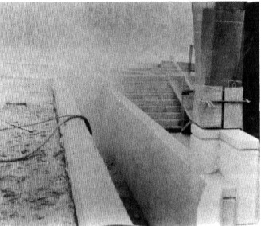
Silica Evaluation and Control
Routes of Exposure
Associated Illnesses
PELs
General Industry Standard
Construction Industry Standard
Sampling Media
Analysis
Respiratory Protection
Notes:
Intentionally unfilled for notes.

Slide 22
Health Effects
1910.1053
1926.1153
Occupational exposure to respirable crystalline silica is associated with the development of silicosis, lung cancer, pulmonary tuberculosis, and airway diseases
Exposures may also be related to the development of autoimmune disorders, chronic renal disease, and other adverse health effects
USDOL Photo Archive
Notes:
Silica Icon Graphic Created by NCDOL Tom Wilder 07-22-15
At least 1.7 million U.S. workers are exposed to respirable crystalline silica in a variety of industries and occupations, including construction, sandblasting, and mining.
Unless a doctor knows that you work around silica, the disease can go undiagnosed. Symptoms can come on gradually and resemble other problems, such as smoker’s cough or ordinary fatigue. Workers who are exposed to silica dust may want to consult a specialist in this area. Exposed workers should have an x-ray every two or three years and a lung function test once a year. Medical exams are helpful but cannot be relied upon as a primary protective measure. Preventive measures are essential because the disease is often well advanced before detection.

Slide 23
Silica Exposure Limits
1910.1053
1926.1153
AL = 25 µg/m³ as an 8-hour TWA
Written Exposure Control Plan (ECP)
PEL = 50 µg/m³ as an 8-hour TWA
Employers must use engineering controls to prevent or reduce exposure
Respiratory protection is required when exposure remains above PEL after engineering controls are utilized or when required by Table 1
Notes:
Silica Icon Graphic Created by NCDOL Tom Wilder 07-22-15

Slide 24
Medical Surveillance
1910.1053
1926.1153
At no cost to the employee
At a reasonable time and place
General Industry
When exposed at or above 25 µg/m³ for 30 or more days for any 12 consecutive months
Construction
When employee is required to wear a respirator 30 or more days for any 12 consecutive months

Slide 25
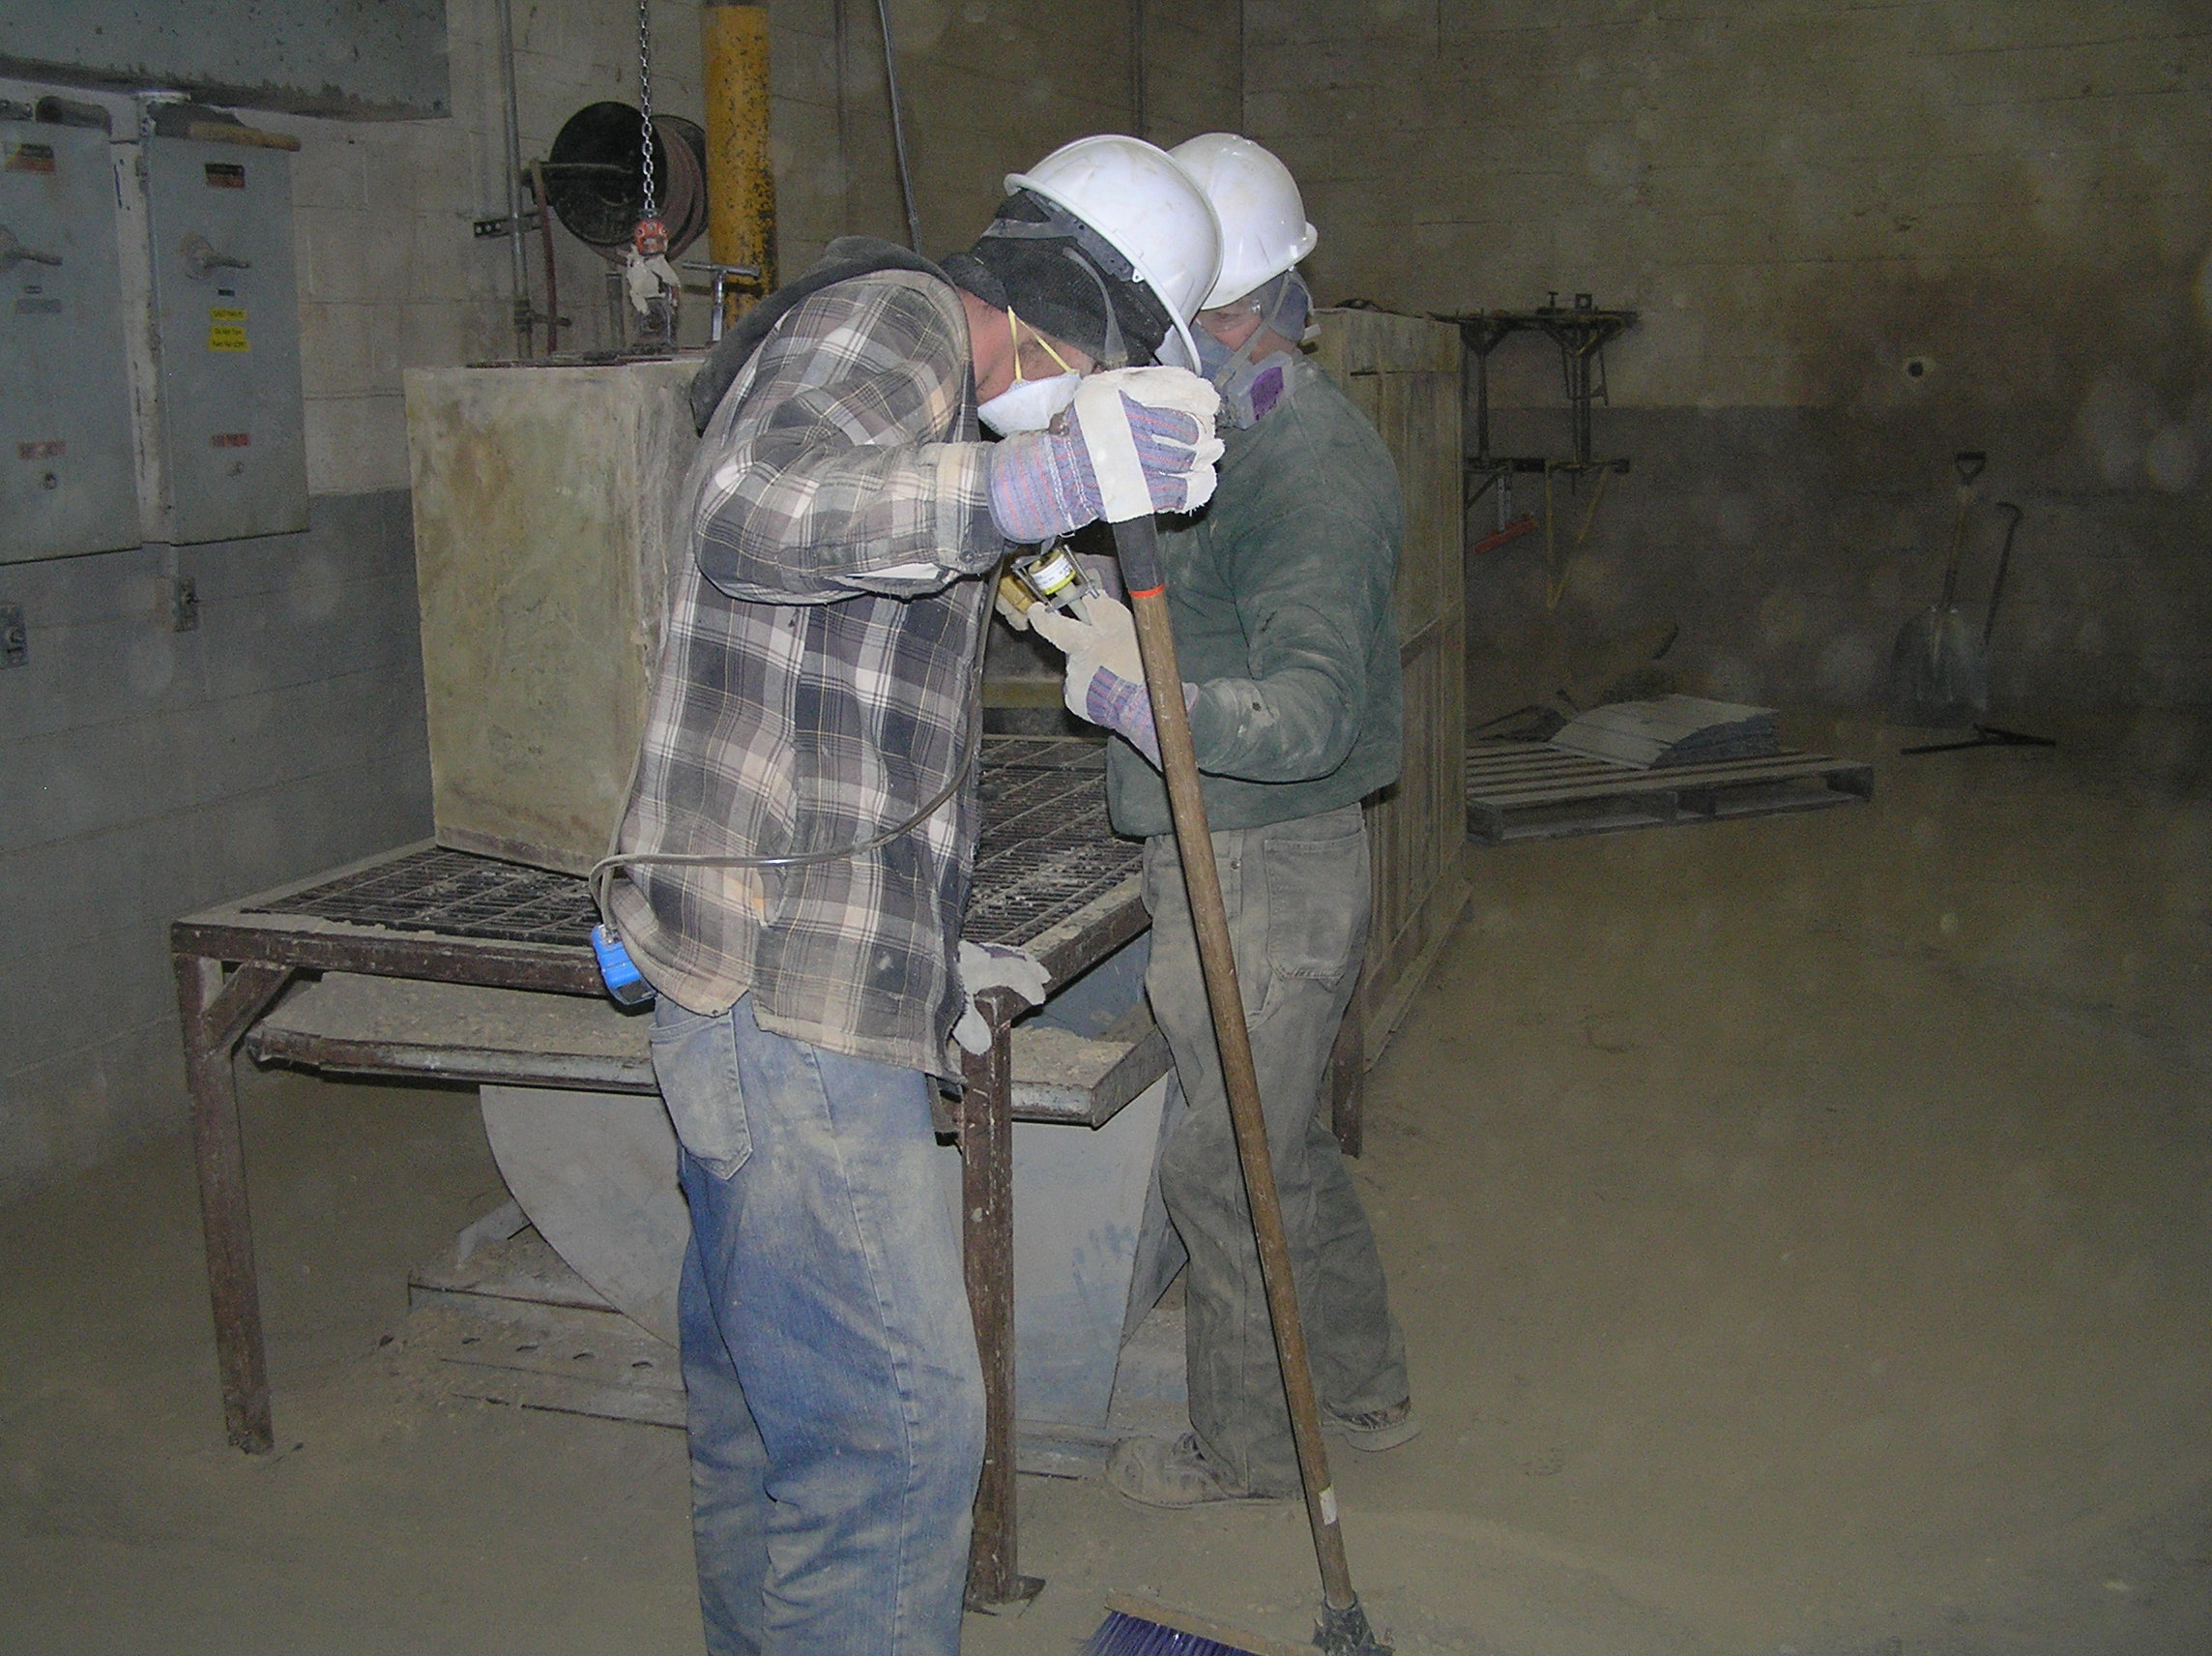

Slide 26
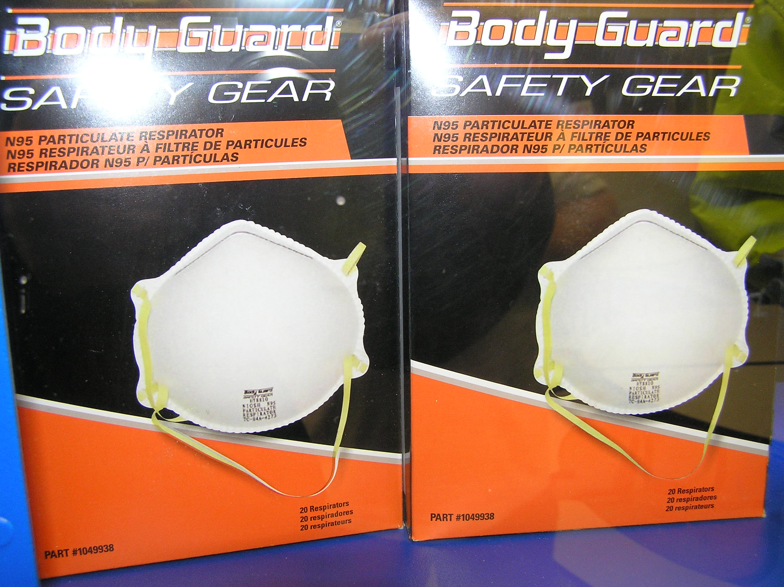

Slide 27
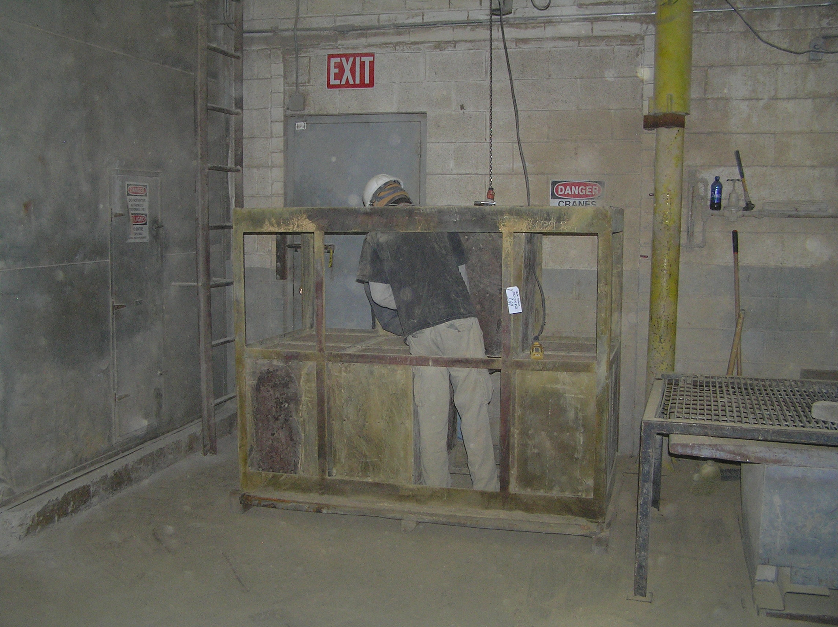

Slide 28
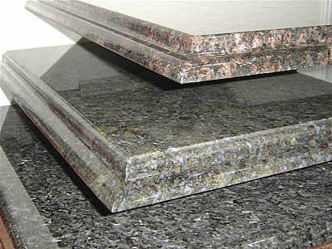
Granite counter tops

Slide 29
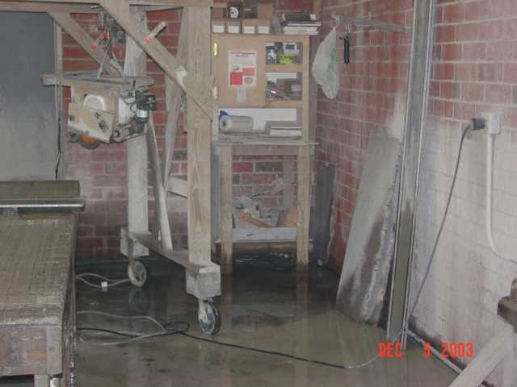

Slide 30
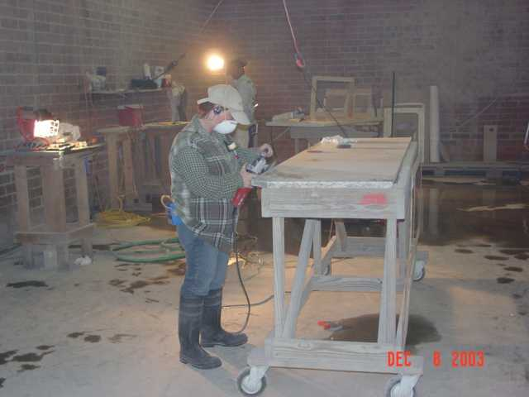

Slide 31
Asbestos
1910.1001
1926.1101
Name given to a group of naturally occurring fibrous silicate minerals mined for their useful properties such as thermal insulation, chemical and thermal stability, and high tensile strength
Used in building materials for resistance against heat and corrosion
Asbestos includes:
Chrysotile
Amosite
Crocidolite
Tremolite
Anthophyllite
Actinolite
Nova Development
Notes:
31
Asbestos Icon Graphic Created by NCDOL Tom Wilder 07-22-15
Asbestos fibers - Have been used in a wide range of manufactured goods, including roofing shingles, ceiling and floor tiles, paper and cement products, textiles, coatings, and friction products such as automobile clutch, brake and transmission parts. Most of these have been banned.
Asbestos is a group of six fibrous minerals that occur naturally in metamorphic deposits located around the world. Of the hydrous magnesium silicate variety, the six types include:
tremolite asbestos - Tremolite asbestos was not often used industrially or commercially; though it could be found (uncommonly) in products such as certain talcum powders in limited amounts.
actinolite asbestos - Actinolite asbestos was not often used industrially or commercially. Airborne actinolite fibers are easily inhaled and severely damaging to the lungs.
anthophyllite asbestos - Like tremolite and actinolite, anthophyllite was not often used industrially or commercially; though it could occasionally be found in certain vermiculites.
chrysotile asbestos - Also called white asbestos, chrysotile asbestos is unique in that it has a serpentine fiber-formation (curled fibers) compared to the amphibole fiber-formation (straight, needle-like fibers) of the other five asbestos types. Chrysotile asbestos is less friable (less-likely to be inhaled) than other types of asbestos. Chrysotile asbestos is less likely to be inhaled and therefore viewed by many to be the safest of the asbestos types.
amosite asbestos - Also called Grunerite or brown asbestos, amosite asbestos is an amphibole originating in Africa. Amosite was used industrially for various purposes such as cement sheet and pipe insulation.
crocidolite asbestos - Also called blue asbestos, crocidolite asbestos is an amphibole mineral that can be found in Africa and Australia. On the opposite end of the spectrum than chrysotile asbestos, crocidolite is viewed to be the most dangerous type of asbestos.

Slide 32
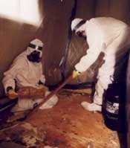
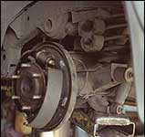
Asbestos Exposures
Class I work
Class II work
Class III
Class IV
Brakes

Slide 33
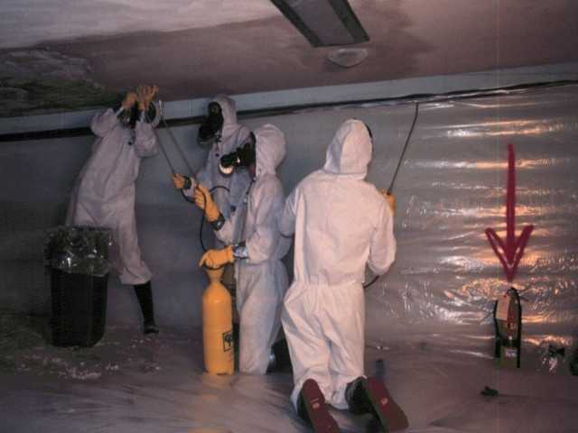
Asbestos Evaluation and Control
Routes of Exposure
Associated Illnesses
PELs
General Industry Standard
Construction Industry Standard
Sampling Media
Analysis
Respiratory Protection
Notes:
Intentionally unfilled for notes.

Slide 34
Asbestos
1910.1001
1926.1101
Airborne fibers range from 5 µm or greater, with a length-to-diameter ratio of at least 3 to 1
ACM: “Asbestos-containing material,” any material containing >1% asbestos
PACM: “Presumed asbestos-containing material” – thermal system insulation and surfacing material found in buildings constructed no later than 1980
Notes:
34
Asbestos Icon Graphic Created by NCDOL Tom Wilder 07-22-15
Note that 5 micron fibers are not visible to the human eye.
Friable: ACM that can be crumbled, pulverized, or reduced to powder by hand pressure. When friable ACM is damaged or disturbed, it releases fibers into the air.
NOTE: The OSHA asbestos standards are triggered by presence of asbestos, not by percentage or whether the material is friable.

Slide 35
Asbestos Health Effects
1910.1001
1926.1101
Asbestosis: A serious, progressive, long-term non-cancer disease of the lungs
Lung Cancer: Causes the largest number of deaths related to asbestos exposure
Most common symptoms of lung cancer are coughing and a change in breathing
Mesothelioma: A rare form of cancer found in the thin lining (membrane) of the lung, chest, abdomen, and heart
Most cases are linked to asbestos exposures
Notes:
35
Asbestos Icon Graphic Created by NCDOL Tom Wilder 07-22-15
Asbestosis: The scarring makes it hard for oxygen to get into the blood. Symptoms of asbestosis include shortness of breath and a dry, crackling sound in the lungs while inhaling. There is no effective treatment for asbestosis. It is caused by inhaling asbestos fibers that irritate lung tissues and cause the tissues to scar.
Lung Cancer: The most common symptoms of lung cancer are coughing and a change in breathing. Other symptoms include shortness of breath, persistent chest pains, hoarseness, and anemia.
Mesothelioma: This disease may not show up until many years after asbestos exposure.

Slide 36
Exposure Limits
1910.1001
1926.1101
Permissible exposure limit
0.1 fiber per cubic centimeter (f/cc) of air as an 8 hour TWA
Excursion limit
Not more than 1 f/cc averaged over 30 minutes
Monitoring
Initially for workers who are or may be exposed at or above the PEL and/or above the excursion limit
Periodic if above PEL or excursion limit
Notes:
Asbestos Icon Graphic Created by NCDOL Tom Wilder 07-22-15
Periodic Monitoring:
For 1910 – After the initial determinations (required by paragraph (d)(2)(i) of this section), samples shall be of such frequency and pattern as to represent with reasonable accuracy the levels of exposure of the employees. In no case shall sampling be at intervals greater than six months for employees whose exposures may reasonably be foreseen to exceed the TWA permissible exposure limit and/or excursion limit.
For 1926 – based on the class of work.
Class 1 & 2 – daily unless a negative initial exposure assessment for the entire job is made
Other than Class I and II work - The employer shall conduct periodic monitoring of all work where exposures are expected to exceed a PEL, at intervals sufficient to document the validity of the exposure prediction.
When all employees required to be monitored daily are equipped with supplied-air respirators operated in the pressure demand mode, or other positive pressure mode respirator, the employer may dispense with the daily monitoring required by this paragraph. However, employees performing Class I work using a control method which is not listed in paragraph (g)(4)(i), (ii), or (iii) of this section or using a modification of a listed control method, shall continue to be monitored daily even if they are equipped with supplied-air respirators.

Slide 37
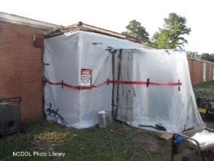
Responsibility
1910.1001
1926.1101
Building/facility owner
Removal/abatement of asbestos is covered by 29 CFR 1926 (Construction)
Must adhere to:
Multi-employer worksite
Hazards abated by contractor who created
Inform others of measures to control exposures
Adjacent employer will check containment
General contractor (GC) requires compliance
Competent person
Notes:
NCDOL Photo Library Closed Case #317094969
In General Industry, the building and facility owners have the responsibility to determine if asbestos is present; they must determine its location, type and condition of the asbestos. If the building is sold, the new owner must be informed of the presence, location and condition of the asbestos in the building.
Discuss with the class the responsibility of asbestos abatement, the hazards and possible exposure.
Any persons in the area must be notified if asbestos abatement work is being preformed.
This means other contractors working in the area such as office employees, teachers and custodial staff.
Measures and/or procedures must be taken immediately to notify any persons (in the area) if a failure in the abatement process, risks exposure.
There must be a competent person on the job daily to inspect the integrity of the abatement work.
37

Slide 38
Medical Surveillance
1910.1001
1926.1101
Required when above PEL/excursion limit
Pre-placement examinations
Medical/work history
Complete physical exam with emphasis on respiratory system, cardiovascular system and digestive tract
Completion of questionnaire – Appendix D
Chest X-Ray (Roentgenogram)
Pulmonary function test (PFT)
Any additional tests required by the Physician
or other Licensed Healthcare Professional (PLHCP)
Periodic exam (annually)
Upon termination of employment (1910)
Notes:
Asbestos Icon Graphic Created by NCDOL Tom Wilder 07-22-15
For 1910 – (l) Medical surveillance. (1) General Employees covered. The employer shall institute a medical surveillance program for all employees who are or will be exposed to airborne concentrations of fibers of asbestos at or above the TWA and/or excursion limit. (2) Pre-placement examinations. Before an employee is assigned to an occupation exposed to airborne concentrations of asbestos fibers at or above the TWA and/or excursion limit, a pre-placement medical examination shall be provided or made available by the employer. (3) Periodic examinations. Periodic medical examinations shall be made available annually.
For 1926 – (m) Medical surveillance. (1) General. (i) Employees covered. [A] The employer shall institute a medical surveillance program for all employees who for a combined total of 30 or more days per year are engaged in Class I, II and III work or are exposed at or above a permissible exposure limit. For purposes of this paragraph, any day in which a worker engages in Class II or Class III operations or a combination thereof on intact material for one hour or less (taking into account the entire time spent on the removal operation, including cleanup) and, while doing so, adheres fully to the work practices specified in this standard, shall not be counted. [B] For employees otherwise required by this standard to wear a negative pressure respirator, employers shall ensure employees are physically able to perform the work and use the equipment. This determination shall be made under the supervision of a physician. (2) Medical examinations and consultations. Frequency. The employer shall make available medical examinations and consultations to each employee covered under paragraph (m)(1)(i) of this section on the following schedules: [A] Prior to assignment of the employee to an area where negative-pressure respirators are worn; [B] When the employee is assigned to an area where exposure to asbestos may be at or above the permissible exposure limit for 30 or more days per year, or engage in Class I, II, or III work for a combined total of 30 or more days per year, a medical examination must be given within 10 working days following the thirtieth day of exposure; [C] And at least annually thereafter. [D] If the examining physician determines that any of the examinations should be provided more frequently than specified, the employer shall provide such examinations to affected employees at the frequencies specified by the physician. [E] Exception: No medical examination is required of any employee if adequate records show that the employee has been examined in accordance with this paragraph within the past 1-year period.
Roentgenogram - A photograph made with x-rays.

Slide 39
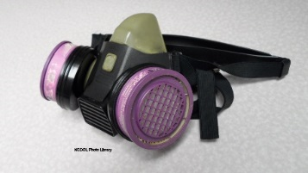
Respirator Selection
1910.1001
1926.1101
When is respiratory protection required?
Above PEL
Based on Class of work performed
Provided in accordance with 29 CFR 1910.134 (b) - (d) (except (d)(1)(iii)), and (f) - (m)
Proper selection per 29 CFR 1910 or 29 CFR 1926
High efficiency particulate air (HEPA) filters for all air purifying respirators (APR)
No filtering face pieces (dust masks)
Notes:
Photo by NCDOL Tom Wilder 07-02-15
Asbestos Icon Graphic Created by NCDOL Tom Wilder 07-22-15
For 1910 – when required (g) Respiratory protection.
(1) General. For employees who use respirators required by this section, the employer must provide each employee an appropriate respirator that complies with the requirements of this paragraph. Respirators must be used during: (i) Periods necessary to install or implement feasible engineering and work-practice controls. (ii) Work operations, such as maintenance and repair activities, for which engineering and work-practice controls are not feasible. (iii) Work operations for which feasible engineering and work-practice controls are not yet sufficient to reduce employee exposure to or below the TWA and/or excursion limit. (iv) Emergencies.
For 1926 - when required (h) Respiratory protection. (1) General. For employees who use respirators required by this section, the employer must provide each employee an appropriate respirator that complies with the requirements of this paragraph. Respirators must be used during: (i) Class I asbestos work. (ii) Class II asbestos work when ACM is not removed in a substantially intact state. (iii) Class II and III asbestos work that is not performed using wet methods, except for removal of ACM from sloped roofs when a negative-exposure assessment has been conducted and ACM is removed in an intact state. (iv) Class II and III asbestos work for which a negative-exposure assessment has not been conducted. (v) Class III asbestos work when TSI or surfacing ACM or PACM is being disturbed. (vi) Class IV asbestos work performed within regulated areas where employees who are performing other work are required to use respirators. (vii) Work operations covered by this section for which employees are exposed above the TWA or excursion limit. (viii) Emergencies.
(3)Respirator selection. (i) Employers must: [A] Select, and provide to employees, the appropriate respirators specified in paragraph (d)(3)(i)(A) of 29 CFR 1910.134; however, employers must not select or use filtering face piece respirators for use against asbestos fibers. [B] Provide HEPA filters for powered and non-powered air-purifying respirators. (ii) Employers must provide an employee with tight-fitting, powered air-purifying respirator (PAPR) instead of a negative pressure respirator selected according to paragraph (h)(3)(i)(A) of this standard when the employee chooses to use a PAPR and it provides adequate protection to the employee. (iii) Employers must provide employees with an air-purifying half mask respirator, other than a filtering face piece respirator, whenever the employees perform: [A] Class II or Class III asbestos work for which no negative exposure assessment is available. [B] Class III asbestos work involving disturbance of TSI or surfacing ACM or PACM. (iv) Employers must provide employees with: [A] A tight-fitting powered air-purifying respirator or a full face piece, supplied-air respirator operated in the pressure-demand mode and equipped with either HEPA egress cartridges or an auxiliary positive-pressure, self-contained breathing apparatus (SCBA) whenever the employees are in a regulated area performing Class I asbestos work for which a negative exposure assessment is not available and the exposure assessment indicates that the exposure level will be at or below 1 f/cc as an 8-hour time-weighted average (TWA). [B] A full face piece supplied-air respirator operated in the pressure-demand mode and equipped with an auxiliary positive-pressure SCBA whenever the employees are in a regulated area performing Class I asbestos work for which a negative exposure assessment is not available and the exposure assessment indicates that the exposure level will be above 1 f/cc as an 8-hour TWA.
APR – Air Purifying Respirator
HEPA – High Efficiency Particulate Air. Filters particles as small as 0.3 microns with an efficiency of 99.97%.

Slide 40
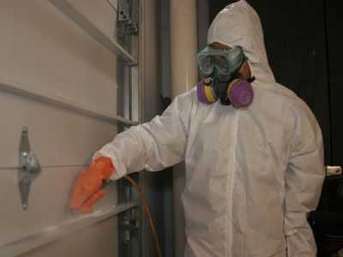
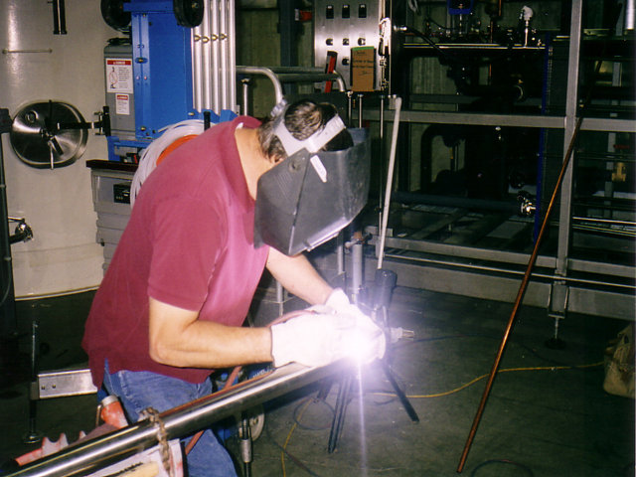
Hexavalent Chromium Exposures
Hot work such as welding on stainless steel
Industrial uses in dyes, paints, inks, plastics

Slide 41
Affected Operations
1910.1026
1926.1126
Electroplating
Welding on stainless steel or Cr(VI) painted surfaces
Painting
Aerospace
Auto body repair
Chromate pigment and chemical production
Chromium dye and catalyst production
Glass manufacturing
Plastic colorant production
Construction
Refractory brick restoration
Paint removal from bridges
Traffic painting
Notes:
41
Hexavalent Chromium Icon Graphic by NCDOL Tom Wilder 07-22-15
Some of the major industries covered by the standard are listed here.
Chrome content of stainless steel ranges from 11.5 to ~30%
They represent industries and operations where you find the major exposures to Cr(VI).

Slide 42
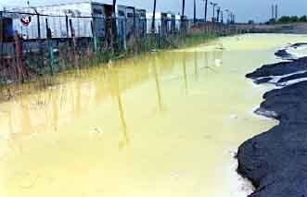
Hexavalent Chromium Evaluation and Control
Routes of Exposure
Associated Illnesses
PELs
General Industry Standard
Construction Industry Standard
Sampling Media
Analysis
Respiratory Protection
Notes:
The alchemy of contamination. Chromium in the soil of this New Jersey industrial parking lot has dissolved in a pool of standing water. Because chromium can go into solution and move through soil, chromium pools and blooms (the crystallized chromium left on the surface when the water evaporates) may occur some distance from the original site of contamination.

Slide 43
Hexavalent Chromium
1910.1026
1926.1126
Toxic form of chromium metal that is generally man-made
Used in many industrial applications primarily for its anti-corrosive properties
Can be created during certain “hot work” processes where the original form of chromium was not hexavalent
Notes:
43
Hexavalent Chromium Icon Graphic Created by NCDOL Tom Wilder 07-22-15
The metal chromium is an element that exists in several forms or “valence states”. The hexavalent form of chromium is a stable form that is known to be toxic. Another stable form, trivalent chromium, is not thought to be toxic.
Hexavalent chromium can exist as many different compounds that vary from highly water soluble to slightly water soluble to water insoluble.
Hexavalent chromium compounds have many varied uses in industry and are often used for their anti-corrosive properties in metal coatings, protective paints, dyes, and pigments.
Hexavalent chromium can also be formed when performing “hot work” such as welding on stainless steel, melting chromium metal, or heating refractory bricks in kilns. In these situations the chromium is not originally hexavalent but the high temperatures cause oxidation that converts the chromium to hexavalent chromium.
Stainless steel is defined in metallurgy as a ferrous alloy with a minimum of 10% chromium content. High oxidation resistance in air at ambient temperature is normally achieved with additions of a minimum of 13% (by weight) chromium, and up to 26% is used for harsh environments. The chromium forms a passivation layer of chromium(III) oxide (Cr2O3) when exposed to oxygen. The layer is too thin to be visible, meaning the metal stays shiny. It is, however, impervious to water and air, protecting the metal beneath. Also, when the surface is scratched this layer quickly reforms. This phenomenon is called passivation by materials scientists,

Slide 44
Health Effects
1910.1026
1926.1126
Lung cancer in workers who breathe airborne hexavalent chromium
Irritation or damage to the nose, throat, and lung (respiratory tract) if hexavalent
chromium breathed at high levels
Irritation or damage to the eyes and skin if hexavalent chromium contacts these organs in high concentrations
Notes:
Hexavalent Chromium Icon Graphic Created by NCDOL Tom Wilder 07-22-15
The primary health effect of concern is lung cancer caused by airborne exposures to hexavalent chromium. OSHA considers all Cr(VI) compounds to be carcinogenic.
Airborne exposures can also cause ulcers and holes in the nasal septum and may cause asthma in chromium sensitized individuals.
Dermal exposures to hexavalent chromium can result in skin ulcers commonly referred to as “chrome holes” and may also lead to dermatitis.

Slide 45
Exposure Limits
1910.1026
1926.1126
Permissible exposure limit
5 µg/m³, calculated as an 8-hour time-weighted average
Action level
2.5 µg/m³
Exposure determination
See paragraph (d) for more specifics
Notes:
Hexavalent Chromium Icon Graphic Created by NCDOL Tom Wilder 07-22-15
If the employer has a workplace or work operation covered by the Cr(VI) standards which is above the action level, but below the PEL, the employer must conduct 8-hour TWA exposure for each worker exposed to Cr(VI) every six months.
When monitoring for Cr(VI), employers must use a method of monitoring and analysis that provides values within plus or minus 25 percent of the true value at least 95 percent of the time for airborne concentrations at or above the Action Level. Examples of methods that meet these criteria are OSHA method ID215 (version 2) and NIOSH methods 7600, 7604, 7605 and 7703. 5 µg/m³ reads 5 micrograms per cubic meter of air
OSHA was convinced by comments submitted to the record that characterizing employee exposures is important in all work settings and that there are performance or task-based approaches that can be used when a scheduled monitoring approach is less practical. Therefore, OSHA is requiring exposure determination for all industry sectors and is allowing two options for characterizing employee exposures: a scheduled monitoring approach similar to previous OSHA health standards and a performance-oriented option.
The employer should read the section 1910.1026(d) carefully because there is different methods available for exposure determination. Affected employees must be notified where exposures exceed the PEL. Methods used for air monitoring and analysis must be sufficiently accurate. Employees or their representatives must be allowed to observe Cr(VI) monitoring. Where the exposure determination indicates that employee exposures exceed the PEL, the employer must notify affected employees within 15 days (5 days in construction). This can be accomplished by posting the results in a location that is accessible to all affected employees, or by notifying employees individually. The employer must describe the action being taken to reduce exposures to or below the PEL.

Slide 46
Monitoring
1910.1026
1926.1126
Scheduled
Initial monitoring indicates exposures are:
Below the AL: monitoring can be discontinued
At or above the AL: monitor every 6 months
Above the PEL: monitor every 3 months
Periodic personal monitoring
Performance-oriented option
To determine 8-hour TWA for each employee
based on any combination of the following:
Air-monitoring data
Historical monitoring data
Objective data
Notes:
Hexavalent Chromium Icon Graphic Created by NCDOL Tom Wilder 07-22-15
The standard states that monitoring can be done in 1 of 2 ways as long as you can give a good accounting of the employee exposure.

Slide 47
Regulated Areas
1910.1026(e)
General Industry employers only
Areas where exposures exceed or can be reasonably expected to exceed the PEL
Must be demarcated from other areas
Must limit access to employees who have a need to be there
Notes:
Hexavalent Chromium Icon Graphic Created by NCDOL Tom Wilder 07-22-15
Demarcate: Is to determine or mark off the boundaries or limits.
The purpose of a regulated area is to ensure that employees are aware of the presence of Cr(VI) at levels above the PEL, and to limit exposure to as few employees as possible.

Slide 48
Medical Surveillance
1910.1026
1926.1126
Occupationally exposed for 30 days or more at or above the AL or employees who are showing signs/symptoms of exposure
Conducted within 30 days after initial assignment
Annually
Within 30 days after PLHCP written medical opinion
Employee shows signs and symptoms of adverse health effects
Within 30 days after exposure of uncontrolled release
Termination of employee
Notes:
Hexavalent Chromium Icon Graphic Created by NCDOL Tom Wilder 07-22-15
The above lists when medical surveillance is required. Refer to standard for further information.
Paragraph (k) in 1910 and paragraph (i) in 1926

Slide 49
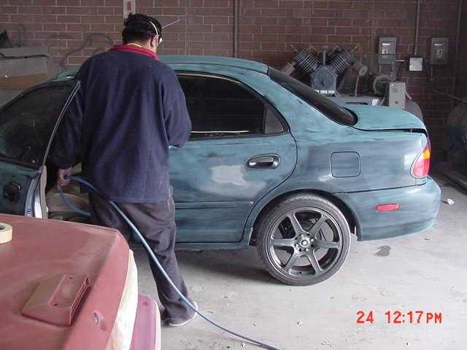
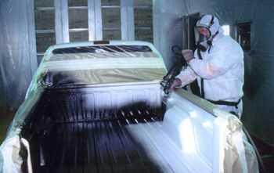
Isocyanate Exposures
Polyurethane polymers
Surface coating
Automotive industry
Spray-on bed liners
Manufacturing
Foam mattresses
Under carpet padding
Insulation materials
Packaging materials
Foam blowing
Extrusion operations

Slide 50
Isocyanate PELs & IDLH
Methyl isocyanate
PEL= 0.02 ppm
IDLH= 3 ppm
Methylene bisphenyl isocyanate
PEL= 0.02 ppm (Ceiling)
IDLH= 75 mg/m3 or 7.32 ppm
Toluene-2, 4-diisocyanate
PEL= 0.02 ppm (Ceiling)
IDLH= 2.5 ppm

Slide 51
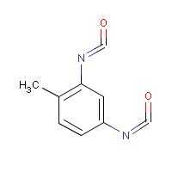
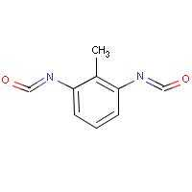
Toluene Diisocyanate (TDI)

Slide 52
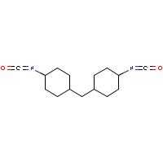
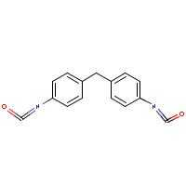
MDI and HMDI
Hydrogenated methylene diphenyl diisocyanate
Methylene diphenyl diisocyanate
Notes:
MDI - Methylene diphenyl diisocyanate
HMDI- Hydrogenated Methylene diphenyl diisocyanate

Slide 53
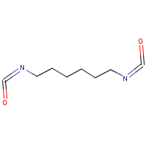
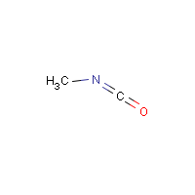
HDI and MIC
1,6-Hexamethylene diisocyanate
Methyl isocyanate
Notes:
HDI- 1,6-Hexamethylene Diisocyanate
MIC- Methyl isocyanate

Slide 54
Medical Surveillance
1910.1000
1926.55
It is recommended that workers exposed
to isocyanates at or above the PEL or TLV undergo annual medical examinations and health surveillance under the supervision of a PLHCP
Physical examination should detail the workers demographic and occupational history
A pulmonary function test (spirometry) is recommended as well as a blood sample to monitor the systemic effects
Notes:
Isocyanates Icon Graphic Created by NCDOL Tom Wilder 07-22-15
These are recommendations.
Spirometry is the most basic and frequently performed test of pulmonary (lung) function. A device called a spirometer is used to measure how much air the lungs can hold and how well the respiratory system is able to move air into and out of the lungs. Because spirometry is based on a maximal forced exhalation, the accuracy of its results are highly dependent on the patient's understanding, cooperation, and best efforts.

Slide 55
Notes
2,4-Toluene diisocyanate is primarily used as a chemical intermediate in the production of polyurenthane products.
2,4-Toluene diisocyanate is extremely toxic from acute (short-term) and chronic (long-term) exposures. Acute exposure in humans, via inhalation, results in severe irritation of the skin and eyes and affects the respiratory, gastrointestinal, and central nervous systems (CNS). Chronic inhalation in humans has resulted in significant decreases in lung function in workers, an asthma-like reaction characterized by wheezing, dyspnea, and bronchial constriction.
Animal studies have reported significantly increased incidences of tumors of the pancreas, liver, and mammary glands from exposure to 2,4-toluene diisocyanate via gavage (experimentally placing the chemical in the stomach). The International Agency for Research on Cancer (IARC) has classified 2,4-toluene diisocyanate as a Group 2B, possible human carcinogen.
SOURCE: EPA’s website http://www.epa.gov/ttn/atw/hlthef/toluene2.html
Notes:
Intentionally blank for notes.

Slide 56
Notes
Respiratory Sensitization
Isocyanates can sensitize workers, making them subject to severe asthma attacks if they are exposed again, even when concentrations are continuously below the NIOSH REL [NIOSH 1973, 1978; Banks 1998].
Skin exposures may be associated with the onset of respiratory symptoms [Petsonk et al. 2000]. Respiratory disorders associated with isocyanate exposure include asthma and hypersensitivity pneumonitis [Baur et al. 1984; Baur 1995].
Sensitization may result from a single episode of overexposure or intermittent exposures at low concentrations. Once a worker is sensitized, even low concentrations may trigger symptoms such as wheezing, chest tightness, shortness of breath, and cough. Persons with chronic hypersensitivity pneumonitis may also experience fatigue and weight loss. These symptoms may begin immediately or may be delayed for up to 8 hours after exposure. Death from severe asthma in sensitized subjects has been reported [Fabbri et al. 1988; MIFACE 2003].
SOURCE: NIOSH website: http://www.cdc.gov/niosh/docs/2006-149/#3
Notes:
Intentionally blank for notes.

Slide 57
Notes
Bhopal India
December 3-4, 1984
Shortly after midnight, methyl isocyanate (MIC) gas leaks from a tank at the UCIL Bhopal plant. According to the state government of Madhya Pradesh, approximately 3,800 people die and several thousand other individuals experience permanent and partial disabilities.
UCC Technical team reports that a large volume of water was introduced into the MIC tank and triggered a reaction that resulted in the gas release. Independently, a committee of experts for the Indian government arrives at the same conclusion
Source: Bhopal Information Center (Union Carbide) website http://www.bhopal.com/chronology
Notes:
Injuries estimates as high as 200,000

Slide 58
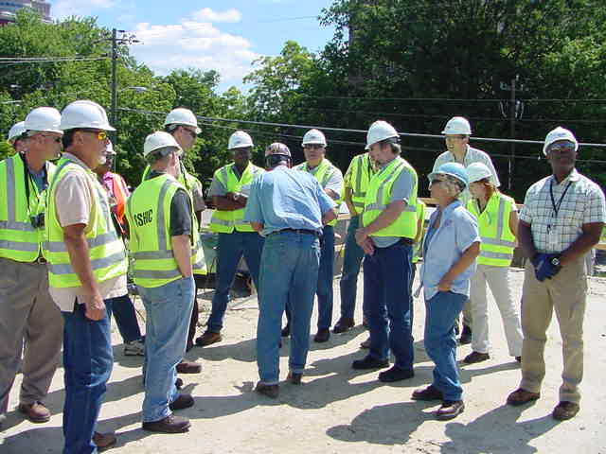
Inspection Expectations
General Industry Programmed Inspections
Randomly chosen from data base
Comprehensive health inspections
Potentially joint health and safety
Unprogrammed Inspections
Fatalities, accidents, referrals, and complaints
Limited in scope

Slide 59
Health Hazards SEP Referrals
CSHO Referrals
All compliance personnel will be instructed to look for lead, silica, hexavalent chromium, isocyanates, and asbestos activities
DHHS Referrals
Asbestos removal jobs projected to last 15 days or longer
Workers having blood lead levels above 25ug/100 grams of whole blood

Slide 60

Inspection Expectations
All aspects of lead, silica, exavalent chromium, isocyanates, and asbestos related work will be evaluated.
Air monitoring and wipe samples
Dermal exposure surveys
Hazard communication
PPE hazard assessments
Respiratory protection
Medical monitoring
Recordkeeping
Relevant training documentation

Slide 61

Summary
Exposures relevant to the Health Hazards Special Emphasis Program
Recognize where exposures to these targeted chemicals occur and important conditions impacting their hazards
Evaluating SEP Health Hazards
during your inspections

Slide 62

Thank You For Attending!
Final Questions?
1-800-NC-LABOR
(1-800-625-2267)
www.nclabor.com
Notes:
Tell students that now is time they log out of the session, if they have no further questions.

