Slide 1
N.C. Department of Labor OSH Division
Asbestos Standards
- 29 CFR 1926.1101
- 29 CFR 1910.1001
Notes:
Rev 0: 6/24/2013
START WITH REMINDER OF LEAD AT HOME
http://www.icij.org/project/dangers-dust/map-top-asbestos-producers-and-consumers

Slide 2

Asbestos in Construction
29 CFR 1926.1101)
Scope and application
Definitions
Permissible exposure limits
Multi-employer worksites
Regulated areas
Exposure assessments and monitoring
Methods of compliance
Respiratory protection
Protective clothing
Hygiene facilities
Communication
Housekeeping
Medical surveillance
Recordkeeping
Competent person
Appendices

Slide 3
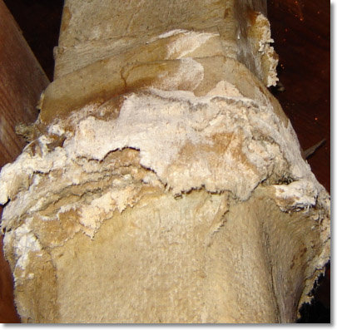
Scope and Application
29 CFR 1926.1101(a)
Covers asbestos exposure in all work as defined in 1910.12(b) 1926.10(a), regardless of the type of worksite or location
“Construction work" means work for construction, alteration, and/or repair, including painting and decorating.
Definition’s Source: 29 CFR 1910.12(b)
1926.10(a), and/or OSHA Dictionary
Notes:
Definition of Construction Work is from OSHA Dictionary

Slide 4
Scope and Application
29 CFR 1926.1101(a)
Includes but is not limited to:
Demolition or salvage of structures
Removal or encapsulation of materials
Construction, alteration, repair, maintenance, or renovation
Installation of products containing asbestos
Spill/emergency clean-up
Transportation, disposal, storage, containment and housekeeping activities on the site where construction activities are performed
Does not apply to asbestos-containing asphalt roof coatings, cements and mastics
Notes:
Question: Why doesn’t the scope and application apply to asbestos-containing asphalt roof coatings, cements and mastics?
Answer: Because asbestos-containing asphalt roof coatings, cements and mastics are considered Category I nonfriable asbestos-containing material (ACM). Category I nonfriable ACM is a NESHAP term.

Slide 5

Asbestos in Construction
29 CFR 1926.1101)
Scope and application
Definitions
Permissible exposure limits
Multi-employer worksites
Regulated areas
Exposure assessments and monitoring
Methods of compliance
Respiratory protection
Protective clothing
Hygiene facilities
Communication
Housekeeping
Medical surveillance
Recordkeeping
Competent person
Appendices

Slide 6
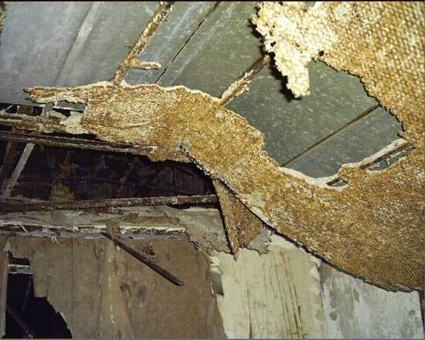
Definitions
29 CFR 1926.1101(b)
Asbestos
Chrysotile, amosite, crocidolite, tremolite asbestos, anthophyllite asbestos, actinolite asbestos, and any of these minerals that have been chemically altered; includes PACM
ACM
“Asbestos-containing material,” any material containing >1% asbestos
PACM
“Presumed asbestos-containing material”

Slide 7
Additional Definitions
Friable
Any materials that contain more than 1% asbestos and can be crumbled, pulverized, or reduced to powder by hand pressure when dry.
Nonfriable
Any materials that contain more than 1% asbestos and that can not be crumbled, pulverized, or reduced to powder by hand pressure when dry.

Slide 8
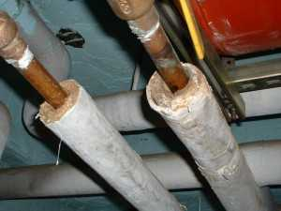
Examples
Notes:
Question: Friable or Nonfriable
Answer: TSI runs are friable. The elbows and joints maybe nonfriable.

Slide 9
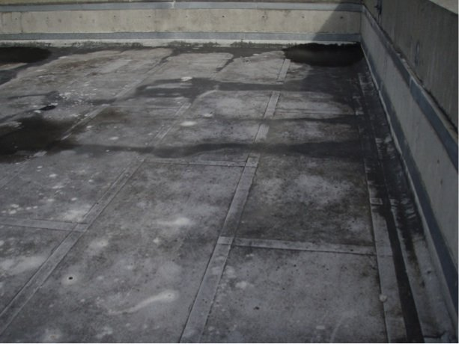
Examples
Notes:
Question: Friable or Nonfriable
Answer: Mastics, cements, coatings are usually nonfriable

Slide 10
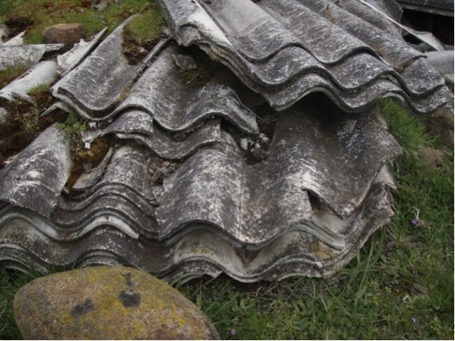
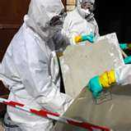
Examples
Notes:
Question: Friable or Nonfriable
Answer: Transite™ (cementitious asbestos) panels are nonfriable unless damaged during removal.

Slide 11
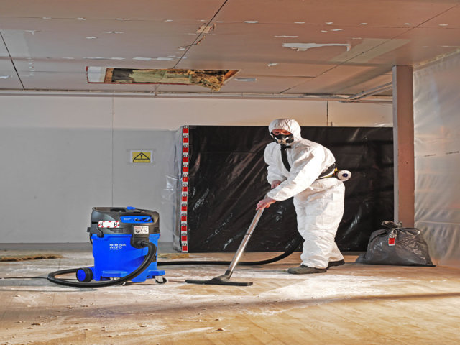
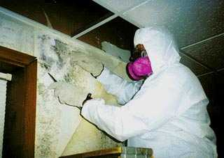
Examples
Notes:
Question: Friable or Nonfriable
Answer: The ACM on the floor would be considered friable.
The ACM plaster would also be considered friable due to damage incurred while removing the wall paper.

Slide 12
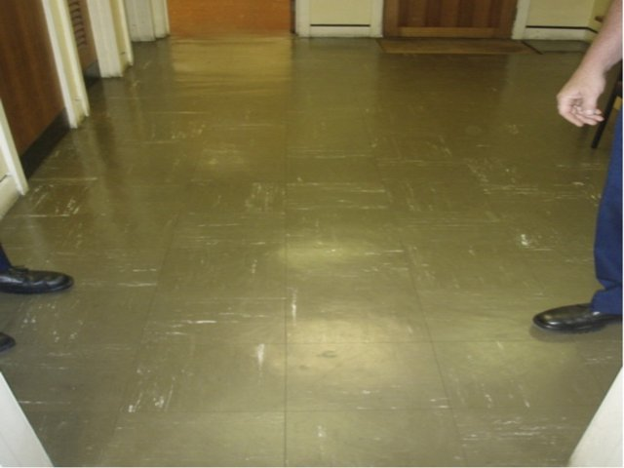
Examples
Notes:
Question: Friable or Nonfriable
Answer: 9” X 9” ACM floor tiles are nonfriable (unless damaged)

Slide 13
Definitions
29 CFR 1926.1101(b)
Critical Barrier
One or more layers of plastic sealed over all openings into a work area or
Any other similarly placed physical barrier
To prevent airborne asbestos in a work area from migrating to an adjacent area.
Surfacing Material
Material that is sprayed-on, troweled-on, or otherwise applied to surfaces
Thermal System Insulation (TSI)
ACM applied to pipes, fittings, boilers, breeching, tanks, ducts or other structural components to prevent heat loss or gain

Slide 14
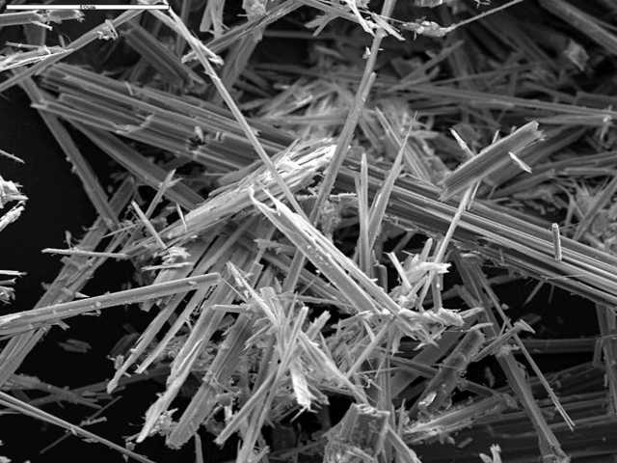
Definitions
29 CFR 1926.1101(b)
Disturbance
Activities that:
Disrupt the matrix of ACM or PACM,
Crumble or pulverize ACM or PACM, or
Generate visible debris from ACM or PACM
Includes cutting away small amounts of ACM and PACM, ≤ amount contained in one standard-sized glove bag or waste bag in order to access a building component
Notes:
> 1 std glove bag or waste bag places Class III removal of TSI or SM into Class I operation.

Slide 15
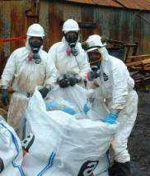
Definitions
29 CFR 1926.1101(b)
Class I Asbestos Work
Activities involving the removal of TSI or surfacing ACM and PACM
Class II Asbestos Work
Activities involving the removal of ACM which is not TSI or surfacing material (also
known as Miscellaneous ACM)
Examples: removal of asbestos-containing
wallboard, floor tile, and roofing shingles

Slide 16
Definitions
29 CFR 1926.1101(b)
Class III Asbestos Work (also known as O&M)
Repair and maintenance operations where ACM and/or PACM is likely to be disturbed
Where is this work?
Notes:
Class III work includes maintenance work for which a small amount of ACM must be cut away to access mechanical or structural components of buildings. In order to qualify as Class III work (rather than Class I or Class II work), the amount cut away must be less than the amount that can be contained in a standard-sized glove bag or waste bag.

Slide 17
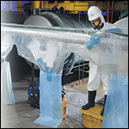
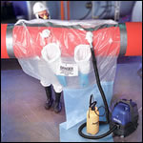
Definitions 29 CFR 1926.1101(b)
VS.
Notes:
Standard Glovebag vs. Large Glovebag

Slide 18
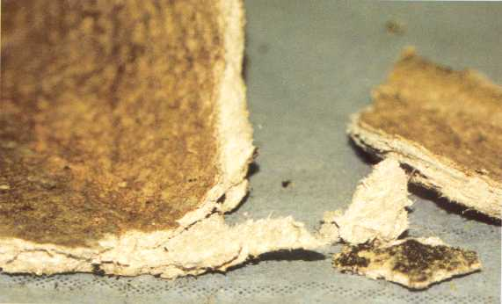
Definitions 29 CFR 1926.1101(b)
Class IV Asbestos Work
Maintenance and custodial activities during which employees contact but do not disturb ACM or PACM and activities to clean up dust, waste and debris resulting from Class I, II, and III activities

Slide 19
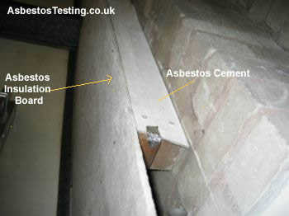
Definitions
29 CFR 1926.1101(b)
Building/Facility Owner
Intact
ACM that has not crumbled, been pulverized, or otherwise deteriorated

Slide 20
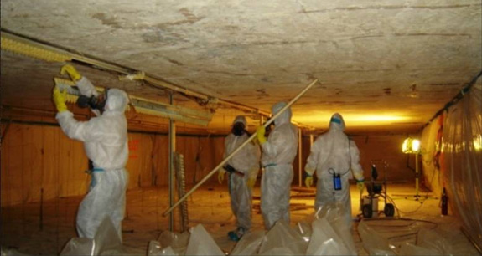
Definitions
29 CFR 1926.1101(b)
Competent Person
Big definition
Notes:
Required Training:
Class III Worker- 2-Hour Asbestos Awareness plus 14 Hours of Additional Training
Class IV Worker- 2-Hour Asbestos Awareness
Can identify existing asbestos hazards in the workplace and select appropriate control strategy for asbestos exposure and
Has authority to take prompt corrective action to eliminate them; and
For Class I and II work: trained in a training course that meets the criteria of EPA’s Model Accreditation Plan for supervisors, or its equivalent (40 CFR 763 AHERA)
For Class III and IV work: is specially trained including a course meeting EPA requirements for training of local education agency maintenance and custodial staff (40 CFR 763.92(a)(2) AHERA)

Slide 21

Asbestos in Construction
29 CFR 1926.1101(c)
29 CFR 1926.1101(c)
Scope and application
Definitions
Permissible exposure limits
Multi-employer worksites
Regulated areas
Exposure assessments and monitoring
Methods of compliance
Respiratory protection
Protective clothing
Hygiene facilities
Communication
Housekeeping
Medical surveillance
Recordkeeping
Competent person
Appendices

Slide 22
Permissible Exposure Limits
29 CFR 1926.1101(c)
Time-Weighted Average Limit
0.1 fiber/cubic centimeter as an 8-hour TWA (0.1 f/cc)
Excursion Limit
1.0 fiber/cubic centimeter as averaged over 30 minutes
Notes:
Excursion limit still counted as part of TWA

Slide 23

Asbestos in Construction
29 CFR 1926.1101(d)
Scope and application
Definitions
Permissible exposure limits
Multi-employer worksites
Regulated areas
Exposure assessments and monitoring
Methods of compliance
Respiratory protection
Protective clothing
Hygiene facilities
Communication
Housekeeping
Medical surveillance
Recordkeeping
Competent person
Appendices

Slide 24
Multi-Employer Worksites
29 CFR 1926.1101(d)
Employer whose work requires a regulated area shall inform other employers of:
Nature of such work
Existence /of and requirements for regulated areas
Other employers are not exposed
Abatement shall be by contractor who
creates or controls source of contamination

Slide 25
Multi-Employer Worksites
29 CFR 1926.1101(d)
D1
D4 ????? You want me to do what?
D5

Slide 26
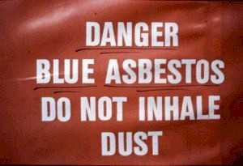
Asbestos in Construction
29 CFR 1926.1101(e)
Scope and application
Definitions
Permissible exposure limits
Multi-employer worksites
Regulated areas
Exposure assessments and monitoring
Methods of compliance
Respiratory protection
Protective clothing
Hygiene facilities
Communication
Housekeeping
Medical surveillance
Recordkeeping
Competent person
Appendices

Slide 27
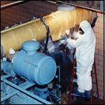
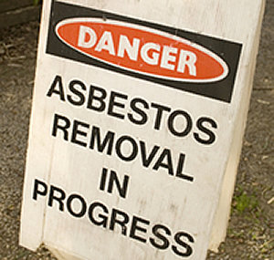
Regulated Areas
29 CFR 1926.1101(e)
Class I, II, and III asbestos work
All other operations where PEL is or may reasonably be exceeded
Notes:
“Regulated area”: an area established by the employer to demarcate areas where Class I, II, and III asbestos work is conducted, and any adjoining area where debris and waste from such asbestos work accumulate; and a work area within which airborne concentrations of asbestos, exceed or there is a reasonable possibility they may exceed the permissible exposure limit. Requirements for regulated areas are set out in paragraph (e) of this section.

Slide 28
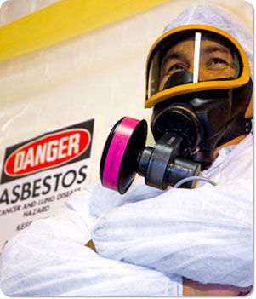
Regulated Areas
29 CFR 1926.1101(e)
Demarcated in any effective manner
Critical barriers or negative pressure enclosures may be used
Signs must be provided
Limited access
Respirators to be provided
Supervised by competent person
Notes:
Access limited to persons authorized by employer or OSH Act

Slide 29
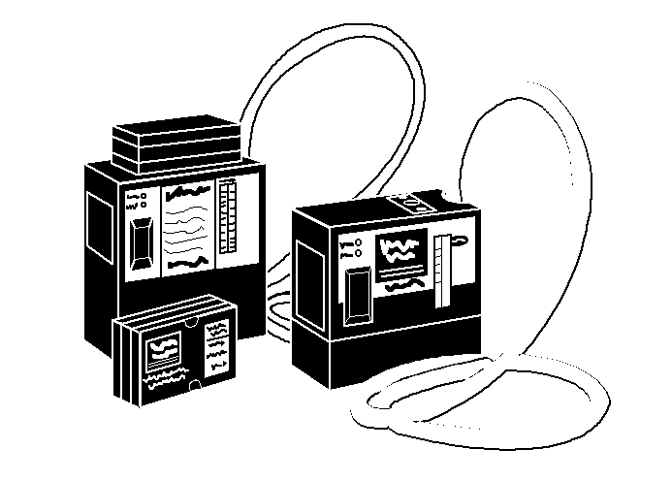
Asbestos in Construction
29 CFR 1926.1101(f)
Scope and application
Definitions
Permissible exposure limits
Multi-employer worksites
Regulated areas
Exposure assessments and monitoring
Methods of compliance
Respiratory protection
Protective clothing
Hygiene facilities
Communication
Housekeeping
Medical surveillance
Recordkeeping
Competent person
Appendices

Slide 30
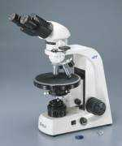
REALLY???!!!
More like what I used!
Notes:
Now let’s discuss the requirements for exposure assessments and monitoring

Slide 31
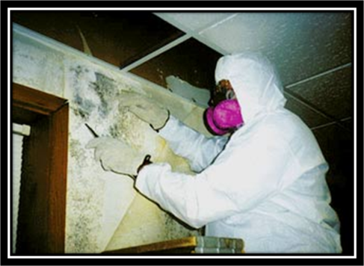

Slide 32
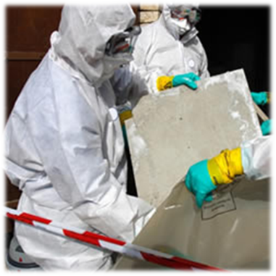

Slide 33
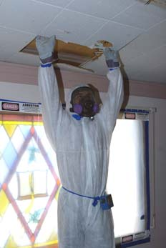
Exposure Assessments and Monitoring
29 CFR 1926.1101(f)(1)
General Requirements
For each workplace/operation where monitoring is required under this section:
Must be a representative 8-hr TWA
30-min EL samples (1.0f/cc) highest exposure tasks
Competent person must conduct the exposure assessment
Notes:
EL = Excursion Limit
Samples collected on filter and analyzed by PCM
Purpose of assessment by competent person: to ensure appropriate control systems are applied

Slide 34
Exposure Assessments and Monitoring
29 CFR 1926.1101(f)(2)
Initial Exposure Assessment
Must conduct assessment before or at the initiation of the operation to ascertain expected exposures
Triggered by exposure data or lack of a “negative exposure assessment”

Slide 35
Exposure Assessments and Monitoring
Basis of Initial Monitoring
Monitoring shall be conducted as per 1926.1101(f)(1)(iii)
1101(f)(2)(i)

Slide 36
Exposure Assessments and Monitoring
29 CFR 1926.1101(f)(2)
For Class I Work the employer shall presume that employees are exposed in excess of the TWA and EL unless
Documented initial exposure monitoring demonstrates employees will not be exposed in excess of the PELs, or
The employer completes a negative exposure assessment as per 1926.1101(f)(2)(iii)

Slide 37
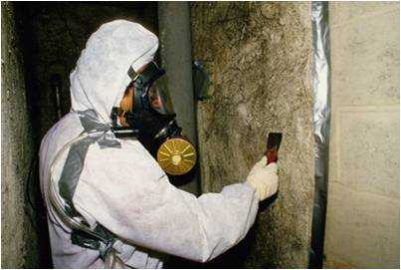
Negative Exposure Assessment
29 CFR 1926.1101(f)(2)
“Negative Exposure Assessment” required to conclude that exposures are likely to be consistently less than PELs
Notes:
(Oh yeah, 8 hours = 480 minutes)

Slide 38
Negative Exposure Assessment
29 CFR 1926.1101(f)
Objective data that product, mineral, or activity cannot release airborne fibers in concentrations > PELs under the most severe conditions
Monitoring data obtained w/in prior 12 months for work operations/conditions “closely resembling” current operations and were conducted by employees no more trained/experienced than current employees
Results of initial exposure monitoring of the current job

Slide 39
Periodic Monitoring
29 CFR 1926.1101(f)
Class I and II work in a regulated area: daily representative monitoring unless employer has NEA for the entire operation
All other operations: periodic monitoring sufficient to document the exposure
Notes:
Exception: Employees doing Class I work who are using a control listed in (g)(4)(i), (ii), or (iii) and employees doing Class II work may be equipped with supplied-air respirators operated in the positive-pressure mode in lieu of daily monitoring

Slide 40
Termination of Monitoring
29 CFR 1926.1101(f)
May discontinue monitoring if exposures < PELs
Additional monitoring is required when change may produce exposures > PELs
Process
Control equipment
Personnel
Work practice

Slide 41
Termination of Monitoring
Observation of monitoring by employees and their designated representatives
Affected employees notified of the monitoring results, in writing or by posting

Slide 42
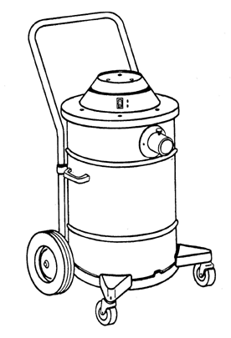
Asbestos in Construction
29 CFR 1926.1101(g)
Scope and application
Definitions
Permissible exposure limits
Multi-employer worksites
Regulated areas
Exposure assessments and monitoring
Methods of compliance
Respiratory protection
Protective clothing
Hygiene facilities
Communication
Housekeeping
Medical surveillance
Recordkeeping
Competent person
Appendices

Slide 43
Notes:
Now let’s discuss paragraph (g) - methods of compliance

Slide 44
Methods of Compliance
29 CFR 1926.1101(g)
All asbestos work: Regardless of level of exposure
Vacuum cleaners with HEPA filters
Wet methods or wetting agents during handling, mixing, removal, cutting, application, and cleanup
Prompt cleanup and disposal of wastes and debris in leak-tight containers
Notes:
see (g)(8)(ii) for roofing exceptions
UNLESS INFEASIBLE – wet methods.. Where?

Slide 45
Methods of Compliance
29 CFR 1926.1101(g)
Engineering controls and work practices to achieve PELs
LEV with HEPA filter dust collection system
Enclosing/isolating processes producing asbestos dust
Notes:
LEV = local exhaust ventilation

Slide 46

Methods of Compliance
29 CFR 1926.1101(g)
PROHIBITIONS
High-speed abrasive disc saws
Compressed air
Dry sweeping, shoveling, or other cleanup
Employee rotation

Slide 47
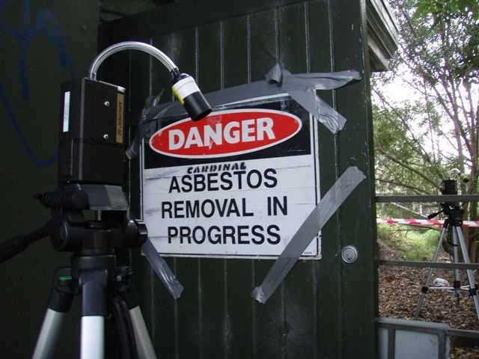
Methods of Compliance
29 CFR 1926.1101(g)
Class I Jobs
Critical barriers to prevent the migration of airborne asbestos from the regulated area
Containment

Slide 48
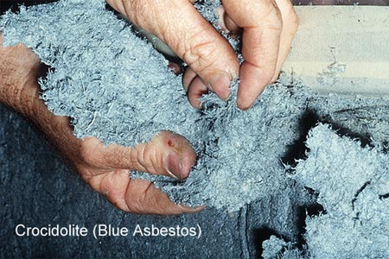
Methods of Compliance
29 CFR 1926.1101(g)
Class I Jobs - Specific control methods required:
>25 linear or 10 square feet of TSI or surfacing material
For all other Class I jobs where there is no negative exposure assessment
For Class I jobs where employees are working in areas adjacent to the regulated
area
Notes:
Next slide

Slide 49
Methods of Compliance
29 CFR 1926.1101(g)
Class I Jobs
Isolation of HVAC systems (double layer of 6 mil plastic or equivalent)
Impermeable dropcloths beneath removal activity

Slide 50
Methods of Compliance
Cover all objects within regulated area with impermeable materials
Where no NEA, or > PEL, ventilation of the regulated area to move air from the employee’s breathing zone toward HEPA-filtered collection device

Slide 51
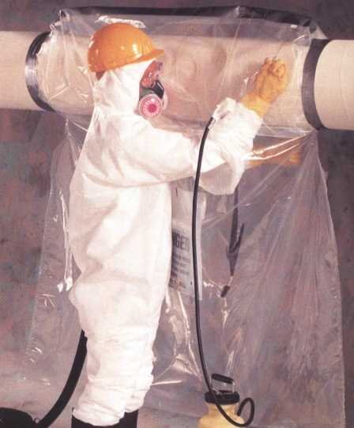
Methods of Compliance
29 CFR 1926.1101(g)
Class I Jobs
One or more of the following specific control methods shall be used:
Negative Pressure Enclosure (NPE) Systems
Glove Bag Systems
Negative Pressure Glove Bag Systems
Negative Pressure Glove Box Systems
Water Spray Process System
Small walk-in enclosure accommodating
1 - 2 persons, if the project can be
completely contained in the enclosure
Notes:
Negative Pressure Enclosure (NPE) Systems, where work area configuration does not make erection infeasible
Glove Bag Systems, for removal of PACM and/or ACM from straight runs of piping, elbows, and other connections
Negative Pressure Glove Bag Systems, for removal of ACM or PACM from piping
Negative Pressure Glove Box Systems, for removal of ACM or PACM from pipe runs
Water Spray Process System, for removal of ACM and PACM from cold line piping, where employees have completed a separate 40-hour training course in its use

Slide 52
Methods of Compliance
29 CFR 1926.1101(g)
Class II Jobs
Supervision by competent person, and when:
No NEA; or
May be > PELs; or
ACM not removed in substantially intact state
Critical barriers
Impermeable drop-cloths
Notes:
If other barrier or isolation method, must be verified by perimeter monitoring or clearance monitoring.

Slide 53
Methods of Compliance
29 CFR 1926.1101(g)
Removal of vinyl and asphalt flooring materials which contain ACM or for which in buildings constructed ≤ 1980, the employer has not verified the absence of ACM
Removal of roofing material
Removal of cementitious asbestos-containing siding and shingles or transite panels
Removal of gaskets
Performing any other Class II removal
Installation, removal, or repair of intact bituminous/resinous encapsulated roofing materials (mastics, flashings, etc.) and asphaltic pipeline wraps
Notes:
Talk about dates
Discuss settlement agreements for roofing and flooring.
Also, public sector has to deal with ruptured asbestos-containing cementitious water pipes

Slide 54
Methods of Compliance
29 CFR 1926.1101(g)
Class I methods may also be used for Class II work, except that glove bags and glove boxes are allowed if they fully enclose the Class II material to be removed
Alternative controls may be used if they comply with the following:
Data representing exposure will not exceed the PELs
A competent person evaluates and certifies such controls
Notes:
Note: competent person may evaluate alternative control; CIH or PE not required.

Slide 55
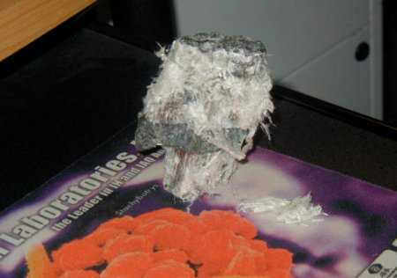
Methods of Compliance
29 CFR 1926.1101(g)
Class III Jobs
Wet methods
LEV, to the extent feasible

Slide 56
Methods of Compliance
29 CFR 1926.1101(g)
Drilling, cutting, abrading, sanding, chipping, breaking, or sawing TSI or surfacing material
Impermeable dropcloths and mini-enclosures or
Glove bag systems or another isolation method
No NEA or > PELs
Impermeable dropcloths and plastic barriers or
Isolation using a control system specified for Class I jobs
Where
TSI or surfacing material involved or
No NEA, or > PELs
Respiratory protection required according to paragraph (h)

Slide 57
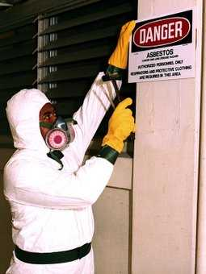
Methods of Compliance
29 CFR 1926.1101(g)
Class IV Jobs
Trained per paragraph (k)(9)
respirators are required / then they shall wear respirators
Waste and debris in areas where
friable TSI or surfacing material is
accessible assumed to contain
asbestos

Slide 58

Asbestos in Construction
29 CFR 1926.1101(h)
Scope and application
Definitions
Permissible exposure limits
Multi-employer worksites
Regulated areas
Exposure assessments and monitoring
Methods of compliance
Respiratory protection
Protective clothing
Hygiene facilities
Communication
Housekeeping
Medical surveillance
Recordkeeping
Competent person
Appendices

Slide 59
Notes:
Discuss respiratory protection, protective clothing and hygiene facilities

Slide 60
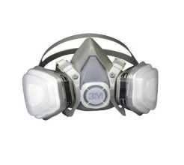
Respiratory Protection
29 CFR 1926.1101(h)
Must be provided and used for:
Class I jobs
Class II jobs where ACM is not removed substantially intact
Class II and III jobs not performed using wet methods; exception: sloped roofs
Class II and III jobs where no NEA
Class III jobs where TSI or surfacing material ACM or PACM is disturbed
Class IV work in regulated areas where employees performing other work are required to wear respirators
> PELs
Emergencies

Slide 61
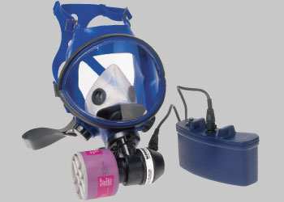
Respirator Selection
29 CFR 1926.1101(h)
Employers shall provide respirators per Table 1
NIOSH approved
Tight-fitting, PAPR shall be provided in lieu of any negative-pressure respirator whenever
Employee chooses to use this type of respirator and
Respirator will provide adequate protection
Notes:
PAPR = powered-air purifying respirator

Slide 62
Table 1 Respiratory Protection for Asbestos Fibers
Airborne concentration of asbestos or conditions of use | Required respirator
Not in excess of 1 f/cc (10 x PEL) or otherwise as required independent of exposure pursuant to paragraph (h)(2)(iv) of this section. | Half–mask air purifying respirator other than a disposable respirator, equipped with high-efficiency filters.
Not in excess of 5 f/cc (50 x PEL). | Full facepiece air–purifying respirator equipped with high efficiency filters.
Not in excess of 10 f/cc (100 x PEL). | Any powered air–purifying respirator equipped with high efficiency filters or any supplied air respirator operated in continuous flow mode.
Not in excess of 100 f/cc (1,000 x PEL) or unknown concentration. | Full facepiece supplied air respirator operated in pressure demand mode.
Greater than 100 f/cc (1,000 x PEL) or unknown concentration. | Full facepiece supplied air respirator operated in pressure demand mode, equipped with an auxiliary positive pressure self–contained breathing apparatus.
Notes:
Should be replaced with 1910.134 table on PELs

Slide 63
Respirator Selection
29 CFR 1926.1101(h)
Half-mask APR (not disposable!) with HEPA filters
Class II and III jobs where no NEA
Class III jobs where TSI or SM being disturbed
Tight fitting PAPRs with HEPA filters or full-facepiece supplied air respirators operated in pressure-demand mode, with HEPA egress cartridges or an auxiliary positive pressure SCBA, required for Class I work where:
NEA has not been produced, and
Exposure assessment levels are ≤ 1 fiber/cc (8-hour TWA)

Slide 64
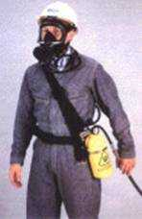
Respirator Selection
29 CFR 1926.1101(h)
Full-facepiece SAR operated in PD mode equipped with an aux. positive pressure SCBA, required for Class I work where
NEA has not been produced, and
Exposure assessment levels are > 1f/cc for an 8-hour TWA
Notes:
SAR = supplied air respirator
Reminder: Exposure assessment assumed > PELs for Class I work until initial exposure monitoring done

Slide 65

Respirator Selection
29 CFR 1926.1101(h)
Comply with 1910.134(b)-(d) (not (d)(1)(iii)), (f), and (m)
Permitted to change filters whenever an increase in breathing resistance is detected
Permitted to leave work areas to wash their faces and respirator facepieces whenever necessary to prevent skin irritation
Notes:
1910.134(b): definitions
1910.134(c): respiratory protection program
1910.134(d): selection of respirators; (d)(1)(iii) refers to identification of hazards and determination of exposure levels
1910.134(e): medical evaluation
1910.134(f): fit testing
1910.134(m): recordkeeping

Slide 66
Respirator Selection
29 CFR 1926.1101(h)
Comply with 1910.134(b)-(d) (not (d)(1)(iii)), (f), and (m)
Permitted to change filters whenever an increase in breathing resistance is detected
Permitted to leave work areas to wash their faces and respirator facepieces whenever necessary to prevent skin irritation
The employer shall identify and evaluate the respiratory hazard(s) in the workplace; this evaluation shall include a reasonable estimate of employee exposures to respiratory hazard(s) and an identification of the contaminant's chemical state and physical form. Where the employer cannot identify or reasonably estimate the employee exposure, the employer shall consider the atmosphere to be IDLH.
Notes:
1910.134(b): definitions
1910.134(c): respiratory protection program
1910.134(d): selection of respirators; (d)(1)(iii) refers to identification of hazards and determination of exposure levels
1910.134(e): medical evaluation
1910.134(f): fit testing
1910.134(m): recordkeeping

Slide 67
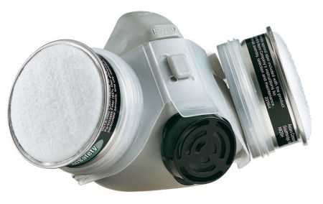
Respirator Selection
29 CFR 1926.1101(h)
No employee will be assigned to tasks requiring respirators if an examining physician finds:
Employee cannot function normally wearing a respirator or
Will endanger him/herself or others
Employees not approved for respirator use may transfer to another job if available

Slide 68
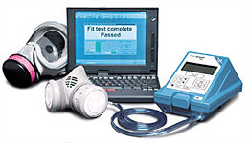
Respirator Fit Testing
29 CFR 1926.1101(h)
Fit tests for negative pressure respirators
Initial fitting and
At least annually thereafter
QLFT may be used only for:
Half-mask respirators or
Full-facepiece air-purifying respirators worn in lieu of half-facepiece APR
QLFT and QNFT conducted per
Appendix C

Slide 69
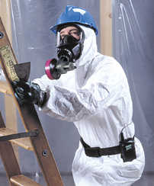
Asbestos in Construction
29 CFR 1926.1101(i)
Scope and application
Definitions
Permissible exposure limits
Multi-employer worksites
Regulated areas
Exposure assessments and monitoring
Methods of compliance
Respiratory protection
Protective clothing
Hygiene facilities
Communication
Housekeeping
Medical surveillance
Recordkeeping
Competent person
Appendices

Slide 70
Protective Clothing
29 CFR 1926.1101(i)
Coveralls, head coverings, gloves, and foot coverings are required for:
Employee exposure > PELs
Employees doing work for which required NEA not produced
Employees performing Class I work involving removal of > 25 linear or 10 sq. ft. of TSI or surfacing ACM or PACM
Laundering of contaminated clothing must be done so as to prevent exposures > PELs
Employers must inform launderers of the requirement to prevent release of airborne asbestos > PELs

Slide 71
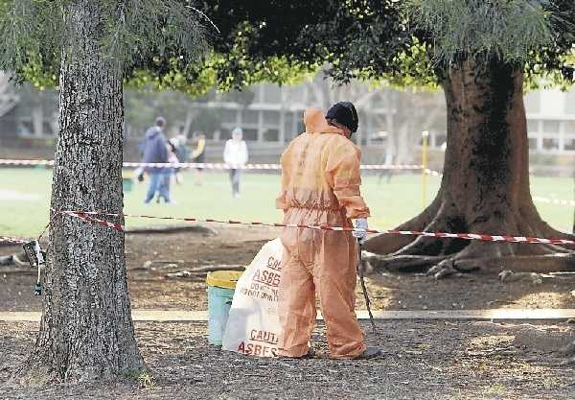
Protective Clothing
29 CFR 1926.1101(i)
Contaminated clothing must be transported in labeled, sealed impermeable bags or containers
Competent person must examine worksuits at least 1x per workshift for rips or tears
Rips/tears must be immediately mended, or the worksuit replaced

Slide 72

Asbestos in Construction
29 CFR 1926.1101(j)
Scope and application
Definitions
Permissible exposure limits
Multi-employer worksites
Regulated areas
Exposure assessments and monitoring
Methods of compliance
Respiratory protection
Protective clothing
Hygiene facilities
Communication
Housekeeping
Medical surveillance
Recordkeeping
Competent person
Appendices

Slide 73
Hygiene Facilities
29 CFR 1926.1101(j)
Class I Jobs > 25 Lin. Ft. or 10 Sq. Ft. of TSI or Surfacing ACM and PACM
Decontamination area adjacent and connected to the regulated area
Equipment room
Shower area (adjacent to equipment room and clean room)
Clean change room
Employees must enter the regulated area through the decon area
Clean room → Shower area → Equipment room
Employees must exit the regulated area through the decon area
Equipment room → Shower area → Clean room
For all Class I work: Lunch areas must be provided in areas in which airborne asbestos concentration is < PELs
Notes:
[Note: check on significance of 25 linear ft and 10 sq. ft.]

Slide 74
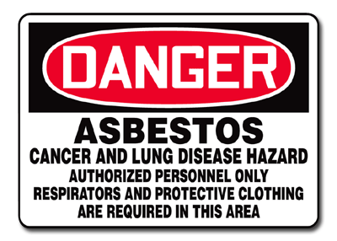
Hygiene Facilities
29 CFR 1926.1101(j)
Other Class I Jobs, Class II Jobs, and Class III Jobs
Must establish an equipment room or area adjacent to the regulated area for the decontamination of employees and equipment
Employees must enter and exit the regulated area through the equipment room or area

Slide 75

Hygiene Facilities
29 CFR 1926.1101(j)
Class IV Jobs
Hygiene facilities and practices must match those of employees performing higher classification work within the same regulated area, or
Decontamination facilities specified for “Other Class I Jobs, Class II Jobs, and Class III Jobs” must be provided for employees cleaning up debris and material identified as TSI or surfacing ACM or PACM
For all jobs covered under this standard: smoking is not permitted where there is exposure to asbestos

Slide 76

Asbestos in Construction
29 CFR 1926.1101(k)
Scope and application
Definitions
Permissible exposure limits
Multi-employer worksites
Regulated areas
Exposure assessments and monitoring
Methods of compliance
Respiratory protection
Protective clothing
Hygiene facilities
Communication
Housekeeping
Medical surveillance
Recordkeeping
Competent person
Appendices

Slide 77
Communication of Hazards
29 CFR 1926.1101(k)
Duties of Building and Facility Owners
Identify presence, location, and quantity of ACM/PACM, including:
TSI and sprayed on/troweled-on surfacing materials in buildings or substrates constructed ≤ 1980
Resilient flooring material installed ≤ 1980
Notes:
Identify ACM/PACM before work begun

Slide 78
Communication of Hazards
29 CFR 1926.1101(k)
Duties of Building and Facility Owners
Notification of:
Presence, location, and quantity of ACM/PACM
To:
Prospective employers applying for/bidding for work
Employees of owner who will work in or adjacent to areas containing such materials
All employers on multi-employer worksites whose employees will be performing work within or adjacent to areas containing such materials
Tenants who will occupy areas containing such materials
Notes:
Identify ACM/PACM before work begun

Slide 79
Communication of Hazards
29 CFR 1926.1101(k)
Duties of Building and Facility Owners
Post signs at entrance to mechanical rooms/areas which contain ACM and/or PACM
Identify material present, its location, work practices to avoid disturbance
Post signs or labels on previously installed ACM/PACM to inform employees of which materials are affected
Asbestos

Slide 80

Communication of Hazards
29 CFR 1926.1101(k)
Duties of Employers
Before work, identify presence, location, and quantity of ACM/PACM
Before work, inform following persons of the location and quantity of ACM/PACM and the precautions to be taken to confine airborne asbestos
Owners of building/facility
Employees who will perform work and
employers of employees who work and/or
will be working in adjacent areas

Slide 81
Communication of Hazards
29 CFR 1926.1101(k)
Duties of Employers
Within 10 days of completion, inform building/facility owner and employers of employees who will be working in the area
Current location and quantity of ACM/PACM remaining
Final monitoring results
Within 24 hrs of discovering ACM/PACM on a worksite, must convey presence, location, and quantity of such newly-discovered materials to:
Owner
Other employers of employees working at worksite
Post signs or labels on previously installed ACM/PACM to inform employees of which materials are affected

Slide 82
Communication of Hazards
29 CFR 1926.1101(k)
Criteria to Rebut the Designation of PACM
Having an AHERA inspection
Performing tests that demonstrate that the material is not ACM
Collection of bulk samples following requirements of 40 CFR 763.86
Performed by an accredited inspector or CIH
Analysis of samples by persons/laboratories participating in nationally-recognized testing programs or round robin testing program
For flooring materials, a determination by an IH based on recognized analytical techniques

Slide 83

Communication of Hazards
29 CFR 1926.1101(k)
Criteria to Rebut the Designation of PACM
Data and information must be maintained for as long as they are relied on to rebut the presumption

Slide 84
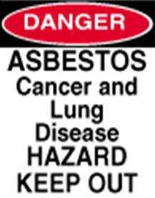
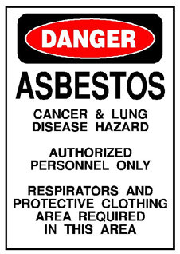
Communication of Hazards
29 CFR 1926.1101(k)
Signs
Warning signs must be used to demarcate regulated areas
Wording for signs:
Additional wording where applicable:
“RESPIRATORS AND PROTECTIVE
CLOTHING ARE REQUIRED IN THIS AREA”

Slide 85
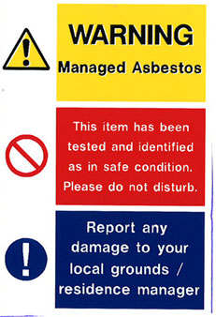
Communication of Hazards
29 CFR 1926.1101(k)
Labels required on:
Products containing asbestos
Containers containing such products, including waste containers
Installed asbestos products, where feasible, including previously installed material identified as ACM/PACM

Slide 86

Communication of Hazards Labels
29 CFR 1926.1101(k)
Exemptions from labeling include:
Products where asbestos fibers have been modified by a bonding agent, coating, binder, or other material, if no concentration of fibers PELs will be produced during any reasonably foreseeable use, handling, etc.
Products where asbestos is < 1.0% by weight
Installed materials where signs providing same information are posted

Slide 87
Communication of Hazards Labels
29 CFR 1926.1101(k)
Wording on labels
Labels must also contain a warning statement against breathing asbestos fibers
DANGER
CONTAINS ASBESTOS FIBERS
AVOID CREATING DUST
CANCER AND LUNG DISEASE HAZARD

Slide 88

Employee Information and Training General Requirements
29 CFR 1926.1101(k)
Provided prior to or at time of initial assignment
Annually
Manner comprehensible to employee

Slide 89
Employee Information and Training Basic Information
29 CFR 1926.1101(k)
How to recognize asbestos, including PACM
Health effects
Relationship between smoking and asbestos in producing lung cancer
Operations that could result in exposure and protective measures and their use, as applicable
For Class III and IV work, information equivalent to the contents of EPA 20T-2003, “Managing Asbestos In-Place”
Purpose, proper use, fitting instructions, and limitations of respirators

Slide 90
Employee Information and Training Basic Information
29 CFR 1926.1101(k)
Appropriate work practices for the job
Medical surveillance program requirements
Content of standard, including appendices
Names, addresses, and phone numbers of public health organizations providing information/materials/programs for smoking cessation
Requirements concerning signs and labels

Slide 91
Employee Information and Training Class I and Class II
29 CFR 1926.1101(k)
Class I Jobs
Equivalent to EPA MAP asbestos abatement worker training
Class II Work
Must include “hands-on” training and specific work practices and engineering controls for the category of materials as well as basic information required for all employees
Class II Work
With asbestos-containing roofing materials, flooring materials, siding materials, ceiling tiles, or transite panels must be at least 8 hours

Slide 92
Employee Information and Training Class III
29 CFR 1926.1101(k)
Consistent with the EPA training course for local education agency maintenance and custodial workers who will disturb ACM or PACM (40 CFR 763.92(a)(2))
Must include “hands-on” training and take at least 16 hours
Exception: If a competent person determines the EPA curriculum is not adequate, training must include the basic information as well as specific applicable work practices and controls and “hands-on “ training

Slide 93
Employee Information and Training Class IV
29 CFR 1926.1101(k)
Consistent with EPA requirements for training local education agency maintenance and custodial workers who contact but do not disturb ACM or PACM
At least 2 hours
Include:
Location of ACM/PACM, asbestos-containing flooring material, or flooring material where absence of asbestos has not been certified
Instruction in recognition of damage, deterioration, and delamination of asbestos-containing building materials
Notes:
(40 CFR 763.92(a)(1))

Slide 94
Employee Information and Training Access
29 CFR 1926.1101(k)
Make available to employees without cost
Written materials relating to training program
Copy of the Standard
NIH Publication No. 89-1647 or equivalent self-help smoking cessation program material
Provide to OSHA and NIOSH upon request all information and training materials

Slide 95

Asbestos in Construction
29 CFR 1926.1101(l)
Scope and application
Definitions
Permissible exposure limits
Multi-employer worksites
Regulated areas
Exposure assessments and monitoring
Methods of compliance
Respiratory protection
Protective clothing
Hygiene facilities
Communication
Housekeeping
Medical surveillance
Recordkeeping
Competent person
Appendices

Slide 96
Notes:
Now let’s discuss the housekeeping requirements of this standard

Slide 97
Housekeeping
29 CFR 1926.1101(l)
Vacuuming
HEPA-filtered equipment
Used and emptied so minimizes reentry of asbestos into workplace
Asbestos waste and contaminated articles consigned for disposal
Collected and disposed of in sealed, labeled, impermeable bags or other containers
Dust and debris in areas containing accessible TSI or surfacing ACM/PACM or visibly deteriorated ACM
No dry sweeping or vacuuming without HEPA filters
Prompt cleanup and disposal in leak-tight containers

Slide 98
Housekeeping
29 CFR 1926.1101(l)
Care of asbestos-containing flooring material
No sanding
Strip finish only with low abrasion pads, speed < 300 rpm, and wet methods
Burning or dry buffing only on flooring with sufficient finish so pad cannot contact flooring material

Slide 99

Asbestos in Construction
29 CFR 1926.1101(m)
Scope and application
Definitions
Permissible exposure limits
Multi-employer worksites
Regulated areas
Exposure assessments and monitoring
Methods of compliance
Respiratory protection
Protective clothing
Hygiene facilities
Communication
Housekeeping
Medical surveillance
Recordkeeping
Competent person
Appendices

Slide 100
29 CFR 1926.1101(m)
Notes:
Medical surveillance under paragraph (m)

Slide 101
Medical Surveillance Employees Covered
29 CFR 1926.1101(m)(1)
Class I, II and III work for a combined total of 30 or more days/year
Exposed ≥ PELs for total of 30 days/year
Days of Class II or III work where the work is 1 hour or less and other work practices are required by the standard are complied with, do not count in the total Employees
Otherwise required to wear negative pressure respirators by this standard must have this use approved by a physician

Slide 102

Medical Surveillance Examination
29 CFR 1926.1101(m)(1)
By or under the supervision of a licensed physician
No cost to the employee
Reasonable time and place
PFTs administered by:
Licensed physician or
Person who has completed a training course in spirometry sponsored by an appropriate academic or professional institution
Notes:
PFTs = pulmonary function tests

Slide 103

Medical Surveillance Examinations and Consultations
29 CFR 1926.1101(m)(1)
Prior to assignment to an area where negative-pressure respirators are worn
Within 10 working days of the 30th day of exposure, within one year, for employees
Engaged in Class I, II, and/or III work
Annually thereafter
More frequently when recommended by the physician
Exception:
No examination required if examined within past 1-year period

Slide 104

Medical Surveillance Content
29 CFR 1926.1101(m)(1)
Medical and work history (special emphasis to pulmonary, cardiovascular, and gastrointestinal systems
Standardized questionnaires
Initial examination: Appendix D, Part 1
Annual examinations: Appendix D, Part 2
Physical examination directed to pulmonary and gastrointestinal systems
Chest X-ray (physician’s discretion)
Pulmonary
FVC
FEV(1)
Other examinations/tests as ordered by physician
Notes:
c/v = cardiovascular
g/I = gastrointestinal

Slide 105

Medical Surveillance Information Provided to Physician
29 CFR 1926.1101(m)(1)
Copy of the standard and Appendices D, E, and I
Description of employee’s duties relative to exposure
Representative exposure level or anticipated exposure level
Description of PPE and respirators used
Information from previous medical examinations

Slide 106
Medical Surveillance Physician’s Written Opinion
29 CFR 1926.1101(m)(1)
Content
Results of medical examination
Whether employee has any medical conditions that would increase risk of impairment from exposure to asbestos
Recommended limitations on employee or on use of PPE (e.g., respirators)
Statement that physician has informed employee of exam results and of any medical conditions that may result from asbestos exposure
Statement that employee has been informed of increased risk of lung cancer due to smoking and asbestos exposure

Slide 107

Medical Surveillance Physician’s Written Opinion
29 CFR 1926.1101(m)(1)
May not include findings or diagnoses unrelated to occupational exposure to asbestos
Must be provided by employer to employee within 30 days of receipt

Slide 108

Asbestos in Construction
29 CFR 1926.1101(n)
Scope and application
Definitions
Permissible exposure limits
Multi-employer worksites
Regulated areas
Exposure assessments and monitoring
Methods of compliance
Respiratory protection
Protective clothing
Hygiene facilities
Communication
Housekeeping
Medical surveillance
Recordkeeping
Competent person
Appendices

Slide 109

Recordkeeping Exposure Measurements
29 CFR 1926.1101(n)
Record must include:
Date of measurement
Operation being monitored
Sampling and analytical methods used and
evidence of their accuracy
Number, duration, and results of samples
Type of protective devices worn
Name, social security number, and exposure of employees whose exposures are represented
Record must be maintained for at least 30 years
Employer may have records maintained by industry trade and employee associations

Slide 110

Recordkeeping Objective Data
29 CFR 1926.1101(n)
Record must include:
Product qualifying for exemption
Source of the objective data
Testing protocol, results of testing, and/or analysis of material for the release of asbestos
Description of operation exempted and how data support exemption
Other data relevant to operations, materials, processing, or employee exposures covered by exemption
Record must be maintained for duration of reliance upon the objective data

Slide 111

Recordkeeping Medical Surveillance
29 CFR 1926.1101(n)
Record must include:
Employee’s name and SSN
Copy of employee’s medical exam results
Physician’s written opinions
Employee medical complaints related to exposure to asbestos
Copy of information provided to physician
Maintained for employment + 30 years
Exam Results

Slide 112
Recordkeeping Other Records
29 CFR 1926.1101(n)
Training records
Must be maintained for 1 year beyond last date of employment by that employer
Data to rebut PACM
Kept for duration used to rebut presumption
Records of required notifications
Must be maintained by building owner for duration of ownership and must be transferred to successive owners

Slide 113
Recordkeeping Records Availability and Transfer
29 CFR 1926.1101(n)
Upon written request, all records are available to OSHA and NIOSH for examination and copying
Upon request, exposure records are available to employees, former employees, designated representatives, and OSHA for examination and copying
Upon request, employee medical records are available to the subject employee, anyone having the employee’s written consent, and OSHA for examination and copying
29 CFR 1910.1020(h) governs transfer of records
When an employer ceases business without a successor employer, the employer must notify NIOSH 90 days before disposal of records and transmit them to NIOSH if requested

Slide 114

Asbestos in Construction
29 CFR 1926.1101(o)
Scope and application
Definitions
Permissible exposure limits
Multi-employer worksites
Regulated areas
Exposure assessments and monitoring
Methods of compliance
Respiratory protection
Protective clothing
Hygiene facilities
Communication
Housekeeping
Medical surveillance
Recordkeeping
Competent person
Appendices

Slide 115
Competent Person General
29 CFR 1926.1101(o)
“On all construction worksites covered by this standard, the employer shall designate a competent person, having the qualifications and authorities for ensuring worker safety and health required by Subpart C, General Safety and Health Provisions for Construction (29 CFR 1926.20 through 1926.32).”

Slide 116

Competent Person Frequency of Inspections
29 CFR 1926.1101(o)
Required inspections - frequent and regular inspections of job sites, materials, and equipment
Additional inspections
Class I jobs
At least once during each work shift
At any time at employee request
Class II, III, and IV jobs
At intervals sufficient to assess whether
conditions have changed
At any reasonable time at employee
request

Slide 117
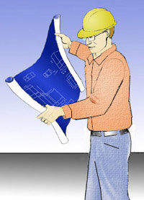
Competent Person Duties
29 CFR 1926.1101(o)
Class I or II jobs, perform or supervise
Set up of regulated area, enclosure, or other containment
Ensuring integrity of enclosure or containment
Set up of procedures to control entry to and exit from the enclosure and/or area
Supervision of employee exposure monitoring
Ensuring that employees working within enclosure
and/or using glove bags wear required protective
clothing and respirators

Slide 118

Competent Person Duties
29 CFR 1926.1101(o)
Ensure employees set up remove/engineering controls, and use work practices and PPE as required
Ensure employees use hygiene facilities and decontamination procedures as required
Ensure engineering controls are functioning properly and employees are using proper work practices
Ensure notification requirements are met

Slide 119

Competent Person Training Class I and II
29 CFR 1926.1101(o)
Comprehensive course for supervisors meeting criteria of EPA MAP (40 CFR 763, subpart E, Appendix C) for stringency, content, and length
Contents - all aspects of asbestos removal and handling
Abatement, installation, removal, and handling
Contents of the standard
Identification of asbestos
Removal procedures
Other practices for reducing the hazard

Slide 120
Competent Person Training Class III and IV
29 CFR 1926.1101(o)
Contents - aspects of asbestos handling appropriate to the work
Procedures for setting up glove bags and mini-enclosures
Practices for reducing asbestos exposures
Use of wet methods
Contents of the standard
Identification of asbestos
Equivalent in stringency, content, and length to EPA requirements for training local education agency maintenance and custodial workers (40 CFR 763.92(a)(2))

Slide 121

Asbestos in Construction
29 CFR 1926.1101(p)
Scope and application
Definitions
Permissible exposure limits
Multi-employer worksites
Regulated areas
Exposure assessments and monitoring
Methods of compliance
Respiratory protection
Protective clothing
Hygiene facilities
Communication
Housekeeping
Medical surveillance
Recordkeeping
Competent person
Appendices

Slide 122

Appendices
29 CFR 1926.1101(p)
Mandatory
A - OSHA Reference Method
C - Qualitative and Quantitative Fit Testing Procedures
D - Medical Questionnaires
E - Interpretation and Classification of Chest Roentgenograms
Non-Mandatory
B - Sampling and Analysis
F - Work Practices and Engineering Controls for Class I Asbestos
Operations
H - Substance Technical Information for Asbestos
I - Medical Surveillance Guidelines for Asbestos
J - Smoking Cessation Program Information for Asbestos
K - Polarized Light Microscopy of Asbestos
Reserved
G

Slide 123

Asbestos in General Industry
29 CFR 1910.1001
Scope and application
Definitions
Permissible exposure limits
Exposure monitoring
Regulated areas
Methods of compliance
Respiratory protection
Protective work clothing and equipment
Hygiene facilities and practices
Communication of hazards
Housekeeping
Medical surveillance
Recordkeeping
Observations of monitoring
Dates
Appendices

Slide 124

Methods of Compliance Engineering and Work Practice Controls
Implemented to reduce < PEL
Particular operations
Coupling cut-off in 1° asbestos cement pipe mfg.
Sanding in 1° and 2° asbestos cement sheet mfg.
Grinding in 1° and 2° friction product mfg.
Carding and spinning in dry textile products
Grinding and sanding in 1° plastics mfg.
Notes:
When eng. ctls. & work practices not sufficient to bring below PELs, must implement to bring to or below 0.5 f/cc or 2.5 f/cc (EL) and supplement w/ respirators

Slide 125
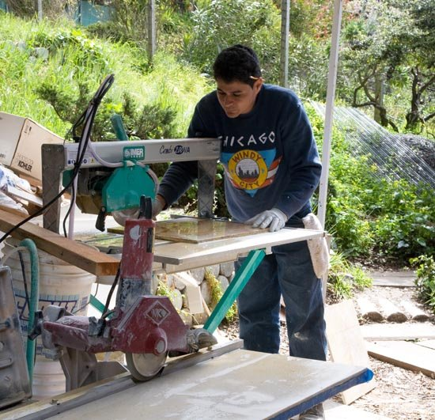
Methods of Compliance Particular Tools
All hand-operated and power-operated tools which would produce or release fibers of asbestos equipped with LEV
Examples:
Saws
Scorers
Abrasive wheels
Drills

Slide 126

Methods of Compliance Engineering and Work Practice Controls
Wet methods
Particular products and operations
Compressed air
Flooring
Written compliance plan
Brake and clutch repair
Notes:
Wet methods of handling, mixing, applying, removing, cutting or scoring of asbestos material.
Particular products & operations: No asbestos cement, mortar, coating, grout, plaster, or similar material containing asbestos, shall be removed from bags, cartons, or other containers in which they are shipped, without being either wetted, or enclosed, or ventilated so as to prevent effectively the release of airborne fibers.
Compressed air cannot be used w/o point of capture LEV
Sanding of ACM flooring prohibited
Specific work practices for asbestos brake and clutch repair

Slide 127

Communication of Hazards
Installed ACM (< 1980)
Examples:
TSI, SM
Asphalt/vinyl flooring
Employers
Building and facility owners
Warning labels
Notes:
Warning signs must be posted at entrance to mechanical rooms/areas where ACM or PACM present

Slide 128
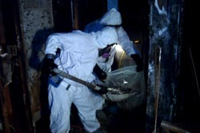
Communication of Hazards
Warning signs
MSDS
Employee information and training
Initial
Annual
Criteria to rebut PACM
Notes:
Warning signs must be posted at entrance to mechanical rooms/areas where ACM or PACM present

Slide 129
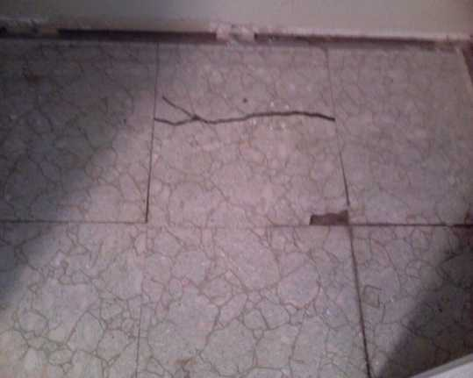
Housekeeping
Care and maintenance of asbestos flooring
Sanding of ACM flooring prohibited
Stripping of finishes
Low abrasion pads
< 300 rpm
Wet methods
Burnishing or dry buffing only on
floors with sufficient finish

Slide 130
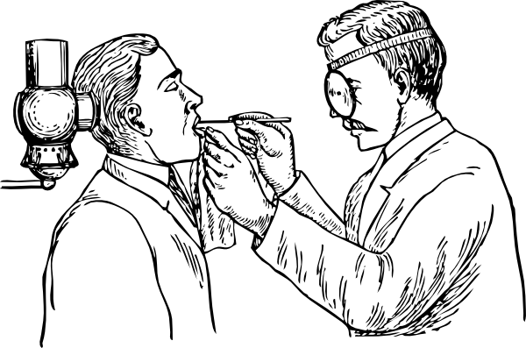
Medical Surveillance
Pre-placement examination
Periodic (annual) examination
Termination of employment examination
Notes:
Termination exam if exposed at or above TWA and/or EL

Slide 131

Recordkeeping
Exposure measurements
30 yrs
Objective data
Period of reliance
Medical surveillance
Employment + 30 yrs
Training records
1 yr beyond last employment date

Slide 132
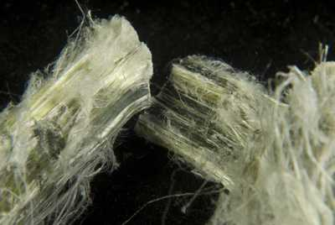
Appendices
A, D, E and F – Mandatory
B, G, H, I and J – Informational

Slide 133

Thank You For Attending!
Final Questions?
1-800-NC-LABOR
(1-800-625-2267)
www.nclabor.com

