Slide 1
Top 10 Most Frequently Cited Serious Violations in FFY 2021
General Industry
Presented by: ETTA, OSH Division, 919-707-7876
Notes:
Revised: 04/22
The information in this presentation is provided voluntarily by the N.C. Department of Labor, Education Training and Technical Assistance Bureau as a public service and is made available in good faith. This presentation is designed to assist trainers conducting OSHA outreach training for workers. Since workers are the target audience, this presentation emphasizes hazard identification, avoidance, and control – not standards. No attempt has been made to treat the topic exhaustively. It is essential that trainers tailor their presentations to the needs and understanding of their audience.
The information and advice provided on this Site and on Linked Sites is provided solely on the basis that users will be responsible for making their own assessment of the matters discussed herein and are advised to verify all relevant representations, statements, and information.
This presentation is not a substitute for any of the provisions of the Occupational Safety and Health Act of North Carolina or for any standards issued by the N.C. Department of Labor. Mention of trade names, commercial products, or organizations does not imply endorsement by the N.C. Department of Labor.

Slide 2
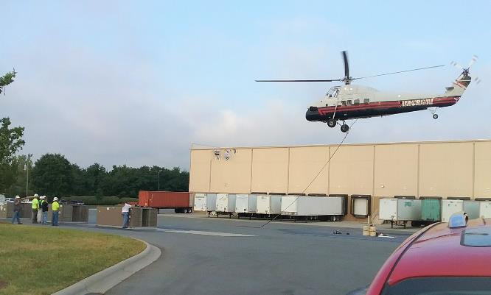
Objectives
In this course, we will discuss the Top Ten cited serious violations in General Industry for federal fiscal year (FFY) 2021.
- The Top Ten list includes data about citations issued 10/01/20 through 9/30/21 in North Carolina.
NCDOL Photo Library
Notes:
NCDOL Photo Library: NCDOL Employee Robert O’Neal provided by Bonded Logistics Charlotte – 10/23/17, Permission Letter Obtained – Photo identifies a helicopter lifting replacement HVAC (Heating, Ventilation, and Air Conditioning) units on to the top of this roof.
The company decided to use a helicopter instead of a crane. The helicopter was half the cost of using a crane! No violations are found in this photo.
Ask the class! Are there any standards that covers the use of a helicopters? Yes, 29 CFR 1910.183 Subpart N - Materials Handling and Storage – Helicopters.

Slide 3
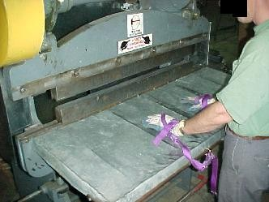
Machine Guarding
1910.212(a)(1)
Number 1: General Requirements
  One or more methods of machine guarding must be provided to protect the operator and other employees in the machine area from hazards:
    Point of operation
    Ingoing nip points
    Rotating parts
    Flying chips and sparks
NCDOL Photo Library
Notes:
3
NCDOL Photo Library: OSHA Region 4 Photo Archive CD V1.0 (NCDOL has received written permission) – Photo identifies an employee using hand restraints to protect them from putting his hands in to the point of operation for this shear cutter.
This standard is cited when a SERIOUS machine guarding hazard exists for which an OSH specific requirement is not yet written.
Types of guarding.
One or more methods of machine guarding shall be provided to protect the operator and other employees in the machine area from hazards such as those created by point of operation, in-going nip points, rotating parts, flying chips and sparks.
Examples of guarding methods are barrier guards, two-hand tripping devices, electronic safety devices, etc.

Slide 4
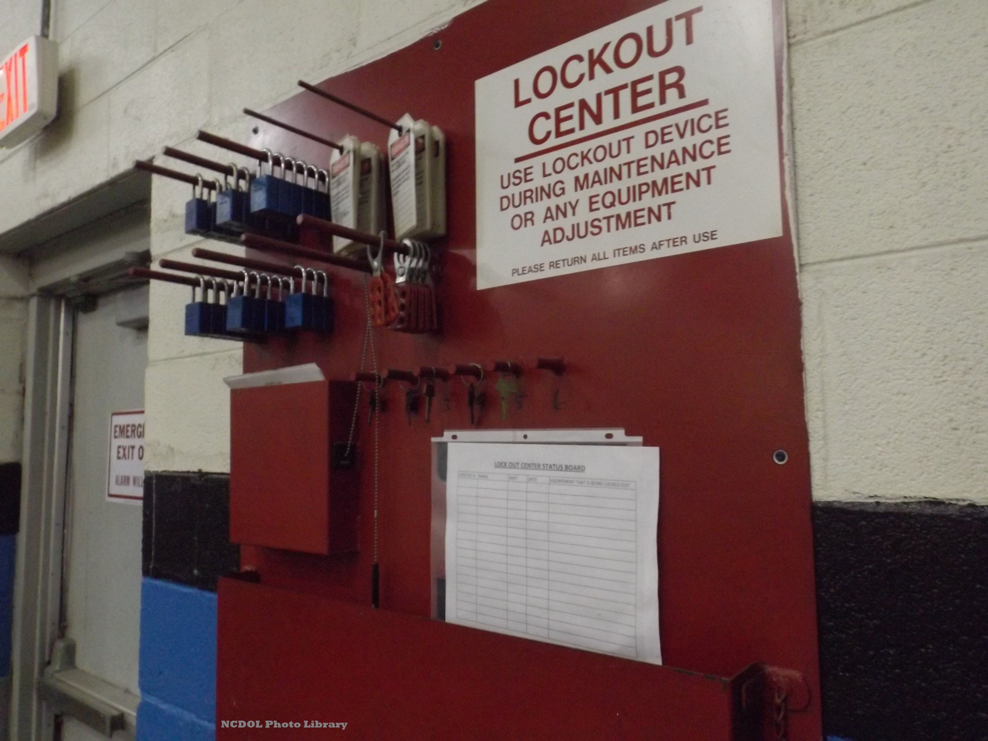
Lockout/Tagout
1910.147(c)(4)(i)
Number 2: Energy Control Procedures
  Procedures shall be developed, documented and utilized for the control of potentially hazardous energy when employees are engaged in the activities covered by this section.
Notes:
NCDOL Photo Library: Access Closed case file: #317714512 – Photo identifies Lock/Tagout Center where they maintain Energy control procedures for the facility.
Procedures shall be developed, documented and utilized for the control of potentially hazardous energy when employees are engaged in the activities covered by this section.
Note: Exception: The employer need not document the required procedure for a particular machine or equipment, when all of the following elements exist:
The machine or equipment has no potential for stored or residual energy or reaccumulating of stored energy after shut down which could endanger employees;
the machine or equipment has a single energy source which can be readily identified and isolated;
the isolation and locking out of that energy source will completely deenergize and deactivate the machine or equipment;
the machine or equipment is isolated from that energy source and locked out during servicing or maintenance;
a single lockout device will achieve a locked-out condition;
the lockout device is under the exclusive control of the authorized employee performing the servicing or maintenance;
the servicing or maintenance does not create hazards for other employees; and
the employer, in utilizing this exception, has had no accidents involving the unexpected activation or reenergization of the machine or equipment during servicing or maintenance.
1910.147(c)(4)(ii)The procedures shall clearly and specifically outline the scope, purpose, authorization, rules, and techniques to be utilized for the control of hazardous energy, and the means to enforce compliance including, but not limited to, the following:
1910.147(c)(4)(ii)(A) - A specific statement of the intended use of the procedure;
1910.147(c)(4)(ii)(B) - Specific procedural steps for shutting down, isolating, blocking and securing machines or equipment to control hazardous energy;
1910.147(c)(4)(ii)(C) - Specific procedural steps for the placement, removal and transfer of lockout devices or tagout devices and the responsibility for them; and
1910.147(c)(4)(ii)(D) - Specific requirements for testing a machine or equipment to determine and verify the effectiveness of lockout devices, tagout devices, and other energy control measures.

Slide 5
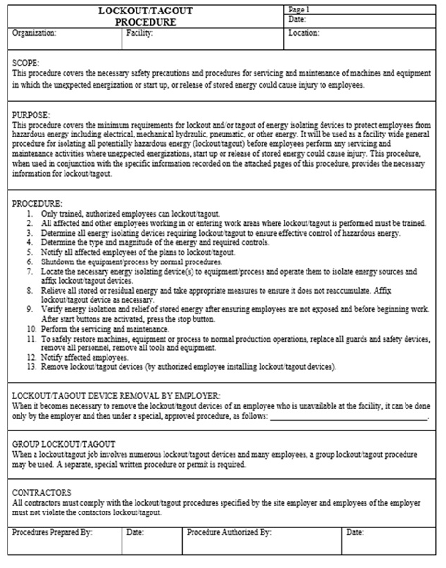
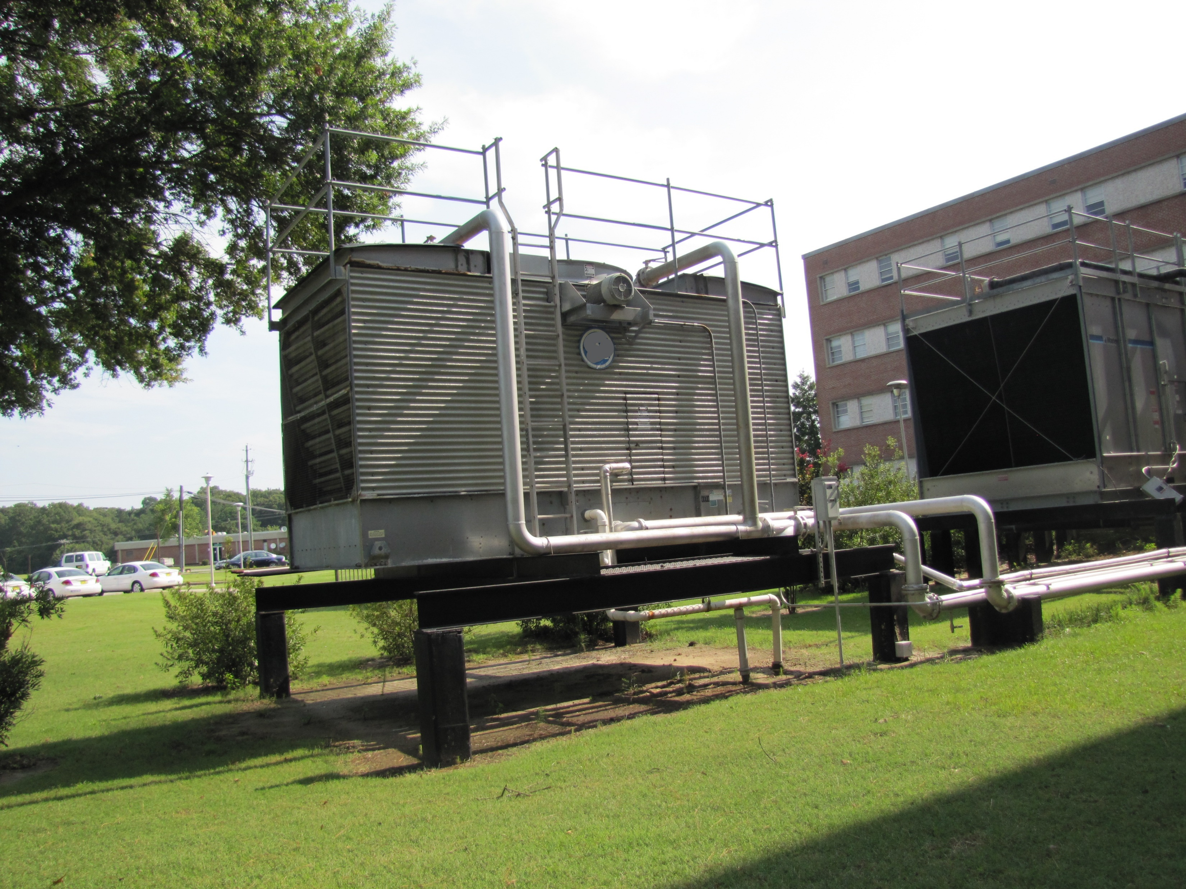
Lockout/Tagout
1910.147(c)(6)(i)
Number 3: Periodic Inspection
  Employers are required to conduct an inspection of energy control procedures at least annually.
NCDOL Photo Library
NCDOL Photo Library
NCDOL Photo Library
NCDOL Photo Library
Notes:
Left Photo: NCDOL Employee Robert O’Neal – Staged – 3/17/2018 - Photo identifies a written lockout/tagout program from our sample programs located on our website.
Right Photo: NCDOL Photo Library: NCDOL Employee Robert O’Neal – Starr Electrical Company – 4/26/18, Permission Letter Obtained – Photo identifies a cooling tower that will require specific procedures due to several different sources of energy.
In the Photo: a cooling tower
Ask the class: What are the different sources of energy? Electrical, mechanical and pressurized water/coolant.

Slide 6
N.C. General Duty Clause
NCGS 95-129(1)
Number 4: N.C. General Duty Clause (GDC)
  Elements necessary for a GDC violation:
    Hazard to which employees were exposed.
    Recognized hazard in the industry.
    Hazard was causing or likely to cause. death or serious injury or physical harm.
    There is a feasible and useful method to correct the hazard.
NCDOL Photo Library
North Carolina General Statutes (NCGS)
Notes:
Ask the class: What are the hazards of doing this type of job task? Mini-excavators are not meant to be loaded in the back of these types of trucks. Dump trucks are not designed to have equipment loaded as noted in this example. They also do not have the correct tie down points “inside the beds.” Employers should never load equipment on trailers that were design for earth moving construction equipment. Equipment trailers will have the correct type of tie downs straps and anchor points as required by NCDOT.
Definition of the General Duty Clause
A statement within the OSH Act providing a requirement that employers furnish employment and places of employment which are free from recognized hazards to the health and safety of their employees. The clause covers situations for which there is no specific standard.
N.C. General Duty Clause: Each employer shall furnish to each of his employees conditions of employment and a place of employment free from recognized hazards that are causing or likely to cause death or serious injury or serious physical harm to his employees.
Conditions required to cite this standard:
1) a hazard to which employees were exposed
2) recognized hazard in the industry
3) hazard was causing or likely to cause death or serious injury or harm
4) there is a feasible and useful method to correct the hazard.

Slide 7
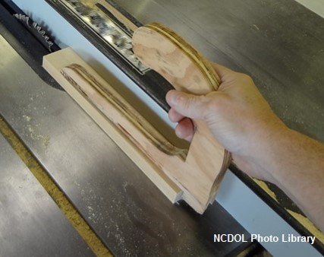
Machine Guarding
1910.212(a)(3)(ii)
Number 5: Point of operation guarding
  The point of operation of machines whose operation expose employees to injury, shall be guarded.
Notes:
NCDOL Photo Library: NC Department of Transportation 07-22-15 Partnership Site, Permission Letter Obtained, Tom Wilder – Photo shows a homemade push stick that keeps the proximity of danger away from the operator's hands.
Ask the class what other types of tools can be used to help prevent hazards when handling material in close proximity to rotating parts.
There are different types of push sticks, and push blocks of all shapes and sizes that can be found at your local hardware stores.
1910.212(a)(3)(ii) The point of operation of machines whose operation expose employees to injury, shall be guarded. The guarding device shall be in conformity with any appropriate standards therefore, or, in the absence of applicable specific standards, shall be so designed and constructed as to prevent the operator from having any part of his body in the danger zone during the operating cycle.

Slide 8
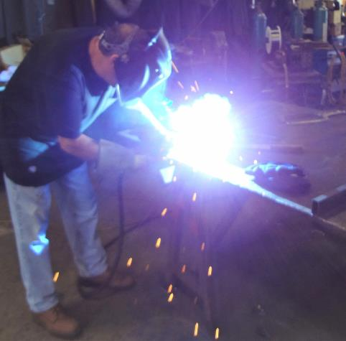
Personal Protective Equipment
1910.133(a)(1)
Number 6: Eye and Face Protection – General Requirements
  Use appropriate eye or face protection when exposed to eye or face hazards.
    Hazards from flying particles
    Molten metal
    Liquid chemicals
    Acids or caustic liquids
    Chemical gases or vapors
    Potentially injurious light radiation
NCDOL Photo Library
Notes:
Slide 1 of 2: PPE 1910.133(a)(1)
NCDOL Photo Library: Taken by NCDOL Employee Robert O’Neal - NC Department of Transportation 07-07-15, Permission Letter Obtained – Photo identifies an employee not using PPE for the protection of his arm or neck areas from the harmful exposure of ultraviolet radiation (UV) radiation.
Welding arcs and flames emit intense visible, ultraviolet, and infrared radiation so employees must protect themselves from these type of radiation.
Long-term exposure to UV radiation can cause skin cancer.
The UV in a welding arc will burn unprotected skin just like UV radiation in sunlight. Burns are the most common injury to welders due to sparks landing on the skin.
Welding arcs are very intense and can cause burns to skin and eyes with just a few minutes of exposure.

Slide 9
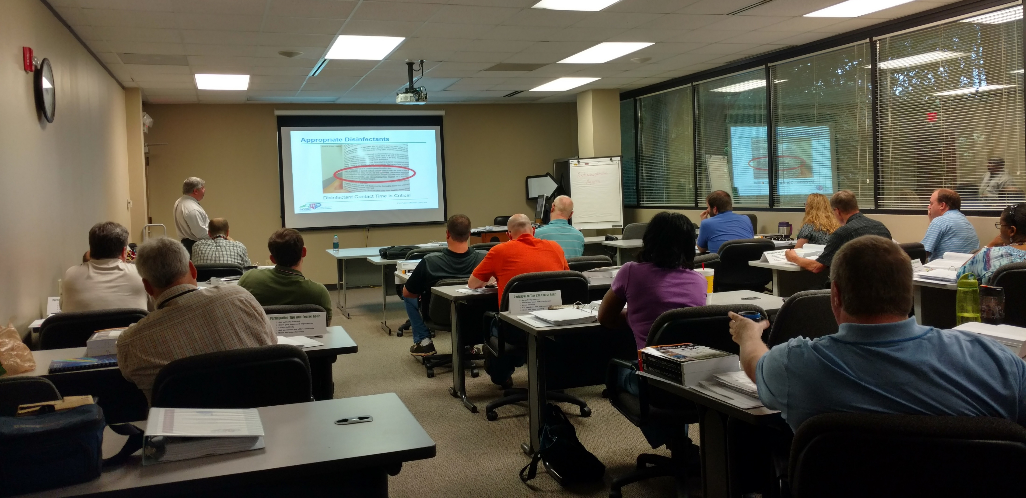
Lockout/Tagout 1910.147(c)(7)(i)(A)
Number 7: Training and Communication
- Each authorized employee shall receive training in the recognition of applicable hazardous energy sources, the type and magnitude of the energy available in the workplace, and the methods and means necessary for the energy isolation and control.
Notes:
NCDOL Photo Library: Taken by NCDOL Employee James Washington on 8/3/2016 during the OSHA 125 Class Lake Boone Trail
The class should understand that in order to meet the requirements of the standard that all training shall be conducted prior to exposing the employee to the hazard.
Each authorized employee shall receive training in the recognition of applicable hazardous energy sources, the type and magnitude of the energy available in the workplace, and the methods and means necessary for energy isolation and control.

Slide 10
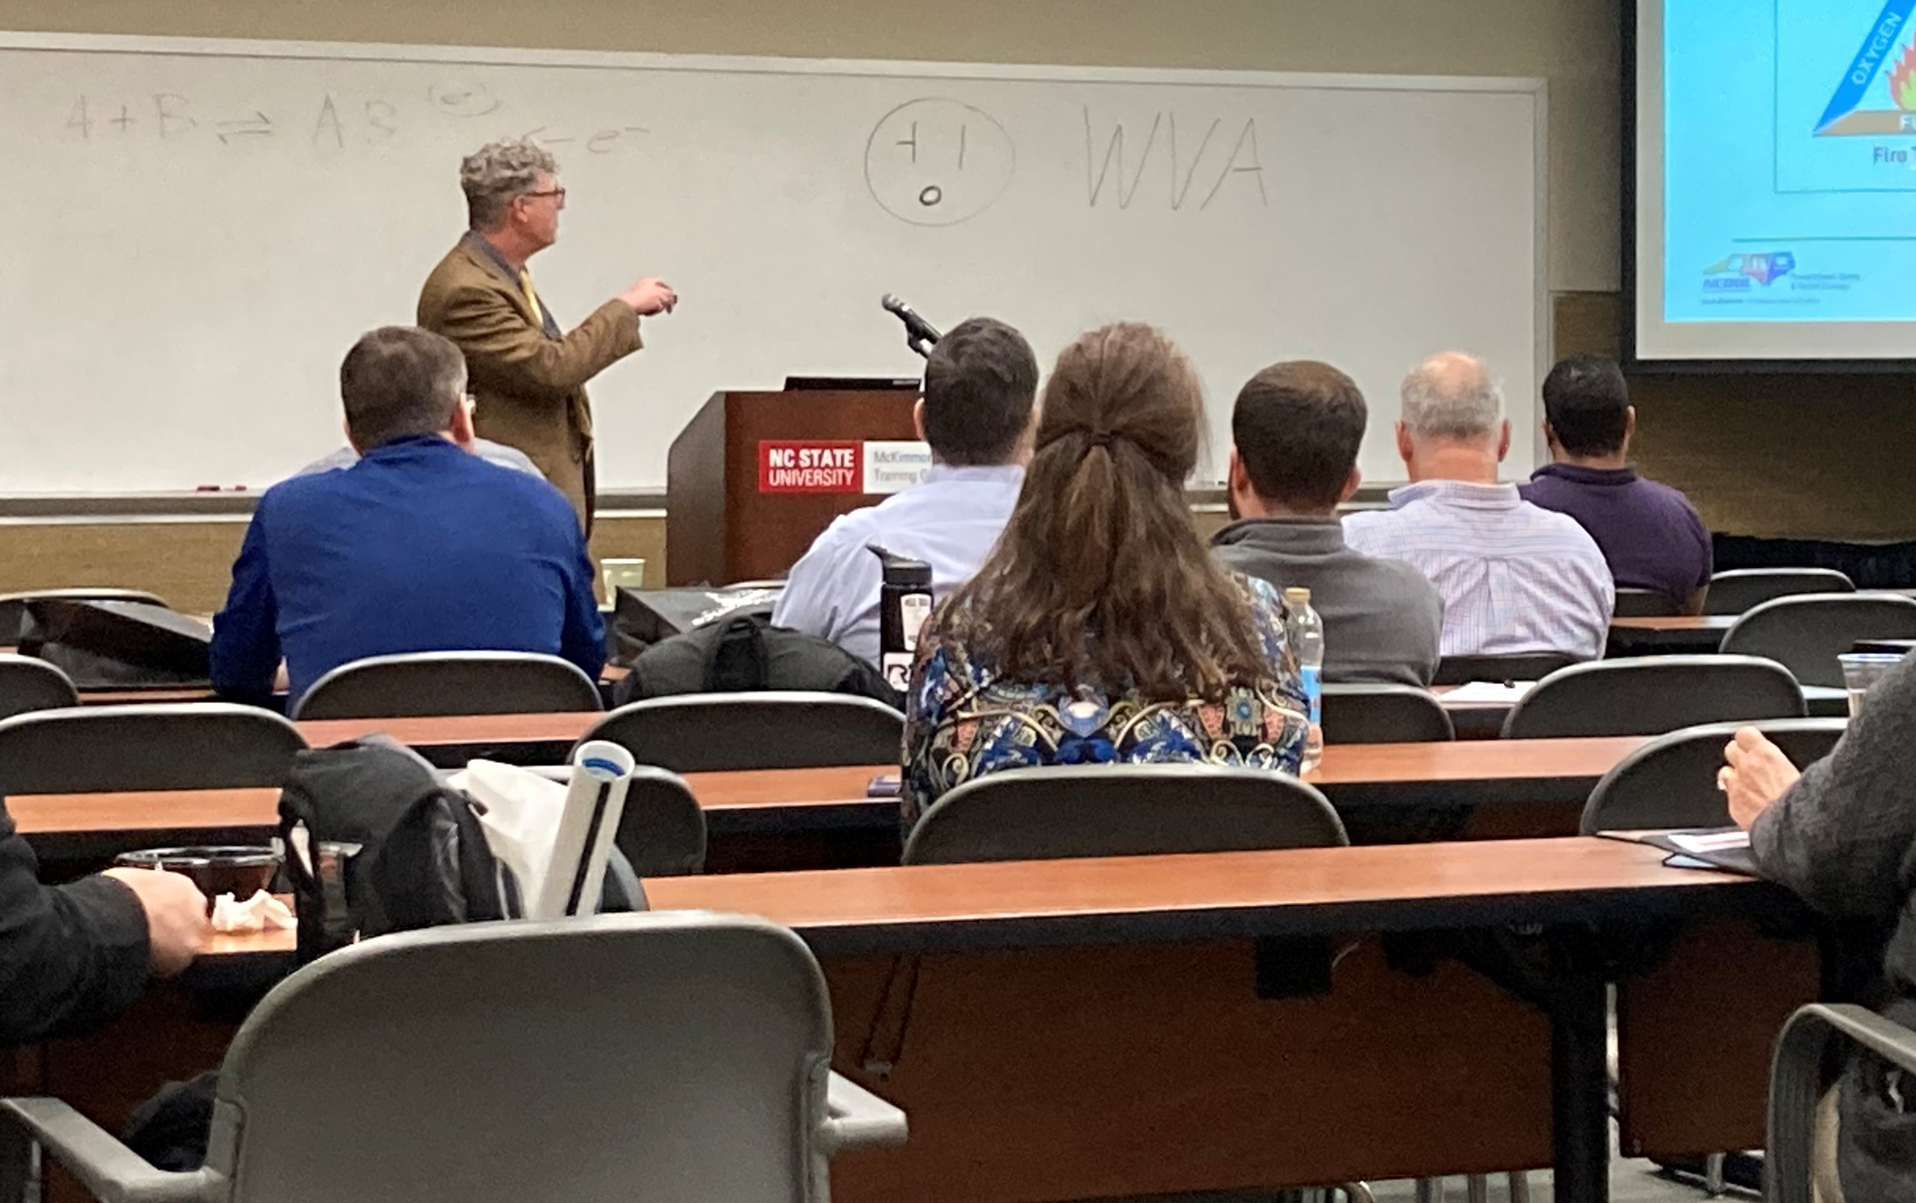
Hazard Communication 1910.1200(h)(1)
Number 8: Employee Information and Training
  Employers shall provide employees with effective information and training on hazardous chemicals in their work area:
    At the time of their initial assignment.
    Whenever a new physical or health hazard is introduced into their work area.
Notes:
NCDOL Photo Library: Taken by NCDOL Employee Wanda Lagoe of Andy Sterlen at the 2022 Best Conference.
Employers shall provide employees with effective information and training on hazardous chemicals in their work area at the time of their initial assignment, and whenever a new physical or health hazard the employees have not previously been trained about is introduced into their work area. Information and training may be designed to cover categories of hazards (e.g., flammability, carcinogenicity) or specific chemicals. Chemical-specific information must always be available through labels and safety data sheets.
While the standard does not state that annual, refresher or periodic training is required, employers should observe that employees must retain the information learned and that some continual training is expected. It is the employer’s responsibility to ensure that employees are adequately trained and equipped with the necessary knowledge.
Training can be conducted on each specific chemical or by categories (e.g., carcinogens, sensitizer, toxic agents) that are or may be encountered by employee during the course of his duties. Chemical specific information must always be available through labels and SDSs.
IAW Appendix A of the CPL 02-02-038 “The training provisions of this standard are not satisfied solely by giving employee the data sheets to read. An employer’s training program is to be a forum for explaining to employees not only the hazards of the chemicals in their work area, but also how to use the information generated the HAZCOM program. This can be accomplished in many ways (audiovisuals, classroom instruction, interactive video), and should include an opportunity for employees to ask questions to ensure that they understand the information presented to them. Furthermore, the training must be comprehensible. If the employees receive job instructions in a language other than English, then the training and information to be conveyed under this standard will also need to be conducted in a foreign language.”

Slide 11
Fall Protection 1910.28(b)(1)(i)
Number 9: Duty to have Fall Protection
  Except as provided elsewhere in this section, the employer must ensure that each employee on a walking-working surface with an unprotected side or edge that is 4 feet (1.2 m) or more above a lower level is protected from falling by one or more of the following:
  (A) Guardrail systems;
  (B) Safety net systems; or
  (C) Personal fall protection systems: personal fall
  arrest, travel restraint, or positioning systems.
Notes:
1926.501(a)
"General."
1926.501(a)(1)
This section sets forth requirements for employers to provide fall protection systems. All fall protection required by this section shall conform to the criteria set forth in 1926.502 of this subpart.
1926.501(a)(2)
The employer shall determine if the walking/working surfaces on which its employees are to work have the strength and structural integrity to support employees safely. Employees shall be allowed to work on those surfaces only when the surfaces have the requisite strength and structural integrity.
NOTE: The standard reference number is at the top right hand corner of many slides in this presentation. This is a quick reference for you to go directly to that number in the construction industry standards book.
As we saw in our previous slide, the duty to have fall protection in construction begins at the 6 foot level.
Walking/working surfaces must be inspected before work begins and they must be strong enough to support the weight of the employees and equipment that they are using.

Slide 12
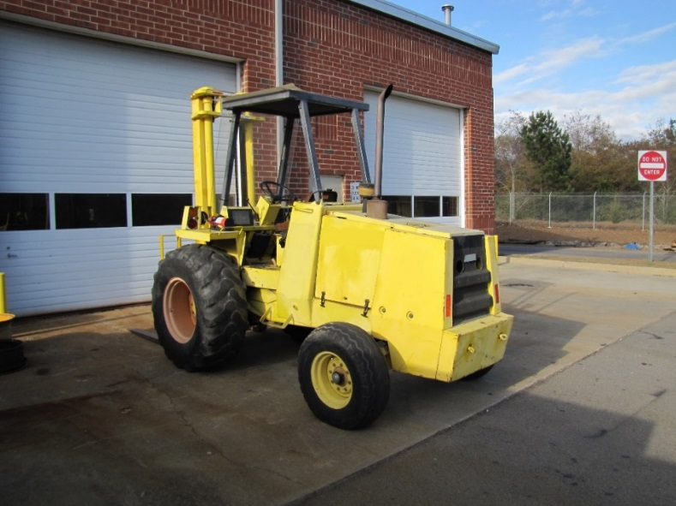
Powered Industrial Trucks 1910.178(I)(1)(i)
Number 10: Operator Training
  Employer shall ensure that each powered industrial truck operator is competent to operate a powered industrial truck safely.
Notes:
NCDOL Photo Library: Closed Case file #317355600
1910.178(l)(1)
Safe operation.
1910.178(l)(1)(i)
The employer shall ensure that each powered industrial truck operator is competent to operate a powered industrial truck safely, as demonstrated by the successful completion of the training and evaluation specified in this paragraph (l).
1910.178(l)(1)(ii)
Prior to permitting an employee to operate a powered industrial truck (except for training purposes), the employer shall ensure that each operator has successfully completed the training required by this paragraph (l), except as permitted by paragraph (l)(5).

Slide 13
Hazard Recognition in General Industry

Slide 14
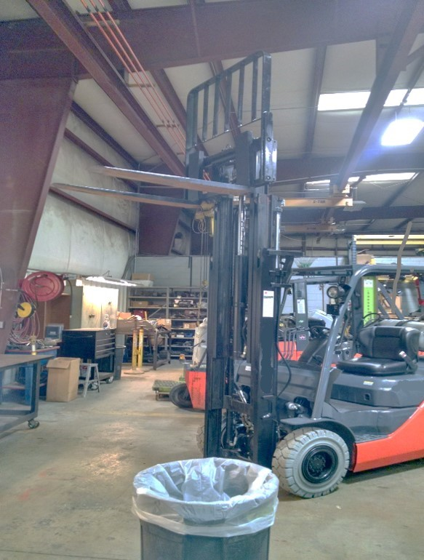
Hazard Recognition
Struck-by hazards
NCDOL Photo Library
Notes:
NCDOL Photo Library: Photo taken by NCDOL Employee Robert O’Neal – Southeast Industrial Equipment, Permission Letter Obtained – 9/22/2016 - Photo identifies a forklift carriage being suspended in the air while work was being performed on it. This was staged to identify hazards whenever this type of work is being preformed.
Ask the class: What are the hazards? Struck-by hazard!
Carriage can fall striking an employee. The overhead crane should have been used to support the carriage while work was being preformed.

Slide 15
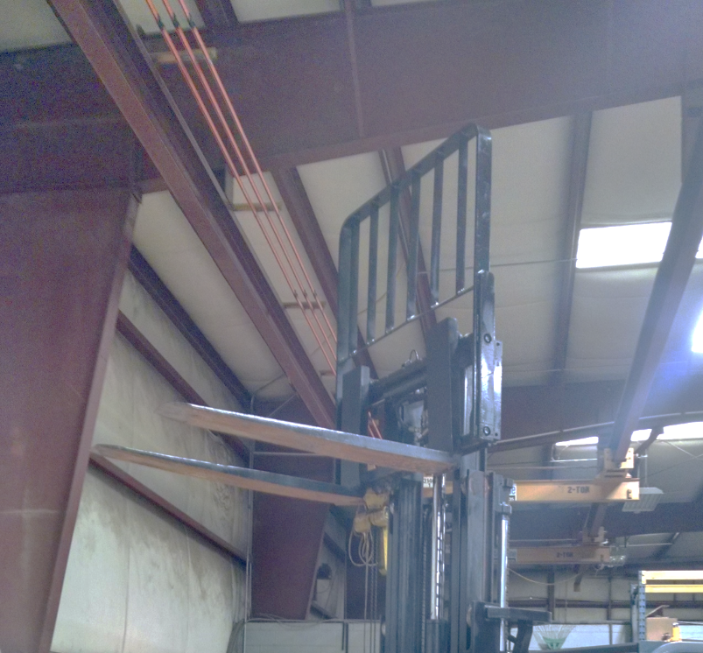
Hazard Recognition
Electrical hazards
Overhead crane
NCDOL Photo Library
Notes:
NCDOL Photo Library: Photo taken by NCDOL Employee Robert O’Neal – Southeast Industrial Equipment, Permission Letter Obtained – 9/22/2016 - Photo identifies a forklift carriage being suspended in the air while work was being performed on it. This was staged to identify hazards whenever this type of work was preformed.
Ask the class: What are the hazards now? Electrical hazard!
Point out the copper lines at the left and top edge of the photo. These are high voltage power lines (three-phase) supplying power to the overhead crane in the back of the shop. There are no protection to prevent accidental contact with them. Whenever, the carriage was raised to this height inside the shop it can easy to contact with the voltage supply lines.

Slide 16
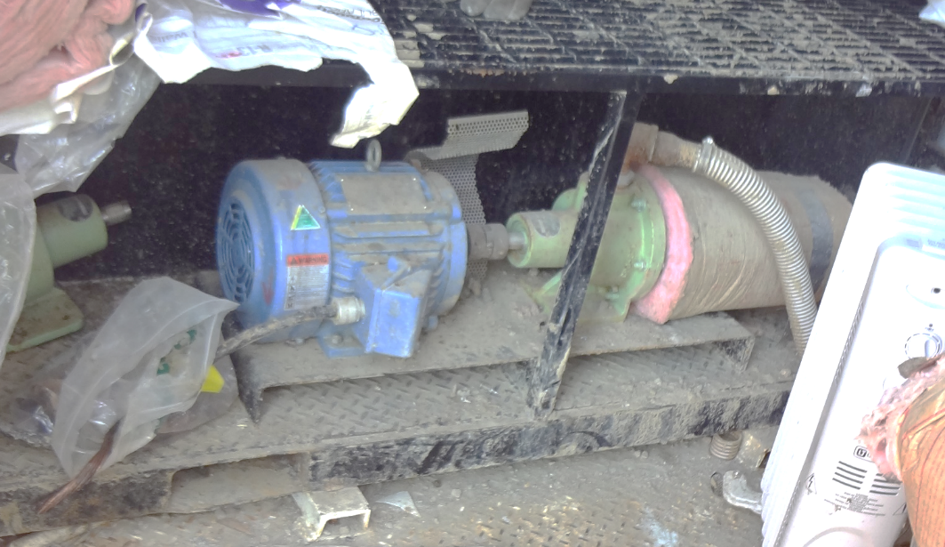
Hazard Recognition
Caught-in hazards
NCDOL Photo Library
Notes:
A close-up view of photo.
NCDOL Photo Library: Closed case file: 316706936 - Photo identifies an open rotating shaft where the guard was removed. The rotating shaft can catch an employees clothing and pull him/her into it. In this case the guard covering the shaft was removed exposing employees to this hazard.
Rotating motion can be dangerous; even smooth, slowly rotating shafts can grip clothing, and through mere skin contact force an arm or hand into a dangerous position. Injuries due to contact with rotating parts can be severe.

Slide 17
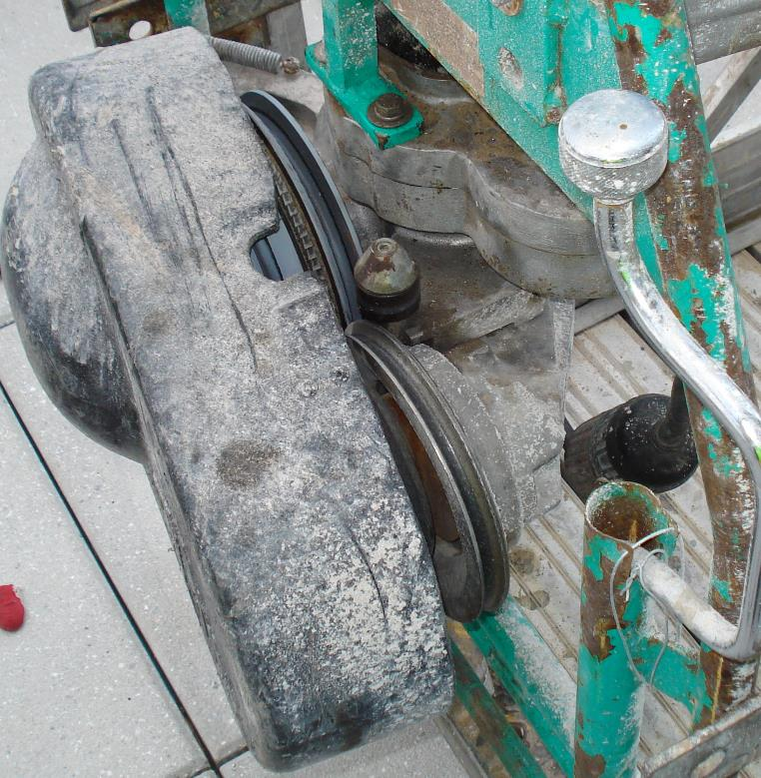
Hazard Recognition
Caught-in hazards
NCDOL Photo Library
NCDOL Photo Library
Notes:
A close-up view of photo.
NCDOL Photo Library: Photo taken by NCDOL Employee Robert O’Neal, Public Access – New Credit Union Sidewalk/Window Cleaners – 7/2/2014 - Photo identifies an exposed belt and gear box on this suspended scaffold’s motor used by window cleaners. The guard had become very loose exposing employees to the belt and gear box drive system. Several things could get caught in this belt/gear box drive; examples including lifelines, clothing or fall protection harnesses/lifelines.
Ask the class: What are the hazards? Caught-in!
Rotating belts/gears can be dangerous; even smooth, slowly rotating belts/gears can grip clothing, and fingers. Injuries due to contact with these can be severe.
17

Slide 18
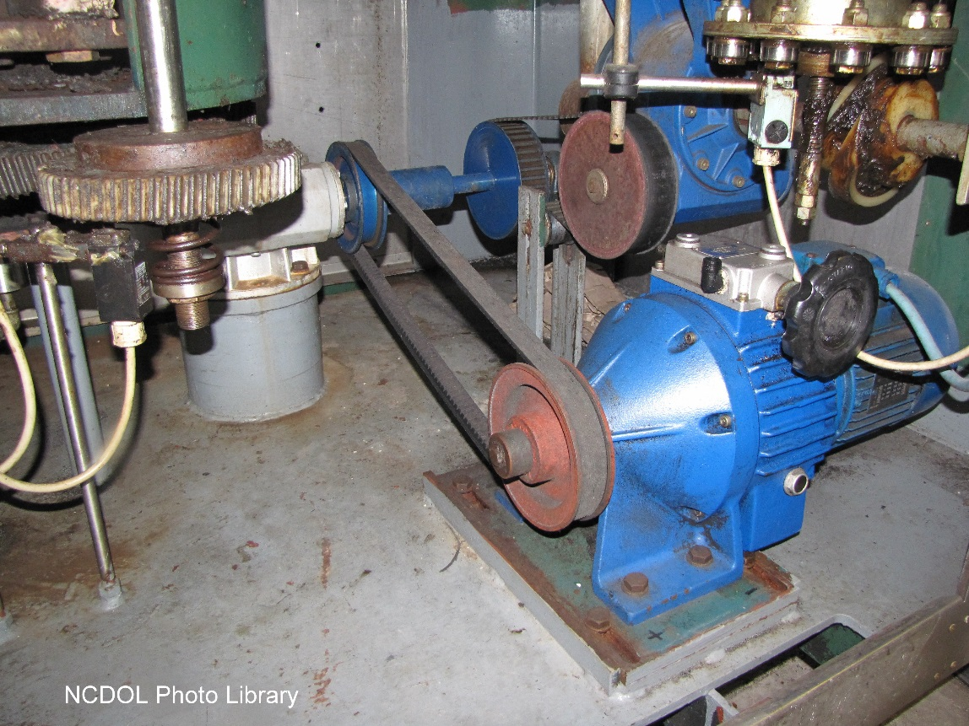
Hazard Recognition
1910.219(f)(1)
Caught-in hazards: Gears must be guarded by complete enclosures or standard guard.
This does not comply
with the requirement
Notes:
NCDOL Photo Library Closed Case File# 316782911
Mechanical Power-Transmission Apparatus 1910.219(f)(1)
Anyone working around stationary equipment should be able to identify potential amputation hazards. Understanding the mechanical components of machinery, the mechanical motion that occurs at or near these components, and specific worker activities performed in conjunction with machinery operation will help workers avoid injury.
In-Running Nip Points, also known as “pinch points,” develop when two parts move together and at least one moves in rotary or circular motion. In-running nip points occur whenever machine parts move toward each other or when one part moves past a stationary object.
Typical nip points include gears, rollers, belt drives, and pulleys.
Gears, sprockets, and chains -1910.219(f)(1) Gears. Gears shall be guarded in accordance with one of the following methods:
1910.219(f)(1)(i) By a complete enclosure; or
1910.219(f)(1)(ii) By a standard guard as described in paragraph (o) of this section, at least seven (7) feet high extending six (6) inches above the mesh point of the gears; or
1910.219(f)(1)(iii) By a band guard covering the face of gear and having flanges extended inward beyond the root of the teeth on the exposed side or sides. Where any portion of the train of gears guarded by a band guard is less than six (6) feet from the floor a disk guard or a complete enclosure to the height of six (6) feet shall be required.

Slide 19
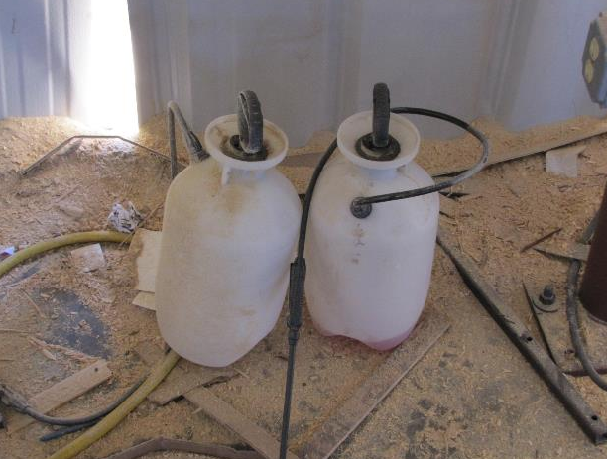
Hazard Recognition
1910.1200(f)(6)(i)-(ii)
Hazard communication – labeling
  General Industry or Construction site?
NCDOL Photo Library
Notes:
NCDOL Photo Library: Closed case file: 315962811 - Photo identifies two spray containers filled with an unknown liquid. This site was a wood truss building company that falls under the general industry standard.
Ask the class: What standard does this situation fall under? Hazard Communication!
However, if this was a construction site would the same violation exist? Yes, because both standards are the same!
19

Slide 20
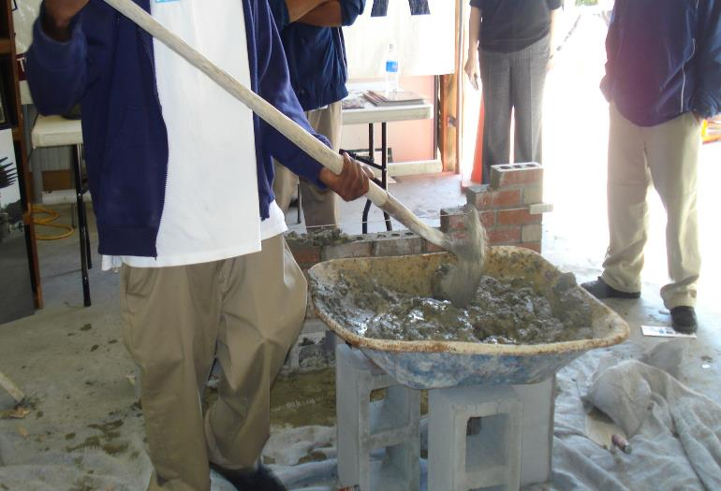
Hazard Recognition
1910.132(d)
Personal protective equipment
  Hazard assessment and equipment selection or use job safety analysis (JSA).
NCDOL Photo Library
NCDOL Photo Library
Notes:
NCDOL Photo Library: Photo taken by NCDOL Employee Robert O’Neal, Public Access, Farmers Market – 4/3/2013 - Photo identifies an employee demonstrating how to build a brick wall. He’s mixing both Portland cement and water together for the wall behind him. The SDS for Portland cement requires employees to wear PPE.
Ask the class: What type of personal protective equipment (PPE) should the employee be using or wearing? Gloves covering the hands, face and eye protection.
Dry Portland cement contacting wet skin or exposure to moist or wet Portland cement may cause more severe skin effects including thickening, cracking or fissuring of the skin. Prolonged exposure can cause severe skin damage in the form of (caustic) chemical burns.
A Job Safety Analysis (JSA) is one of the risk assessment tools used to identify and control workplace hazards. A JSA is a second tier risk assessment with the aim of preventing personal injury to a person, or their colleagues, and any other person passing or working adjacent, above or below. A job hazard analysis is a technique that focuses on job tasks as a way to identify hazards before they occur. It focuses on the relationship between the worker, the task, the tools, and the work environment. Ideally, after you identify uncontrolled hazards, you will take steps to eliminate or reduce them to an acceptable risk level.
20

Slide 21
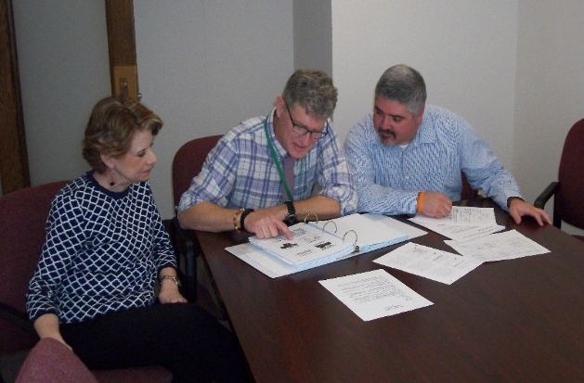
Hazard Recognition
1910.1200(h)(1)
Hazard communication (HazCom) – training
  Training provided to employees upon:
    Initial employment
    When new hazards are introduced into the workplace.
NCDOL Photo Library
NCDOL Photo Library
Notes:
NCDOL Photo Library: Photo Taken By NCDOL Employee Reggie Matthews with Carol Wells, Andy Sterlen, Cory Dunphy who are also NCDOL employees on the 4th floor of the Old Revenue Building at 111 Hillsborough St. Raleigh NC
Employees must be provided the following information:
The requirements of this section;
Any operations in their work area where hazardous chemicals are present; and,
The location and availability of the written hazard communication program, including the required list(s) of hazardous chemicals, and safety data sheets required by this section.
While the standard does not state that annual, refresher or periodic training is required, employers should observe that employees must retain the information learned and that some continual training is expected. It is the employer’s responsibility to ensure that employees are adequately trained and equipped with the necessary knowledge.
Training can be conducted on each specific chemical or by categories (e.g., carcinogens, sensitizer, toxic agents) that are or may be encountered by an employee during the course of his duties. Chemical specific information must always be available through labels and SDSs.
IAW Appendix A of the CPL “The training provisions of this standard are not satisfied solely by giving employee the data sheets to read. An employer’s training program is to be a forum for explaining to employees not only the hazards of the chemicals in their work area, but also how to use the information generated through the HAZCOM program. This can be accomplished in many ways (audiovisuals, classroom instruction, interactive video), and should include an opportunity for employees to ask questions to ensure that they understand the information presented to them. Furthermore, the training must be comprehensible. If the employees receive job instructions in a language other than English, then the training and information to be conveyed under this standard will also need to be conducted in a foreign language.”
We recommend that all training be documented even though the standard does not require it.
21

Slide 22
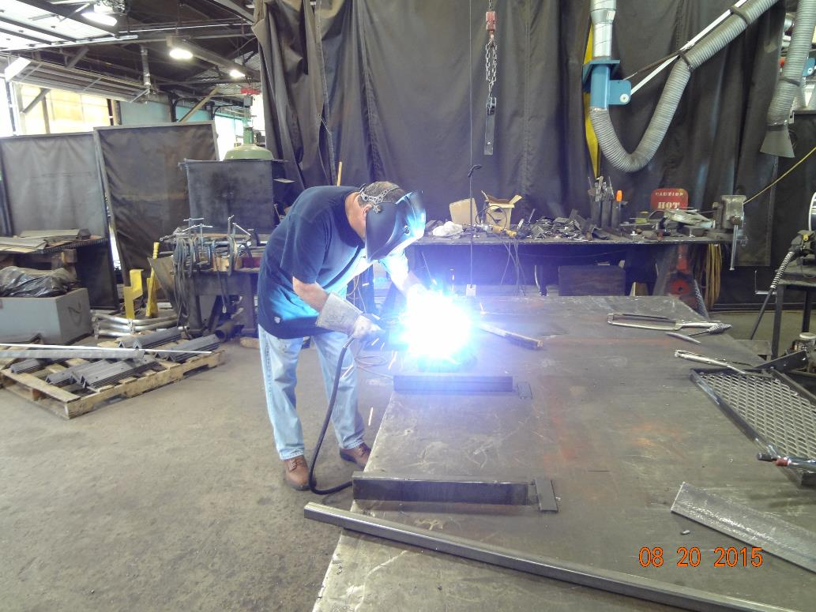
Hazard Recognition
NCDOL Photo Library
NCDOL Photo Library
Notes:
NCDOL Photo Library: Taken by NCDOL Employee Robert O’Neal - NC Department of Transportation 07-07-15, Permission Letter Obtained – Photo identifies an employee arc welding at his work station without the proper PPE.
Ask the class; What type of PPE should he being wearing? Should he be using ventilation? Ventilation is provided! Notice the ventilation duct behind him next to the light curtain! It’s not use.
Skin protection - Wear tightly woven work-weight fabrics to keep UV radiation from reaching your skin.
Respirator/Welders Mask: There are multiple types of respirators. Employers should buy the one that is made for welders and the type of projects you will be performing. If purchasing a mask with a filter, match the filter to the types of metals and coatings used.
Eye protection: welding eye protection protects against injuries from debris and from the effects of the ultraviolet light. Different types of helmets are made to protect you when performing different types of welding. These vary by shade number, having a passive or auto-darkening lens (automatically adjusts to welding rays) and comfort/fit.
Additional informant: Button up your shirt to protect the skin on the throat and neck.
Wear long sleeves and pant legs.
Cover your head with a fabric cap to protect the scalp from UV radiation.
Protect the back of your head by using a hood.
Protect your face from UV radiation by wearing a tight-fitting, opaque welder's helmet.
Make sure that all fabric garments are resistant to spark, heat and flame. Keep the fabrics clean and free of combustible materials that could be ignited by a spark.
22

Slide 23
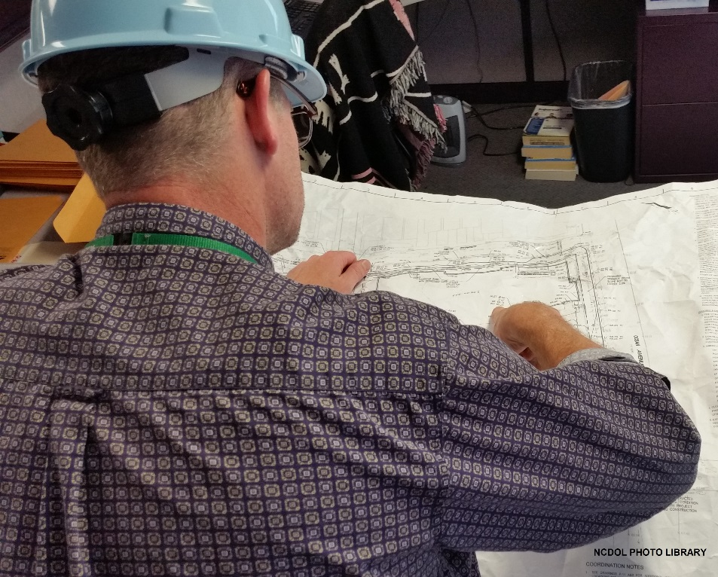
Hazard Recognition
1910.147(c)(6)(i)
Lockout/tagout
  Periodic inspection (at least annually)
NCDOL Photo Library
NCDOL Photo Library
Notes:
NCDOL Photo Library – Taken by NCDOL Employee Cory Dunphy of NCDOL Employee Andy Sterlen’s back in NCDOL Employee Crystal Stalling’s cube on the 4th floor of the Old Revenue Building at 111 Hillsborough St. Raleigh NC on Tuesday,‎ September ‎01, ‎2015 (image: blue print.jpg).
Ask the class: Why do periodic inspections need to be performed?
To ensure that EE’s are following procedures and have not made any unauthorized deviations or “shortcuts”. Also, to ensure that the procedure is continuing to protect employees from the hazard and that it addresses all sources of potential energy to which an EE could be exposed while performing the task, working on a particular piece of equipment, etc.
Who should perform these periodic inspections?
An authorized employee who doesn’t routinely perform the task, one who is not involved in the procedure being inspected.

Slide 24
Summary
In this course, we discussed the Top Ten most frequently cited serious General Industry violations for FFY 2021.
  You should now understand and be able to identify hazards associated with the Top Ten most cited serious OSH violations in general industry.

Slide 25
Thank You For Attending!
Final Questions?
1-800-NC-LABOR
(1-800-625-2267)
www.labor.nc.gov

